Slide 1
How the brain learns to solve multistep, multiscale visual tasks
Sami Mollard
06/10/2023

Slide 2
Outline
The visual cortex as a cognitive blackboard for multistep visual tasks: evidence from monkeys experiments
How to learn such strategies
The visual cortex as a multiscale cognitive blackboard
What next?

Slide 3
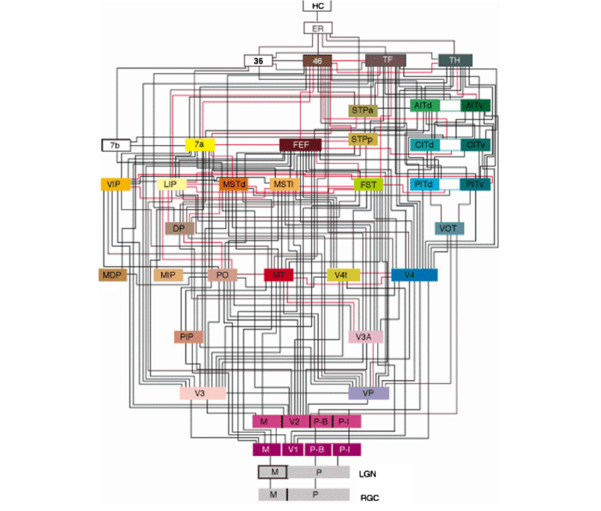
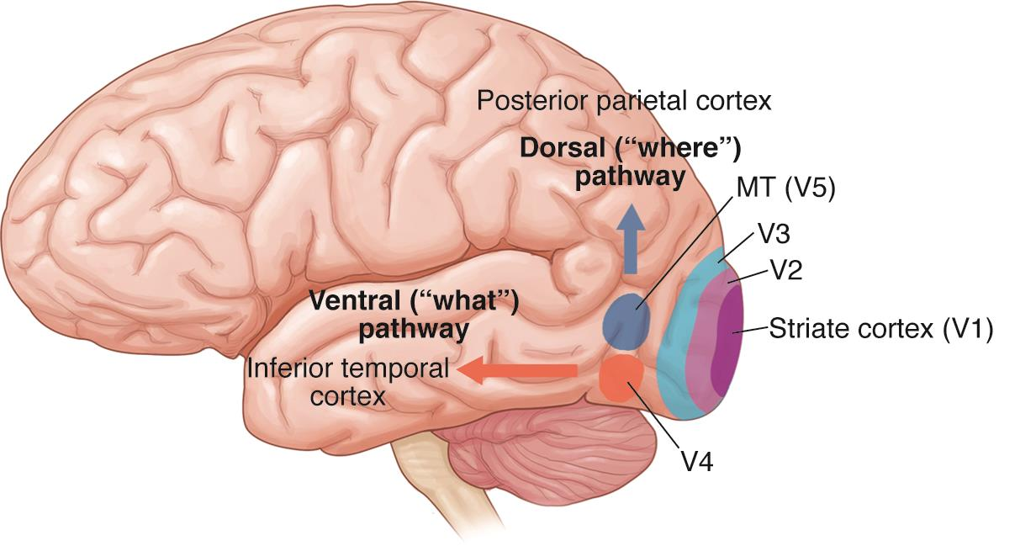
The visual cortex: a highly recurrent neural network
© 2023 American Academy of Ophthalmology
From Felleman and Van Essen, 1991

Slide 4
Neurons’ receptive field
Source: Frank Tong

Slide 5
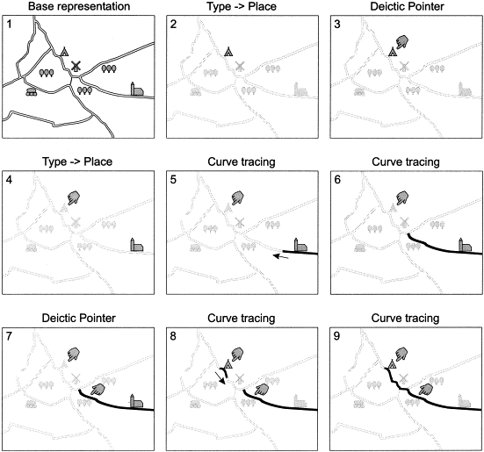
Visual routines (Ullman, 1984)

Slide 6
Example elemental operation: trace task

Slide 7
Example elemental operation: trace task

Slide 8
Example elemental operation: trace task

Slide 9
Example elemental operation: trace task
Fixation point
Eye movement
Target
Distractor

Slide 10
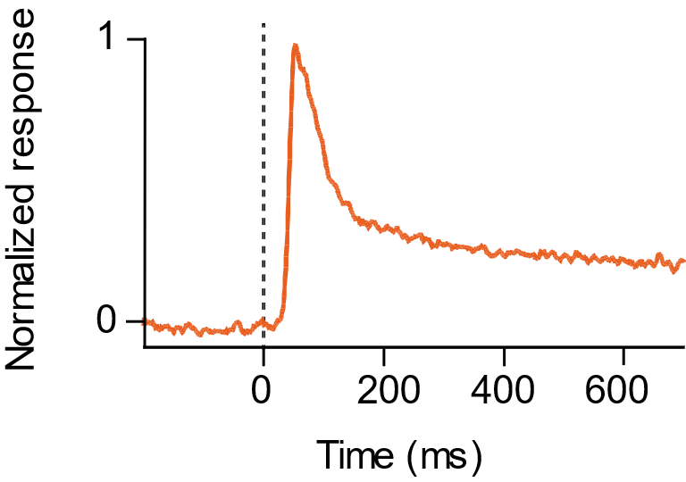
The trace operation in monkeys’ visual cortex
Adapted from Roelfsema et al., 2003

Slide 11
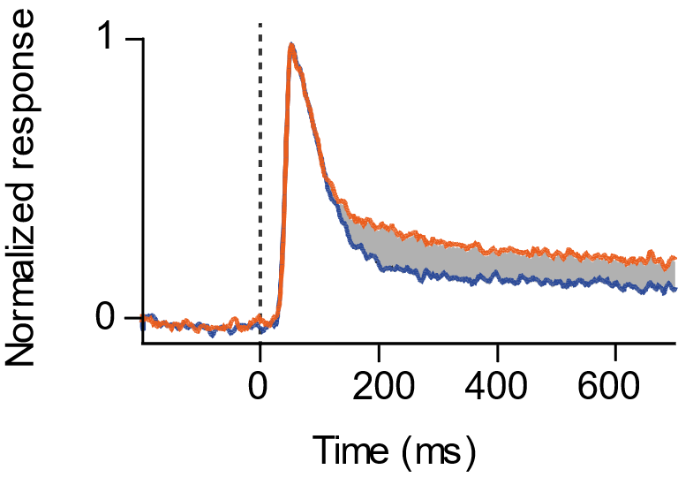
The trace operation in monkeys’ visual cortex
Adapted from Roelfsema et al., 2003

Slide 12
Trace operation, summary

Slide 13
Visual routine: search-then-trace task

Slide 14
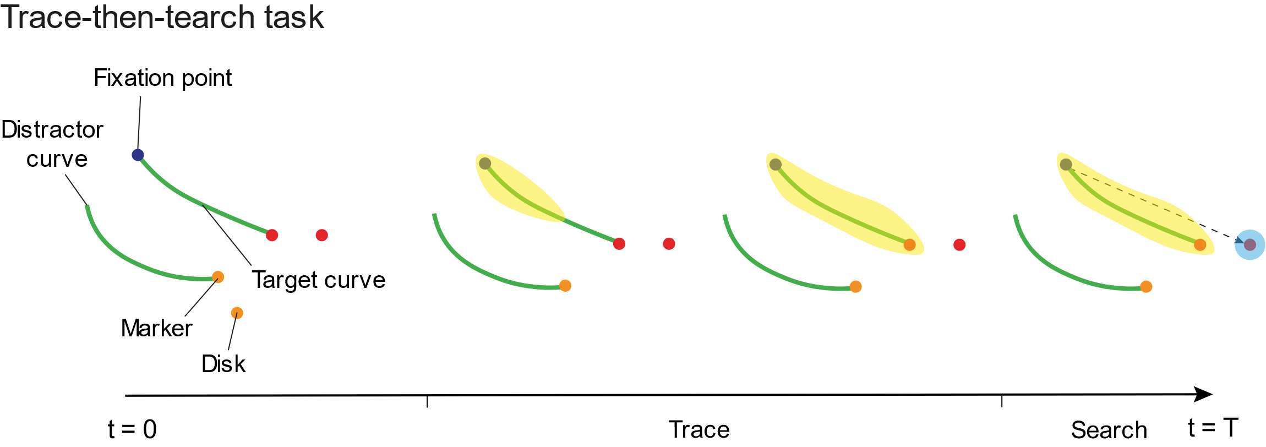
Visual routine: trace then search task

Slide 15
The visual cortex as a cognitive blackboard
The visual cortex act as a cognitive blackboard
Writing on this blackboard is done via tagging the relevant neurons with enhanced activity
Reading and writing to the cognitive blackboard in early visual areas permits the exchange of information between elemental operations that are part of a visual routine
How can such a strategy be learnt?

Slide 16
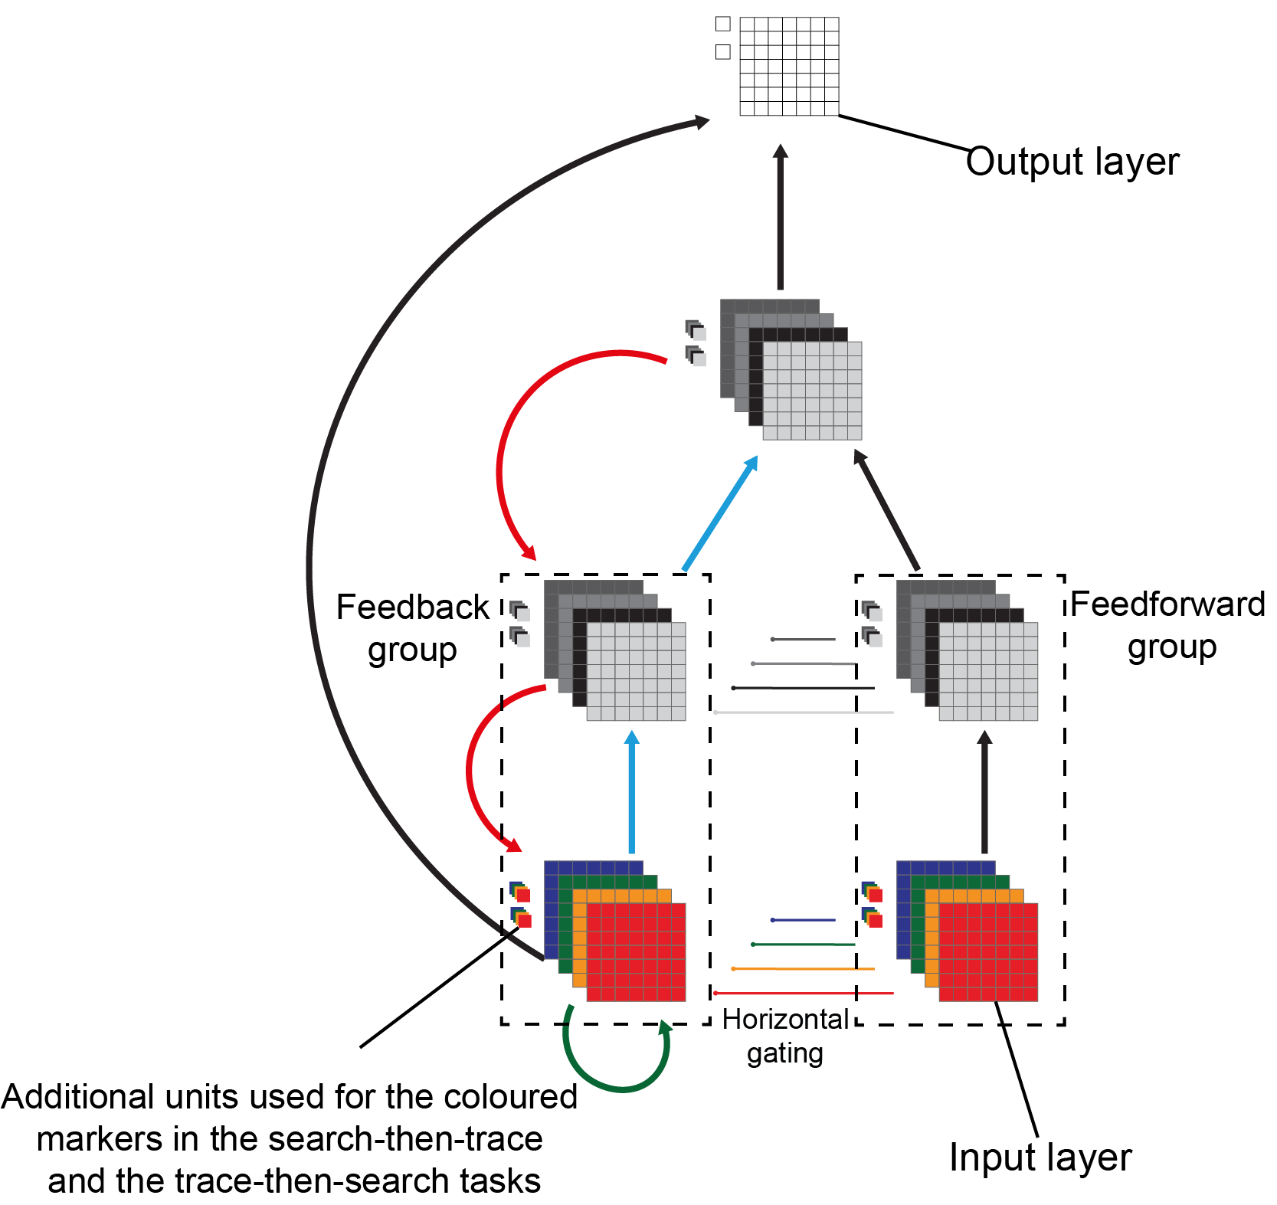
The architecture

Slide 17
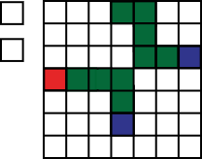
The architecture

Slide 18
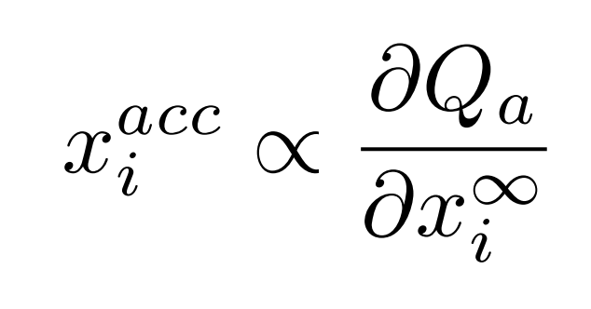
The learning rule
Winning unit Q_{a}
δ
Motor
Layer
Input
Layer
First phase
Convergence to a stable state
Second phase
Propagation in the accessory network
Third phase
Reward and weight update

Slide 19
Networks learn a general rule
Trace task
Search then trace task
Trace then search task

Slide 20
The model learns to spread enhanced activity over the representation of the target curve

Slide 21
The model learns to spread enhanced activity over the representation of the target curve
Model data
Monkey data
Adapted from Roelfsema et al., 2003

Slide 22
The model transmit information between elemental operation with enhanced activity

Slide 23
The model transmit information between elemental operation with enhanced activity

Slide 24
Visual routine conclusion
The model learns a strategy similar as what has been observed in monkeys’ visual cortex
Learning is done only with reward, as for monkeys
But...

Slide 25
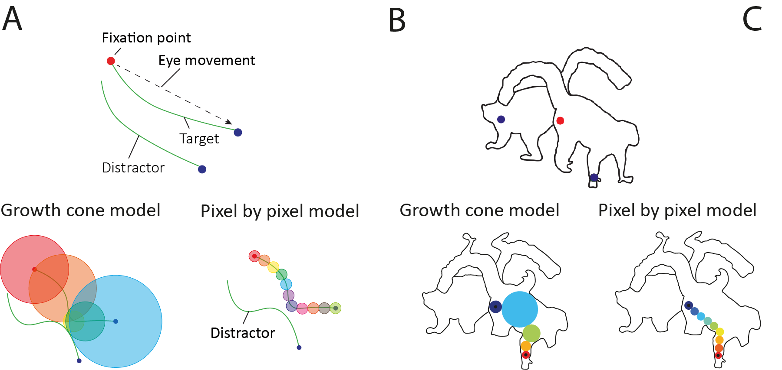
Spreading time doesn’t only depend on the length of the curve
Pooresmaeili et al., 2014
Jeurissen et al., 2016

Slide 26
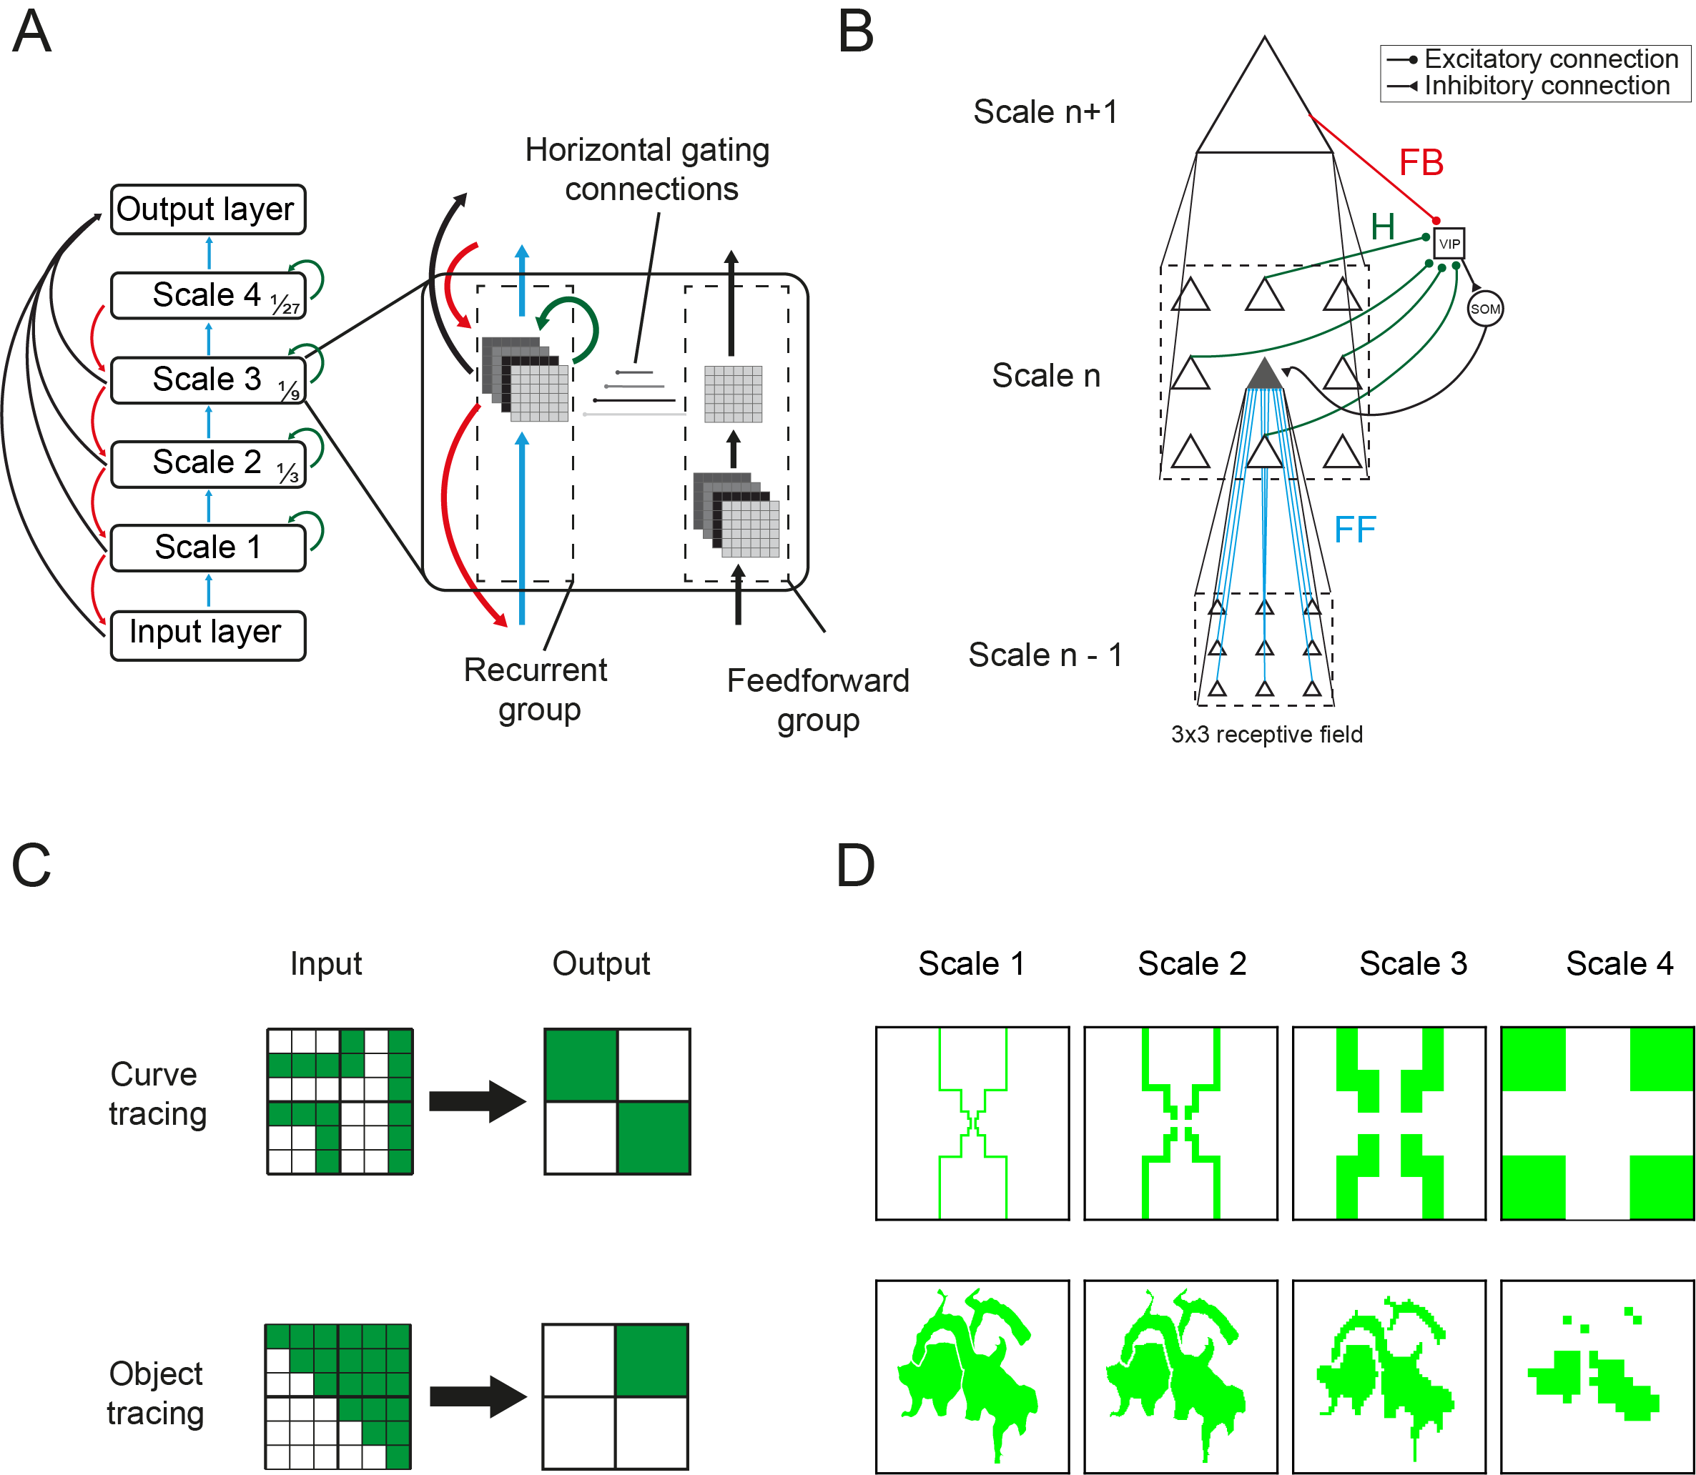
A multiscale architecture with a disinhibitory loop

Slide 27
Feedforward group trained to dynamically learn the appropriate scale

Slide 28
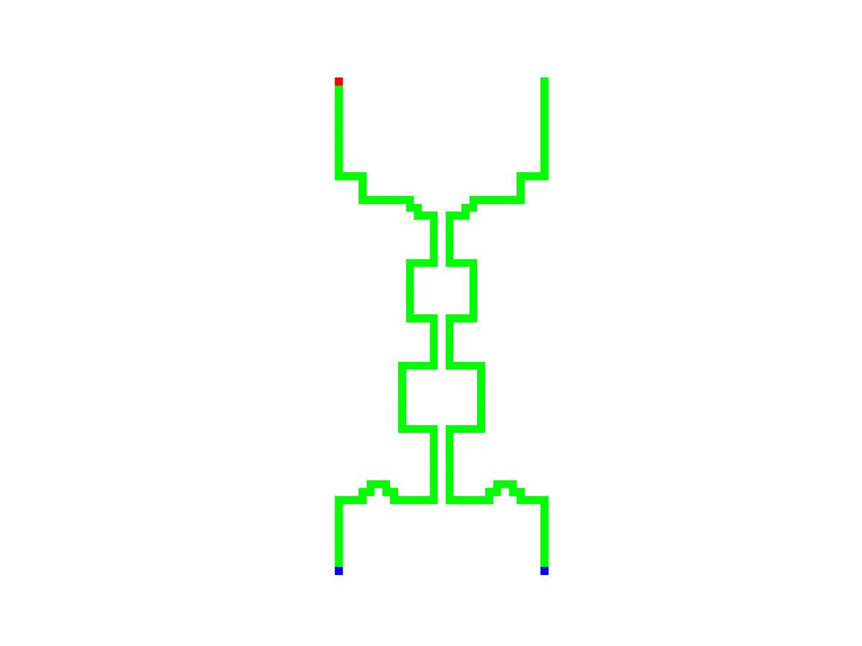
The network learns to propagate a tag of enhanced activity, and to change scale dynamically

Slide 29
What about 2D objects?

Slide 30
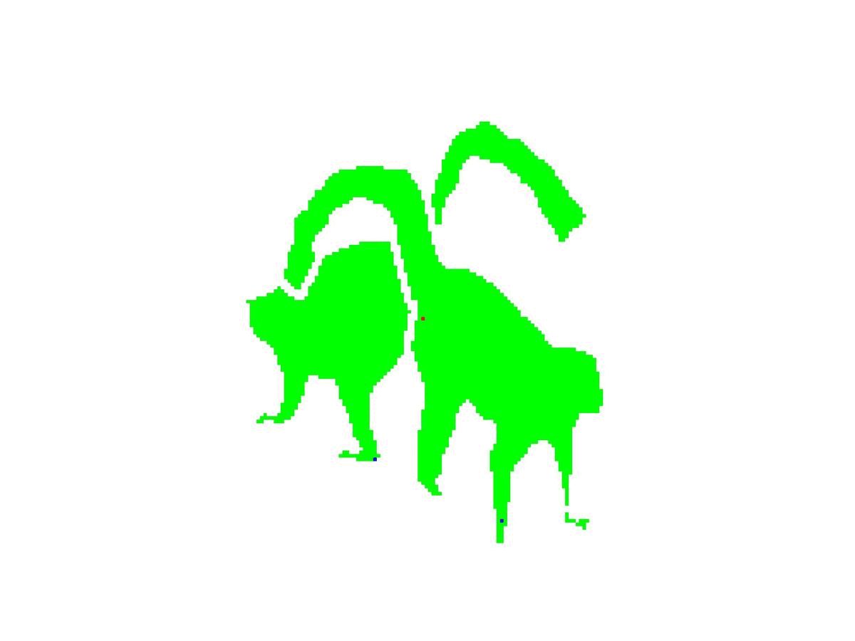
What about 2D objects?

Slide 31
A mechanistic account of the growth-cone model
*

Slide 32
What about naturalistic images?
Adapted from Jeurissen et al., 2016

Slide 33
Thank you!
Pieter Roelfsema
Sander Bohte
Sanne van den Berg
Paolo Papale
Thomas Serre
Lore Goetschalckx
Alekh Ashok

