Slide 1
Symbolic Regression for interpretable machine learning Marco Virgolin (https://marcovirgolin.github.io) CWI Scientific Meeting – Dec 2 2022
Pic © NASA

Slide 2
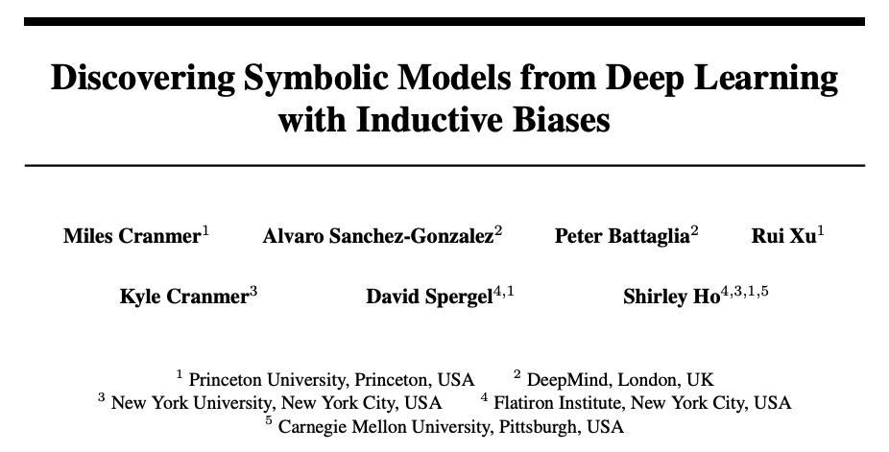

Slide 3
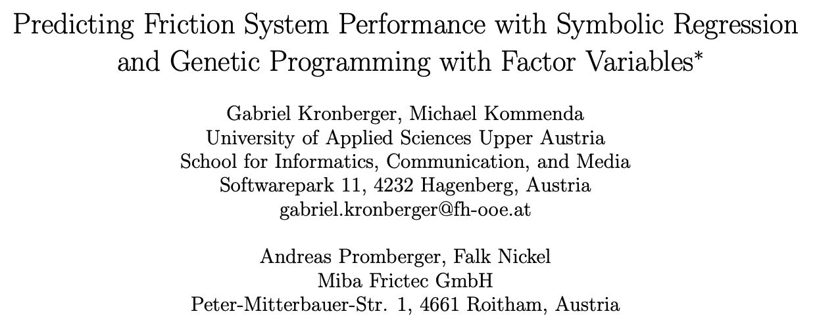

Slide 4
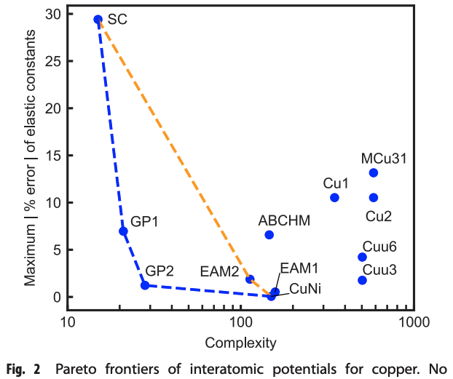

Slide 7
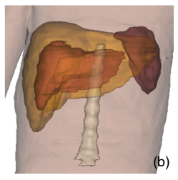
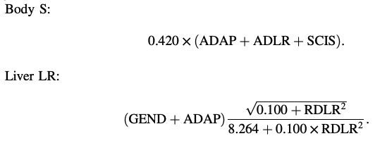
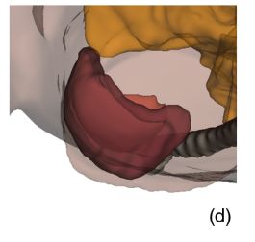

Slide 8
Gaining momentum in the news

Slide 9
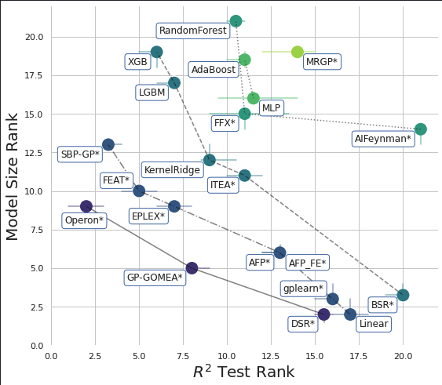
and in software development

Slide 10
In this talk
The Symbolic Regression (SR) problem
Types of data set
Algorithm families for SR
Common representation of SR models
Random search, Exhaustive search, Genetic algorithms, Deep nets
Extra slides
Human-in-the-loop for personalized discovery
Examples of SR for feature construction

Slide 11
The SR problem

Slide 12
Goal
Given data of certain measurements:
Discover $f$
Mass 1st planet $m_{1}$ | Mass 2nd planet $m_{2}$ | Distance in between $r$ | Gravitational force $F$
$$5.972×{10}^{24}$$ | $$6.390×{10}^{23}$$ | $$2.161×{10}^{8}$$ | $$8.172×{10}^{21}$$
$$4.867×{10}^{24}$$ | $$1.898×{10}^{27}$$ | $$6.701×{10}^{8}$$ | $$2.057×{10}^{23}$$
$$3.285×{10}^{23}$$ | $$5.683×{10}^{26}$$ | $$1.367×{10}^{9}$$ | $$9.990×{10}^{20}$$
$$…$$ | $$…$$ | $$…$$ | $$…$$
$$F=6.674×{10}^{−11}×\frac{m_{1}×m_{2}}{r^{2}}$$

Slide 13
The SR problem (i)
We are given a data set
$x_{1}, x_{2},…, x_{d}$ are the “features” or “variables” or “dimensions”;
$y$ is the “label” or “target variable”; $i$ is the index of an “observation”
$x =$ $( x_{1}$ $x_{2}{ x}_{3} … x_{d} ), y$
Age | Debts | Income | … | Housing m^2 | Credit risk
39 | 40,000 | 50K | … | 60 | 10
18 | 2,000 | 20K | … | 20 | 50
87 | 0 | 40K | … | 40 | 4
… | … | … | … | … | …
$$i=1$$
$$i=2$$
$$i=3$$

Slide 14
The SR problem (ii)
E.g., $𝒫=\{+, −, ×, ÷, exp, log⁡, sin⁡, cos⁡,…, x_{1},x_{2},…,x_{d}, −1,+1, 42, π, …\}$
Functions of one, two, or possible more arguments
Variables (or equiv. identity functions of those variables)
Constants (or equiv. constant functions)
$$f\left(x\right)={4×x}_{3}×\log\left(x_{5}\right)−2∈ℱ$$

Slide 15
The SR problem (iii)
We have $𝒟$, we choose $𝒫$, and then we choose a loss function $ℒ$
Goal of $ℒ$: push discovery to achieve $f\left(x\right)≃ y$
E.g., squared error loss:
$ℒ\left( y_{i}, f\left(x_{i}\right)\right)={\left(y_{i} −f\left(x_{i}\right)\right)}^{2}$

Slide 16
The SR problem (iv)
In other words, we need to find the best way to compose the (elementary) functions in $𝒫$
This is a hard combinatorial problem akin to Knapsack & co.!

Slide 17
The SR problem (v)
Remarks:
Like in traditional regression, we also need to tune the constants (coefficients) of $f$
We also we want $f$ to be simple enough to be interpretable (hard to quantify)
[For brevity, not discussed here]

Slide 18
Note: types of data set
Essentially, structured data ->
Maybe less exciting than images or videos, but very common
Can have thousands of features only if few are actually important
Certain data can be converted into structured data via feature engineering (e.g., graphs)
Age | Gender | Income | Housing | Credit risk
39 | F | 50K | Own | 10
18 | M | 20K | Rent | 50
87 | F | 40K | Own | 4
… | … | … | … | …

Slide 19
Algorithm families for SR

Slide 20
Representing SR models
$$f(x)=$$
$$\left(x_{1}−4\right)x_{5}x_{3}$$
$$\left(x_{1}−4\right){×x}_{5}×x_{3}$$
$$\left(x_{1}−4\right){×(x}_{5}×x_{3})$$
Another possibility
$$×$$
$$\left({(x}_{1})\text{−}(−)\text{−}(4)\right)\text{−}{(×)\text{−}((x}_{5})\text{−}(×)\text{−}{(x}_{3}))$$
$$×$$
$$x_{3}$$
$$×$$
$$−$$
$$x_{5}$$
$$−$$
$$×$$
$$x_{1}$$
$$4$$
$$x_{1}$$
$$4$$
$$x_{5}$$
$$x_{3}$$

Slide 21
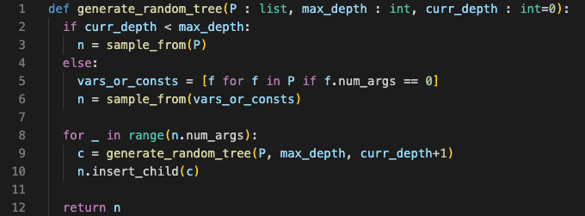
Random search
Repeatedly generate random trees, evaluate them until budget is over

Slide 22
Exhaustive search
Generate all trees up to chosen max. depth (or max. num. nodes)
Heuristic simplifications + hashing to avoid evaluating duplicates
Feasible only for very small $𝒫$ and $𝒟$

Slide 23
Greedy approaches
1. Create reasonably-sized library of small trees (e.g., max depth = 1)
+
+
$$×$$
…
+
$$x_{1}$$
$$x_{1}$$
$$x_{1}$$
$$x_{2}$$
$$x_{1}$$
$$x_{1}$$
$$x_{1}$$
$$×$$
+
Measure loss for all of them, pick best
Pick a leaf using a criterion (e.g., permutation importance); for each tree in library:
i. Replace leaf with that tree
ii. Compute loss for modified tree
iii. If new loss smaller than previous loss, break loop and go to step 3; else, revert attempt
$$x^{(1)}$$
$$x_{2}$$
$$x^{(2)}$$
$$x_{2}$$

Slide 24
Genetic algorithms (i)
Genetic “programming” = GAs with execution of candidate solutions
Generation
Initialize population (with random search)
Crossover + mutation
Parent population
Offspring population
Evaluation + survival of fittest
Evaluation + survival of fittest

Slide 25
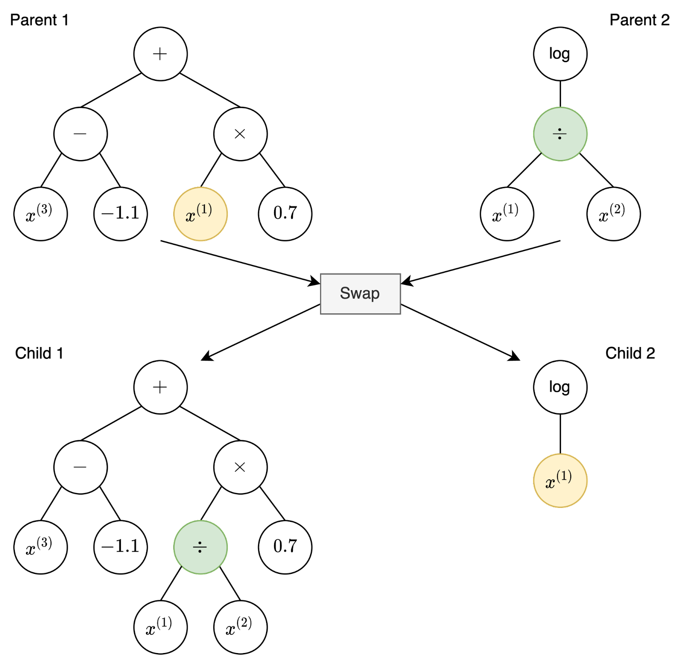
Genetic algorithms (ii)
Classic crossover

Slide 26
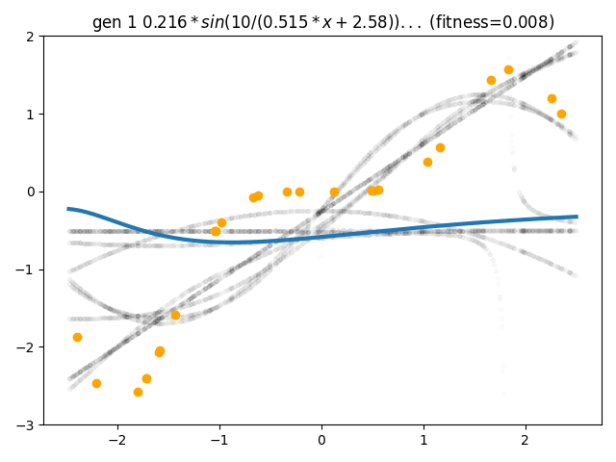
$$y$$
$$x_{1}$$

Slide 27
Genetic algorithms (iii)
Crossover GP-GOMEA’s style
Idea: combos/patterns of nodes that appear in high-quality solutions may be important => should not be disrupted by random crossover
Cast each tree to a template with fixed no. node (pad if needed)
Treat each node index as a random variable
Compute mutual information across pairs of random variables
Build hierarchical clusters of interdependencies
Swap blocks according to a cluster from the hierarchy

Slide 28
Genetic algorithms (iv)
SRBench
250+ data sets
(Advanced) GP methods represent the state-of-the-art for SR
Pic. from La Cava et al.
“Contemporary Symbolic Regression Methods and their Relative Performance”. NeurIPS Datasets & Benchmarks Track. 2021

Slide 29
Deep nets (i)
The case of Transformers: popular & promising variant of the moment
Key ideas: large self-supervised learning + “language translation”

Slide 30
Deep nets (ii) – large self-supervision
Repeat 1 billion times:
Generate a random partial data sets (no label): $𝒟^{j}={\left\{\left(x_{i}^{j},?\right)\right\}}_{i }$
Generate a random tree $f^{j}$
Apply the tree on the features of the data set
${y_{i}^{j}= f}^{j}(x_{i}^{j}$) 4. Now we have a complete data set and a ground-truth function for it
$$𝒟^{j}={\left\{\left(x_{i}^{j},y_{i}^{j}\right)\right\}}_{i }, f^{j}$$

Slide 31
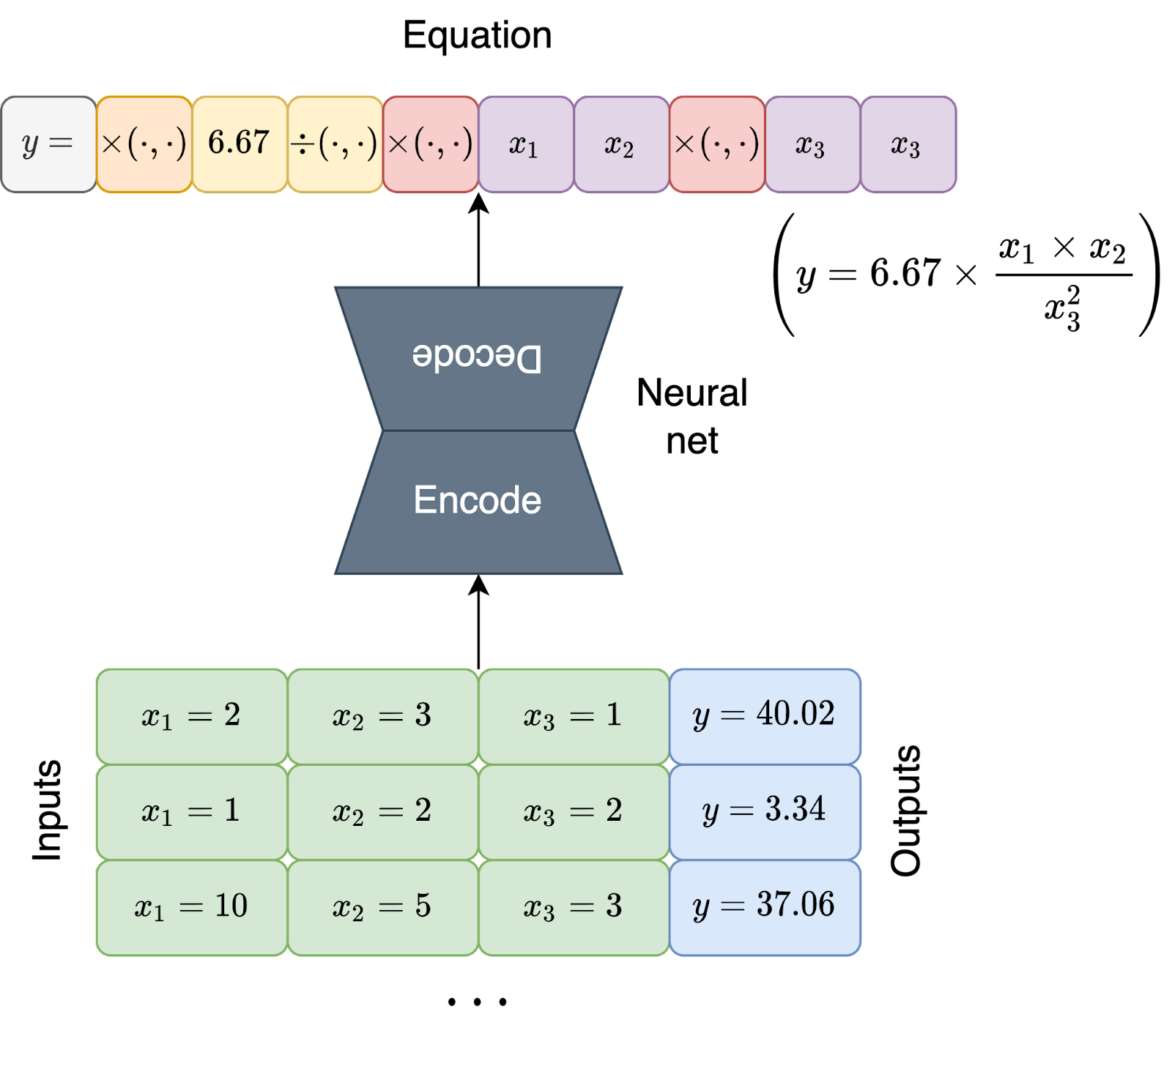
Deep nets (iv) – “language translation”
Sequence of output language
Translate
Sequence-to-Sequence Task
Given $𝒟$ as sequence of the input language, return sequence of symbols that represent $f$ as output language
Sequence of input language
$$i=1$$
$$i=2$$
$$i=3$$
…

Slide 32
Deep nets (v)
Pic. from Kamienny et al. “End-to-end symbolic regression with transformers” NeurIPS 2022

Slide 33
Deep nets (vi)
Pic. from Kamienny et al. “End-to-end symbolic regression with transformers” NeurIPS 2022

Slide 34
Deep nets (vii)
Part of SRBench
~100 data sets
Ours = Transformer by Kamienny et al.
Pic. from Kamienny et al. “End-to-end symbolic regression with transformers” NeurIPS 2022

Slide 35
Thank you! Some links:
Me: https://marcovirgolin.github.io marco.virgolin@cwi.nl
SRBench: https://cavalab.org/srbench/
Meta’s transformer demo: https://symbolicregression.metademolab.com/
Toy genetic programming (SR and more): https://github.com/marcovirgolin/genepro

Slide 36
Extra slides

Slide 37
Human-in-the-loop for personalized discovery
Pic. from Virgolin et al. “Model learning with personalized interpretablity estimation” Workshop EC+DM @ GECCO 2021

Slide 38
Examples of SR for feat. constr. (i)
The axis (constructed features) are learned with SR
SVM fit on top
Circles = training obs., Diamonds = test obs.,
Illumination of model behavior with interpretable axes
Pic. from Virgolin et al. “On explaining machine learning models by evolving crucial and compact features” Swarm and Evolutionary Computation 2020

Slide 39
Examples of SR for feat. constr. (ii)
Similar to before, but for classification
Circles = training obs., Diamonds = test obs. Colors = classes
Pic. from Virgolin et al. “On explaining machine learning models by evolving crucial and compact features” Swarm and Evolutionary Computation 2020

