Slide 1
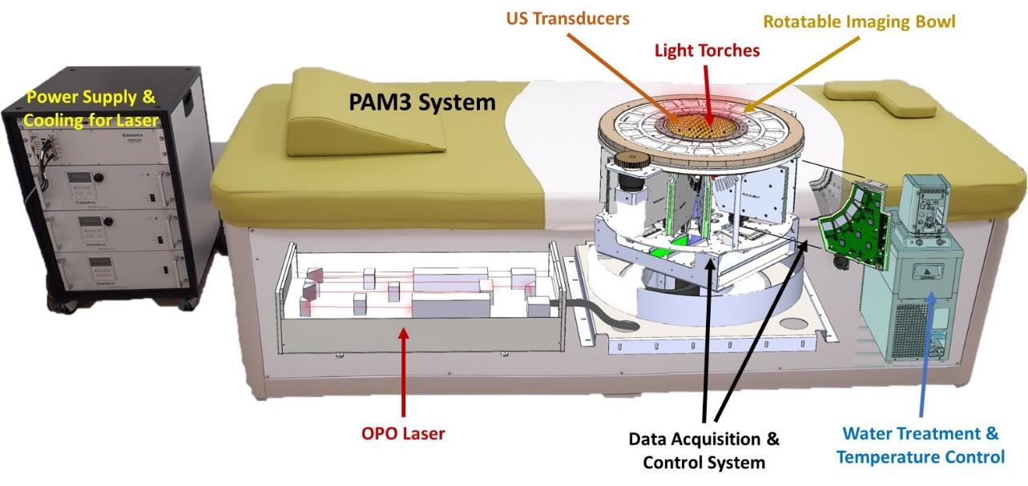
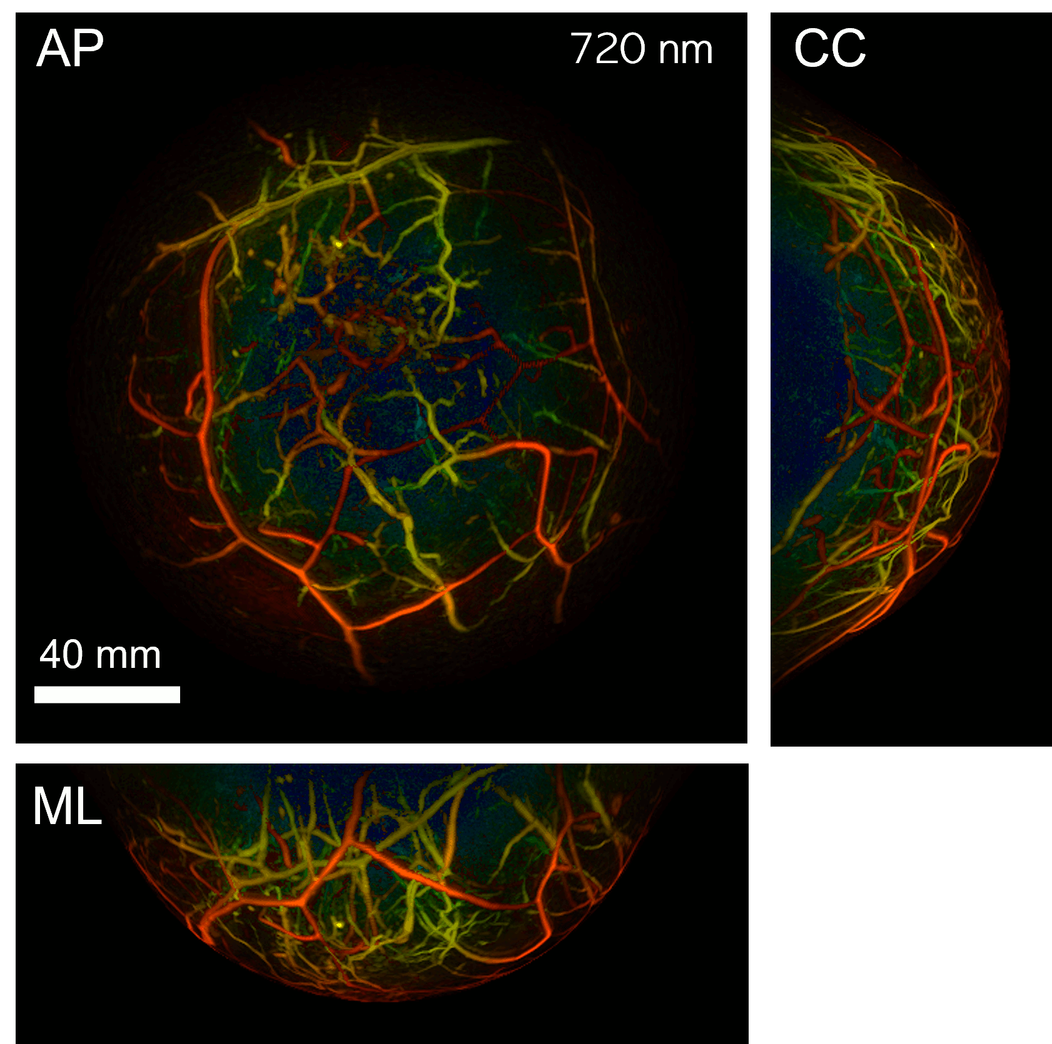
Photoacoustic and Ultrasonic Tomography for Breast Imaging
Felix Lucka (Computational Imaging)
(he/him/his, felix.lucka@cwi.nl)
CWI Scientific Meeting, 2 December 2022

Slide 2

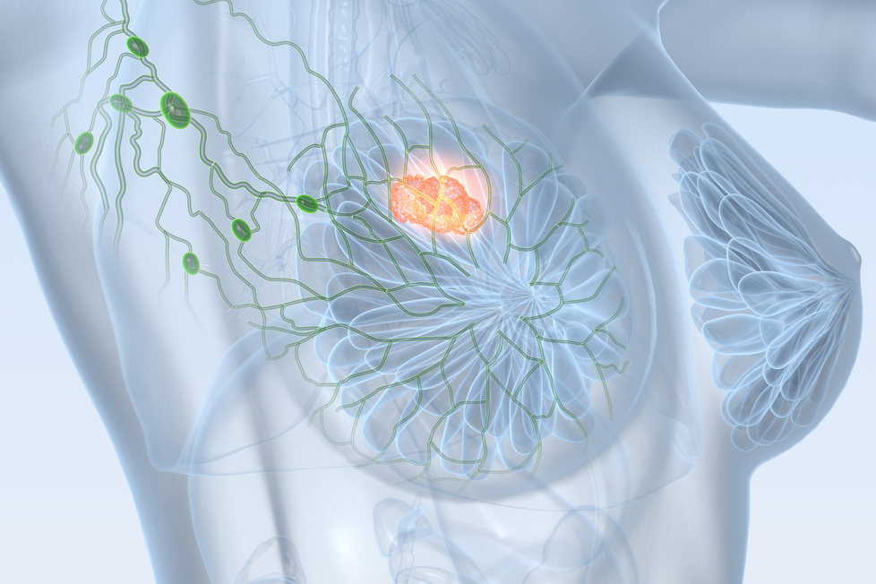
Breast Cancer
Most common cause of cancer death in women worldwide:
25% of all cancer cases
15% of all cancer deaths
Early detection and diagnosis are key to successful treatment!

Slide 3
Conventional Breast Imaging
Magnetic resonance imaging
contrast agent
expensive
availability
not suitable for every woman
X-ray mammography
painful compression
ionizing radiation (tumor induction)
glandular tissue is problematic
Urgent need for novel imaging techniques providing higher specificity, contrast and image resolution than X-ray mammography at lower costs than MRI.
Ultrasonography
whole breast imaging is difficult
operator dependent
courtesy of Rianne Bulthuis and Maura Dantuma

Slide 4
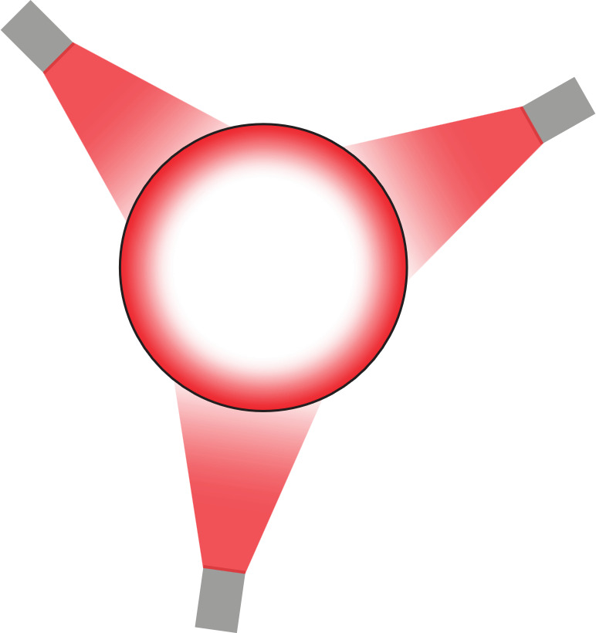
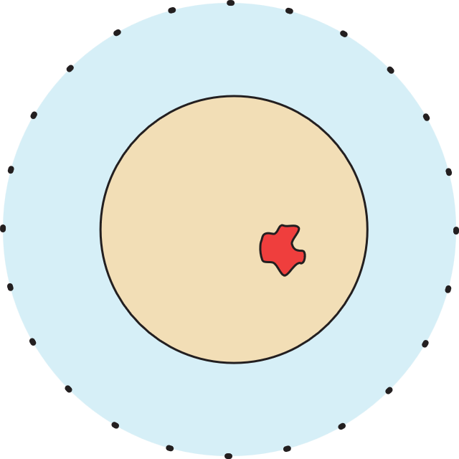
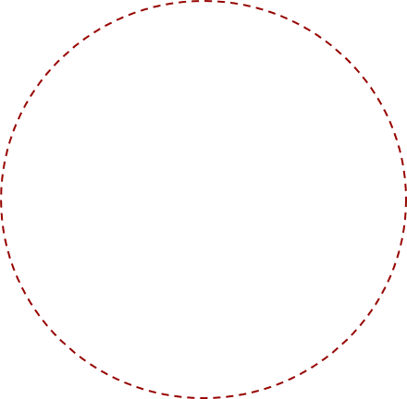
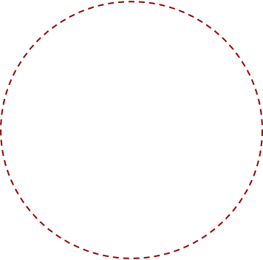



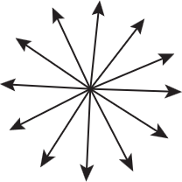

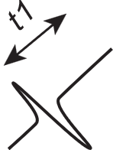
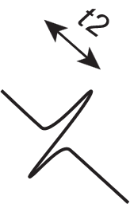
Photoacoustic Tomography (PAT)
Hybrid imaging:
light in, sound out
non-ionizing, near-infrared radiation
quantitative images of optical properties
novel diagnostic information
adapted from Rianne Bulthuis and Maura Dantuma

Slide 5
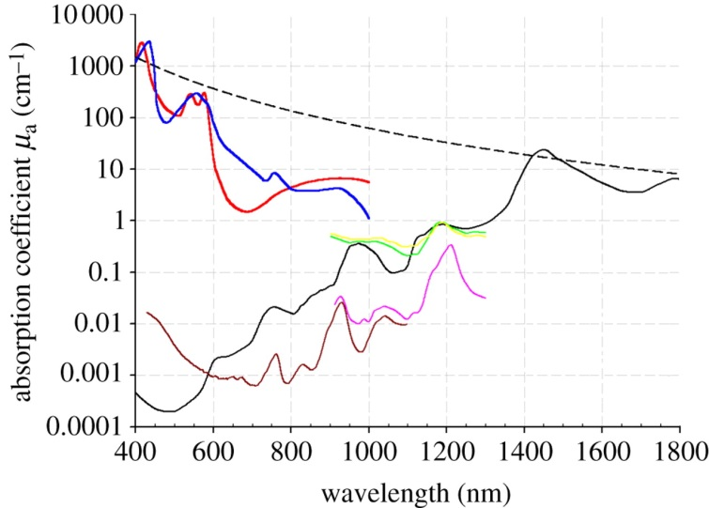
Photoacoustic Imaging: Spectral Properties
Oxyhemoglobin
Deoxyhemoglobin
Elastin
Collagen
Lipid (a) (b)
Water
(from Beard, 2011)
different wavelengths allow quantitative spectroscopic examinations
gap between oxygenated and deoxygenated blood
use of contrast agents for molecular imaging

Slide 6
Ultrasound Tomography (UST)
sound in, sound out
different from conventional US but as safe
quantitative images of acoustic properties
novel diagnostic information
adapted from Rianne Bulthuis and Maura Dantuma
Notes:
"" \item different from conventional US but as safe \item quantitative images of acoustic properties \item novel diagnostic information

Slide 7
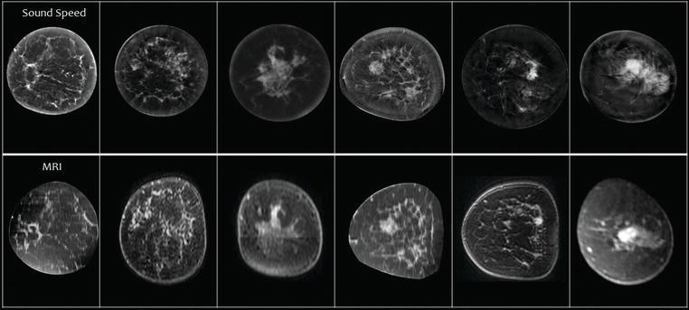
Speed of Sound vs MRI Images
From: Duric, Littrup, 2017. Breast Ultrasound Tomography, IntechOpen
Notes:
"" \item different from conventional US but as safe \item quantitative images of acoustic properties \item novel diagnostic information

Slide 8
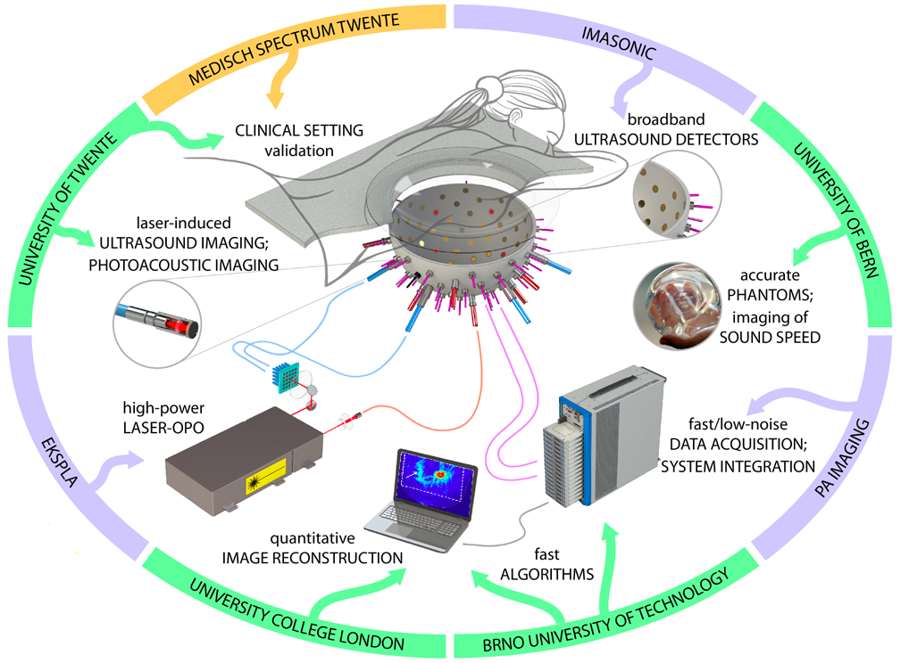
H2020: PAMMOTH
Combined PAT+UST scanner to obtain novel diagnostic information from high resolution maps of optical and acoustic properties

Slide 9

PAM3 System

Slide 10
Our Contributions
simulation studies for
ultrasonic transducer specification
light excitation design
sensing pattern design
measurement protocol design
reconstruction algorithm design
accuracy vs. computational time/resources/complexity
scanner modelling
assist high performance computing implementation
assist phantom & calibration design
process data, refine measurement procedures

Slide 11
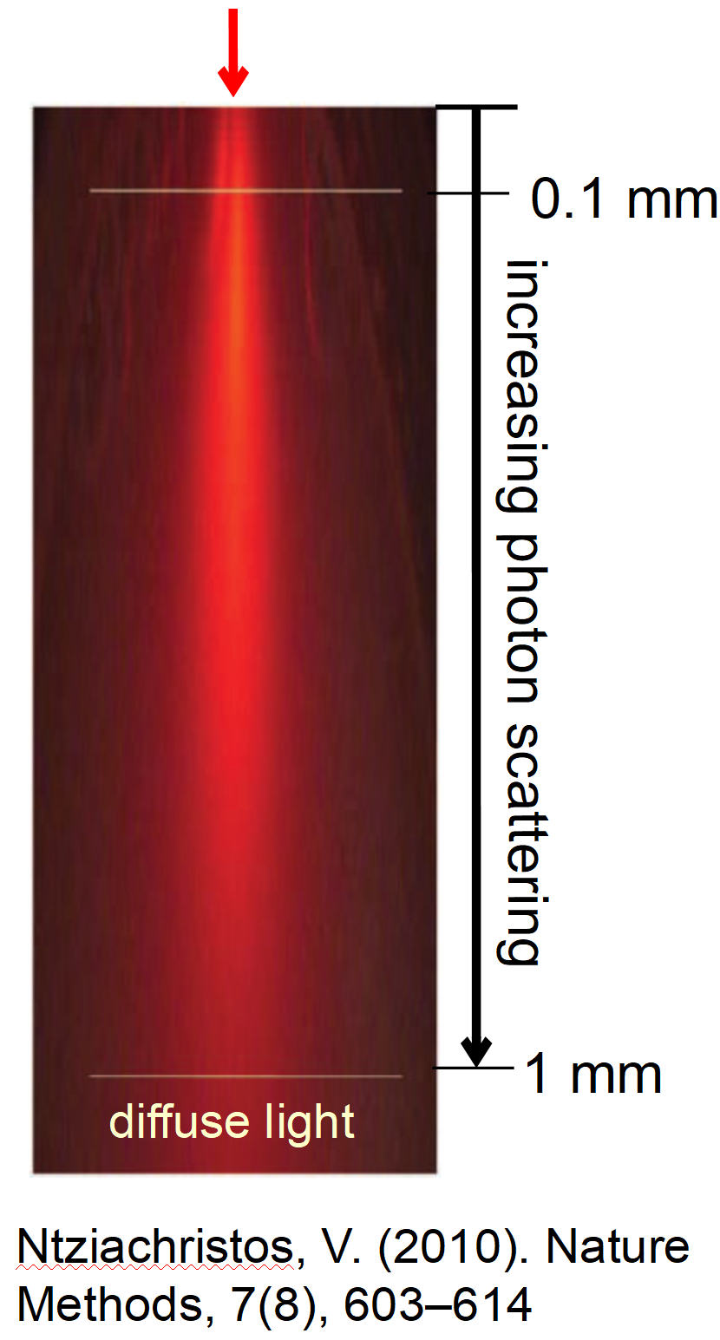



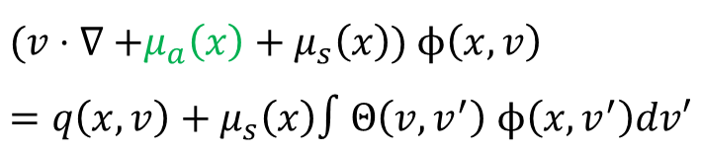

PAT: Mathematical Modelling
radiative transfer equation (RTE)
photoacoustic effect
acoustic wave equation
measurement (on boundary)
two coupled inverse problems:
acoustic initial value problem with boundary data.
optical parameter identification with internal data.
$$(v⋅∇\text{ +}μ_{a}\left(x\right)+μ_{s}\left(x\right)\text{) }ϕ\left(x,v\right)=q\left(x,v\right)+μ_{s}\left(x\right)∫Θ\left(v,v^{′}\right) ϕ\left(x,v^{′}\right)dv′$$
$$p_{0}(x)=Γ\left(x\right)μ_{a}\left(x\right)∫ϕ\left(x,v^{′}\right)dv′$$
$$\left(c{\left(x\right)}^{−2} ∂_{t}^{2}−Δ\right) p\left(x, t\right)=0, p\left(x,0\right)=p_{0}\left(x\right), ∂_{t}p\left(x,0\right)=0$$
$$f= Mp$$
$$f→p_{0}$$
$$p_{0}→μ_{a}$$

Slide 12

Reconstruction of Initial Photoacoustic Pressure
$$\left(c{\left(x\right)}^{−2} ∂_{t}^{2}−Δ\right) p\left(x, t\right)=0, p\left(x,0\right)=p_{0}\left(x\right), f= Mp$$
$$f= MAp_{0}$$
$${\hat{p}}_{0}=\underset{p_{0}∈C}{argmin}{ {\left\|MAp_{0}−f\right\|}_{W}^{2}+R\left(p_{0}\right)}$$
linear inverse problem
variational approach
first order optimization with early stopping
model acoustic properties, model discrepancies
model /calibrate piezoelectric sensor properties: sensitivity, impulse response, angular sensitivity, …
parameter choices, image artifacts, …
high res (0.4mm), broadband numerical wave simulations
Notes:
\hat{p_0} = \argmin_{p_0 \in \cC} \norm{M A p_0 - f^{PA}}^2_W + \cR(p_0)

Slide 13
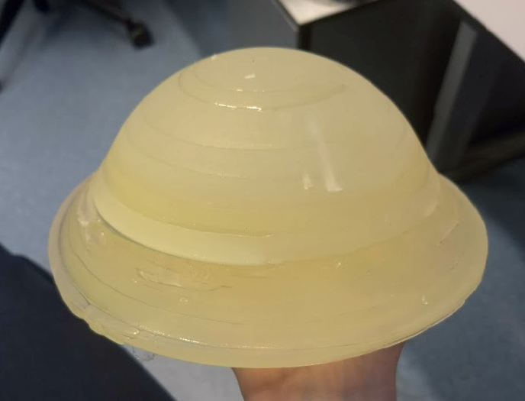
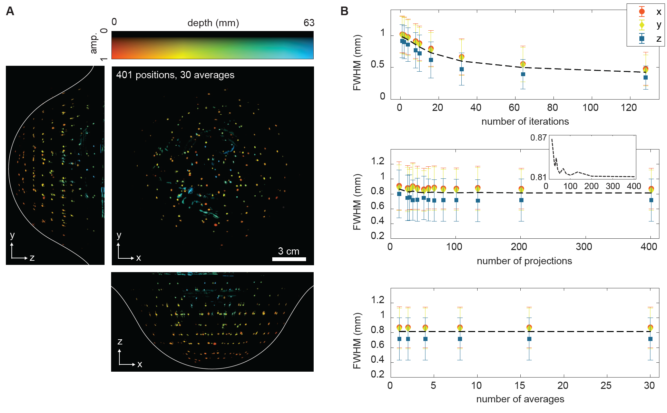
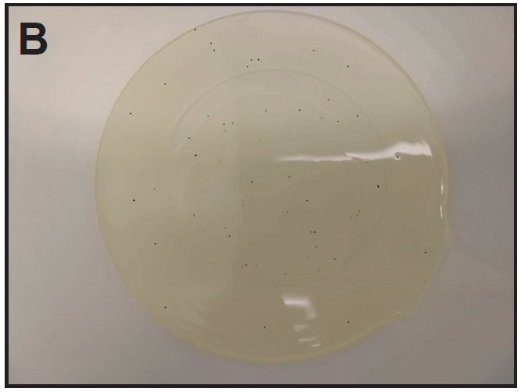
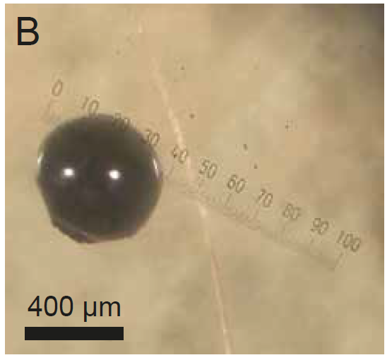
Illustration: Phantom Validation

Slide 14
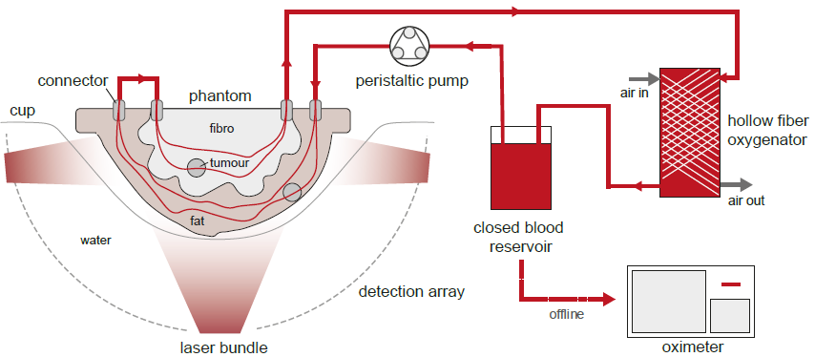
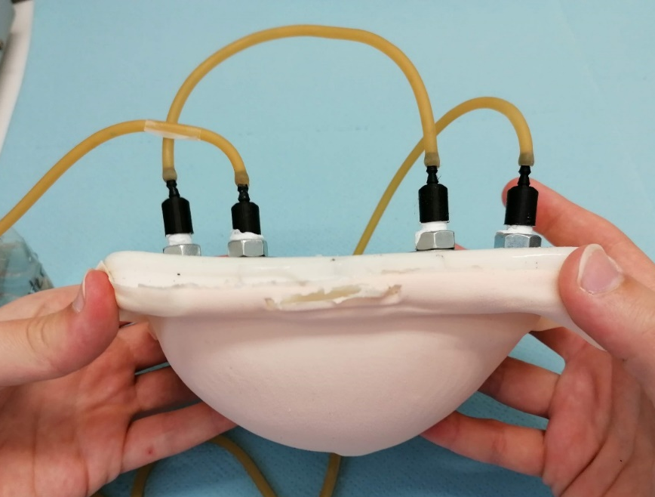
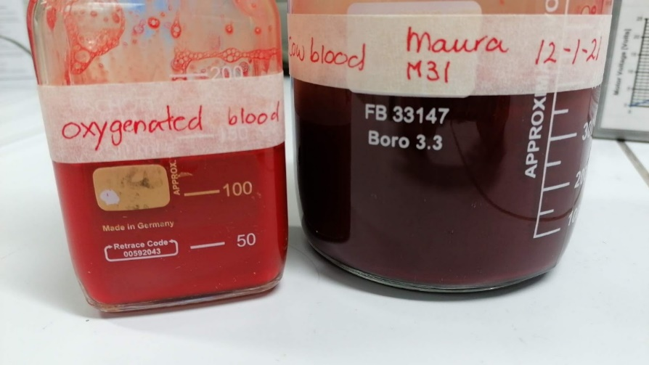
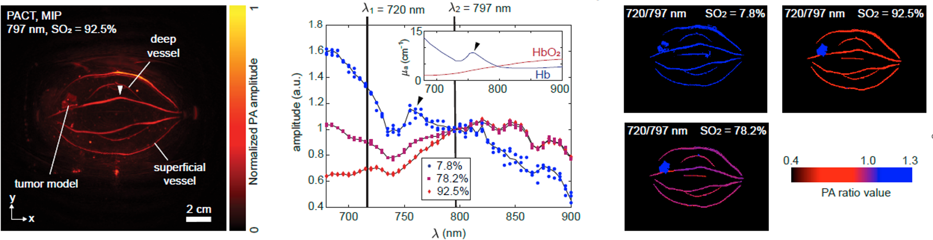
Illustration: Phantom Validation

Slide 15
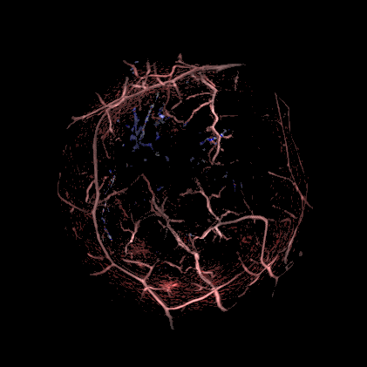
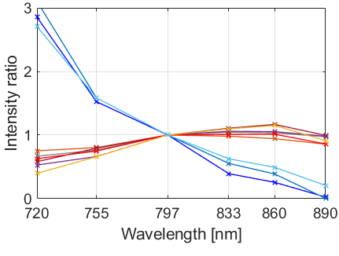
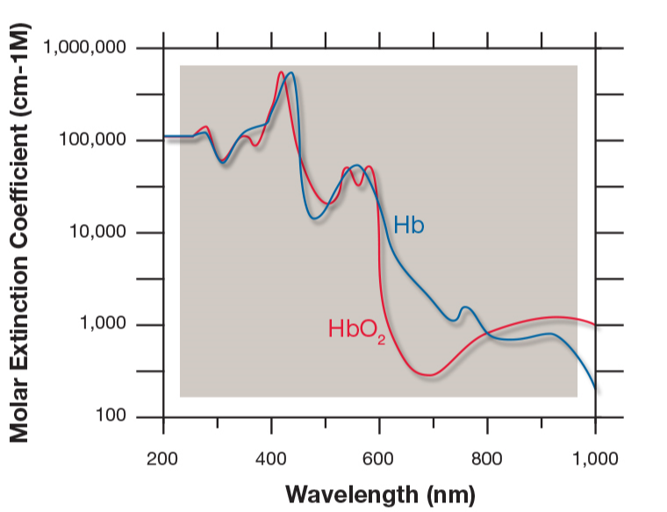
Illustration: In Vivo Results
>1
Intensity ratio 890 nm / 720 nm
<1
Figure from: Spectrum Medical, Non-Invasive Measurement of SaO₂, SvO₂ & Hemoglobin

Slide 16




UST: Mathematical Modelling (simplified)
acoustic wave equation
measurement (on boundary)
multiple sources
inverse problem:
acoustic parameter identification problem with boundary data.
$$\left(c{\left(x\right)}^{−2} ∂_{t}^{2}−Δ\right) p_{i}\left(x, t\right)=s_{i}\left(x,t\right)$$
$$f_{i}= M_{i}p_{i}$$
$$i=1, …, N_{s}$$
$$f→c$$

Slide 17

UST Reconstruction Approaches
Travel time tomography: geometrical optics approximation
robust & computationally efficient
(time-of-flight picking followed by linear inversion)
valid for high frequencies (attenuation!), low res, lots of data
Javaherian, L, Cox, 2020. Refraction-corrected ray-based inversion for three-dimensional ultrasound tomography of the breast. Inverse Problems
Full waveform inversion (FWI): fit full wave model to all data
high res from little data, transducer modelling, constraints
many wave simulations, complex numerical optimization
low TRL but already used in 2D systems

Slide 18


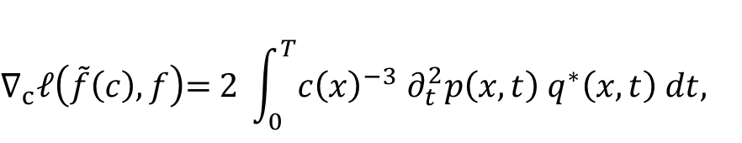
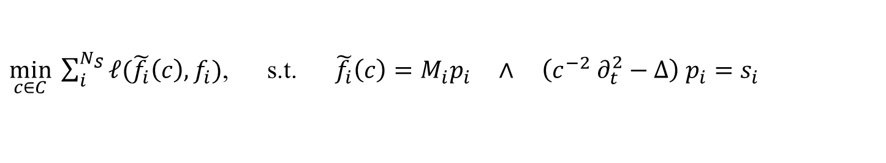
Time Domain Full Waveform Inversion
$\min_{c∈C}{\sum_{i}^{N_{S}}{ℓ(\tilde{f_{i}}\left(c\right), f_{i})}}$, s.t. $\tilde{f_{i}}\left(c\right)=M_{i}p_{i} ∧ \left(c^{−2} ∂_{t}^{2}−Δ\right) p_{i}=s_{i}$
gradient for first-order optimization via adjoint state method
where is the time-reversed data discrepancy
two wave simulations for one gradient (for one source)
Starting point in 2D:
$$∇_{c}ℓ\left(\tilde{f}\left(c\right), f\right)\text{= }\text{2 }\int_{0}^{T}{{c\left(x\right)}^{−3} ∂_{t}^{2}p\left(x,t\right) q^{∗}\left(x, t\right) dt, }$$
$$\left(c^{−2} ∂_{t}^{2}−Δ\right) q^{∗}=s^{∗},$$
$$s^{∗}(x,t)$$
Pérez-Liva, Herraiz, Udías, Miller, Cox, Treeby, 2017. Time domain reconstruction of sound speed and attenuation in ultrasound computed tomography using full wave inversion. JASA

Slide 19
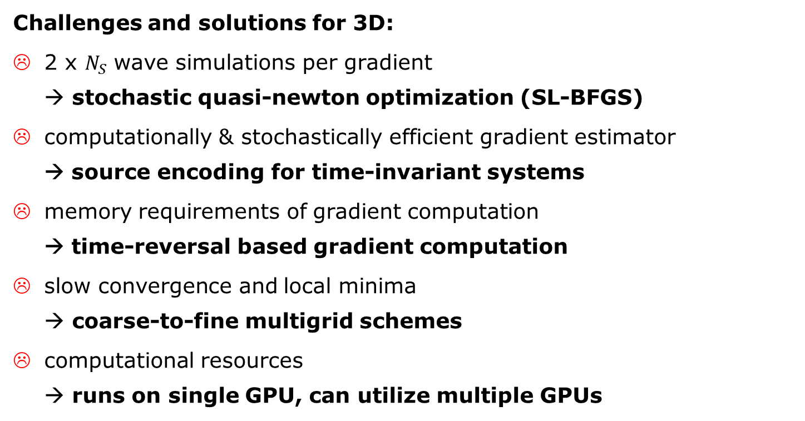
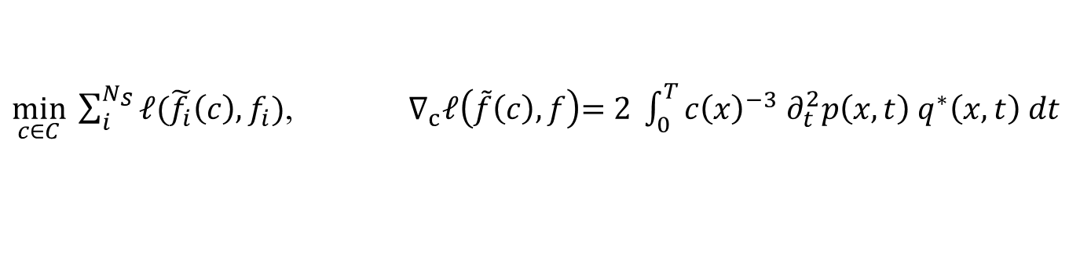
3D Time Domain FWI for Breast UST
$\min_{c∈C}{\sum_{i}^{N_{S}}{ℓ(\tilde{f_{i}}\left(c\right), f_{i})}}$, $∇_{c}ℓ\left(\tilde{f}\left(c\right), f\right)\text{= }\text{2 }\int_{0}^{T}{{c\left(x\right)}^{−3} ∂_{t}^{2}p\left(x,t\right) q^{∗}\left(x, t\right) dt}$
Challenges and solutions for 3D:
2 x $N_{S}$ wave simulations per gradient
→ stochastic quasi-newton optimization (SL-BFGS)
computationally & stochastically efficient gradient estimator
→ source encoding for time-invariant systems
memory requirements of gradient computation
→ time-reversal based gradient computation
slow convergence and local minima
→ coarse-to-fine multigrid schemes
computational resources
→ runs on single GPU, can utilize multiple GPUs
Notes:
\item[\todoitem] computational resources \\ \uncover<6->{\textbf{$\longrightarrow$ runs on single GPU, can utilize multiple GPUs}}

Slide 20
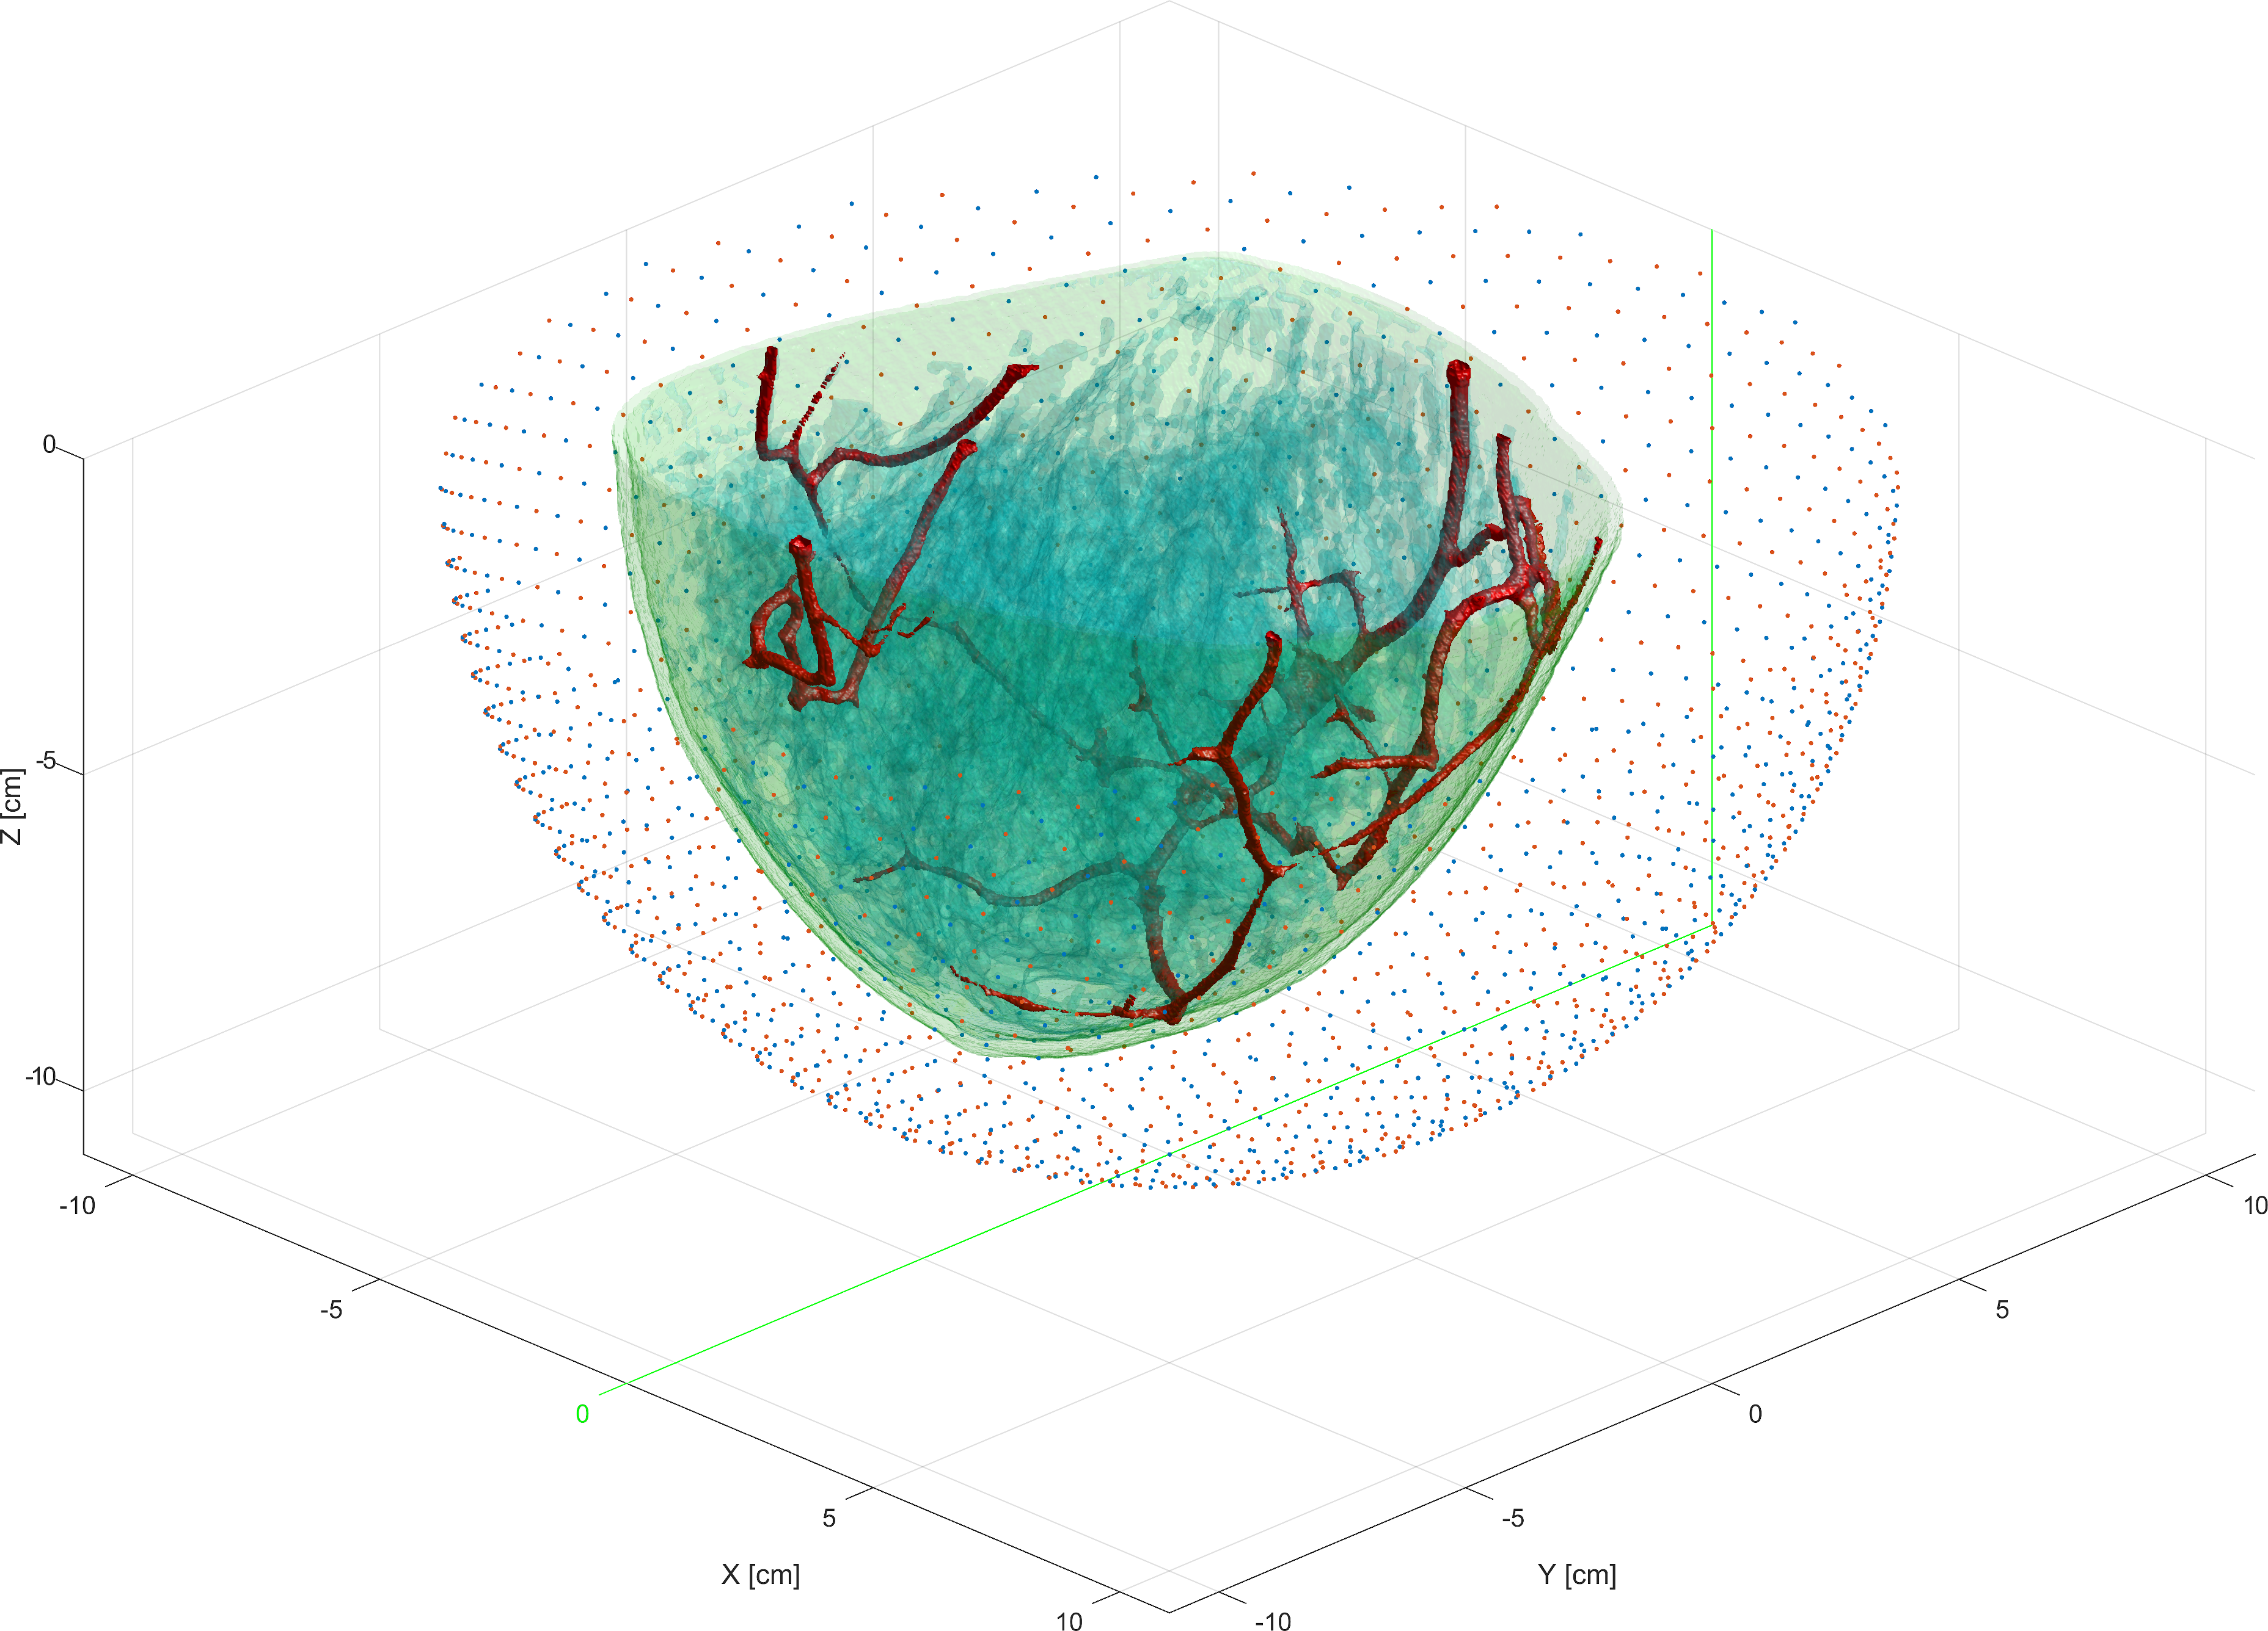
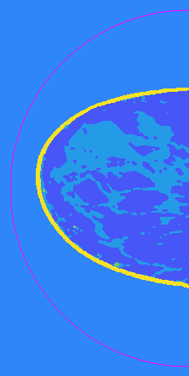
Numerical proof-of-concept study
L, Pérez-Liva, Treeby, Cox, 2021. High Resolution 3D Ultrasonic Breast Imaging by Time-Domain Full Waveform Inversion. Inverse Problems
Notes:
L, P\'{e}rez-Liva, Treeby, Cox, 2021}{High Resolution 3D Ultrasonic Breast Imaging by Time-Domain Full Waveform Inversion}{Inverse Problems 38(2)

Slide 21
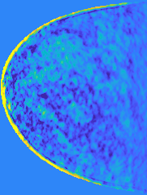
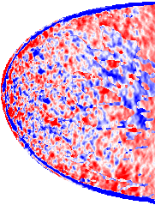
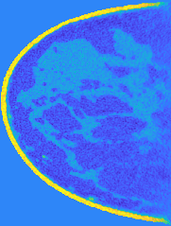
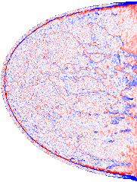
Numerical proof-of-concept study
Starting point
Improvement
L, Pérez-Liva, Treeby, Cox, 2021. High Resolution 3D Ultrasonic Breast Imaging by Time-Domain Full Waveform Inversion. Inverse Problems
Notes:
L, P\'{e}rez-Liva, Treeby, Cox, 2021}{High Resolution 3D Ultrasonic Breast Imaging by Time-Domain Full Waveform Inversion}{Inverse Problems 38(2)

Slide 22
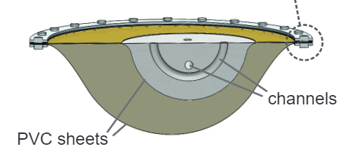
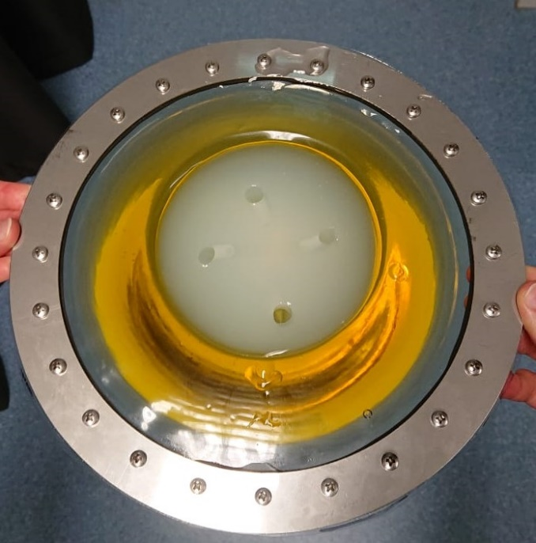
FWI for Experimental Data: Where Are We?
data from phantom objects, volunteers & patients
ray-based travel time tomography reconstructions
photoacoustic reconstructions → data pre-processing, scanner & transducer modelling, wave simulations
modeling of US protocol, data read-in & pre-processing
model calibration
FWI of phantom objects, quantitative evaluation
FWI of volunteer data
FWI of patient data & clinical evaluation
Notes:
\item[\ambiitem] model calibration
\item[\ambiitem] FWI of phantom objects, quantitative evaluation
\item[\todoitem] FWI of volunteer data \item[\todoitem] FWI of patient data, clinical evaluation \end{itemize}

Slide 23





Summary & Outlook
need for novel breast imaging techniques
photoacoustic (PAT) and ultrasound tomography (UST) give access to high-quality images of optical and acoustic tissue properties
combined PAT+UST scanner designed & build
evaluation on data from phantoms, volunteers & patients
PAT reconstructions work well
proof-of-concept studies of FWI for high resolution 3D UST
demonstration of FWI on experimental data
optical inversion in PAT (QPAT)
L, Pérez-Liva, Treeby, Cox, 2021. High Resolution 3D Ultrasonic Breast Imaging by Time-Domain Full Waveform Inversion. Inverse Problems
Felix.Lucka@cwi.nl Photoacoustic and Ultrasonic Tomography for Breast Imaging
Notes:
reconstruction of experimental data

