Slide 1
How to test a Quantum Computer
Stacey Jeffery
Based on joint work with Andrea Coladangelo, Alex Grilo and Thomas Vidick

Slide 2
definitely a real quantum comuter (not fake)
(do not open)
$15M

Slide 3
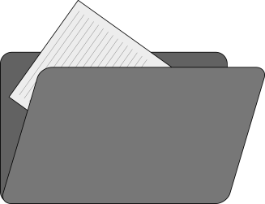
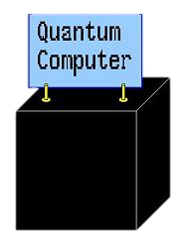
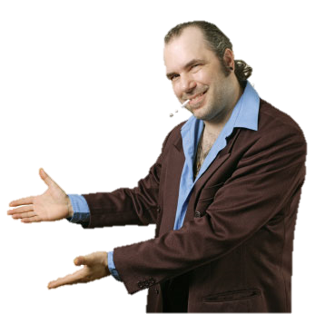
What price should we sell our new widgets for?
seven

Slide 4
How to test a Quantum Computer
Stacey Jeffery
Based on joint work with Andrea Coladangelo, Alex Grilo and Thomas Vidick

Slide 5
Experiments

Slide 6
Quantum Mechanical Experiments

Slide 7
Quantum Mechanical Experiments

Slide 8
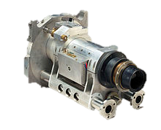
Quantum Mechanical Experiments

Slide 9
Quantum Mechanical Experiments

Slide 10
Quantum Mechanical Experiments

Slide 11
Quantum Mechanical Experiments

Slide 12
Quantum Mechanical Experiments

Slide 13
Quantum Mechanical Experiments

Slide 14
Quantum Mechanical Experiments

Slide 15
Quantum Mechanical Experiments

Slide 16
Quantum Mechanical Experiments

Slide 17
Quantum Mechanical Experiments

Slide 18
Quantum Mechanical Experiments

Slide 19
Testing a Quantum Computer

Slide 20
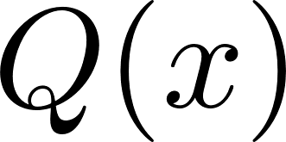
Testing a Quantum Computer

Slide 21
Testing a Quantum Computer

Slide 22
Bell Tests

Slide 23
Bell Tests

Slide 24
Bell Tests

Slide 25
Bell Tests
1
1

Slide 26
Bell Tests
0
0

Slide 27
Bell Tests
0
0

Slide 28
Bell Tests
0
0

Slide 29
Bell Tests
0
0

Slide 30
Bell Tests
1
1

Slide 31
Bell Tests: CHSH Game

Slide 32
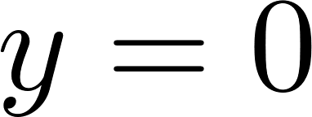
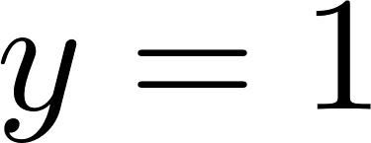
Bell Tests: CHSH Game

Slide 33
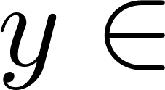
Bell Tests: CHSH Game

Slide 34
Robust Rigidity Theorems

Slide 35
Testing a Quantum Computer

Slide 36
Testing a Quantum Computer

Slide 37
Our Contribution

Slide 38
Our Contribution

Slide 39
Thanks!

