Slide 1



LDBC & The Social Network Benchmark
Peter Boncz
Database Architectures (DA) @ CWI
Special chair “Large-Scale Data Engineering” @ VU
event.cwi.nl/lsde2015

Slide 2




Engines for Data Analysis
Inaugural Lecture October 2014
Notes:
Let me then finally describe what I do. The title of this lecture already says it: designing engines for data analysis.
Going back to a few slides earlier we see a so-called Big Data pipeline. Raw data with low information content (such as images or tweets) are being processed by algorithms on a massive scale, and massaged into high-density information or even knowledge, using machine learning and information retrieval techniques. I focus on the part in the middle, the engine.
The goal of a data processing engine is to make it easy to create such data processing pipelines. I do not typically do the analysis itself, I know little about astronomy, or pharmacy research. But what I know is to build software systems that can process large amounts of data fast.
Engines:
Are Building Blocks for Big Data systems
Shield Problem owners from the complexities of large-scale system building
Make efficient use of hardware
Multiple machines (clusters)
Parallel processing inside one machine
Efficient data structures and algorithms, self optimizing

Slide 3



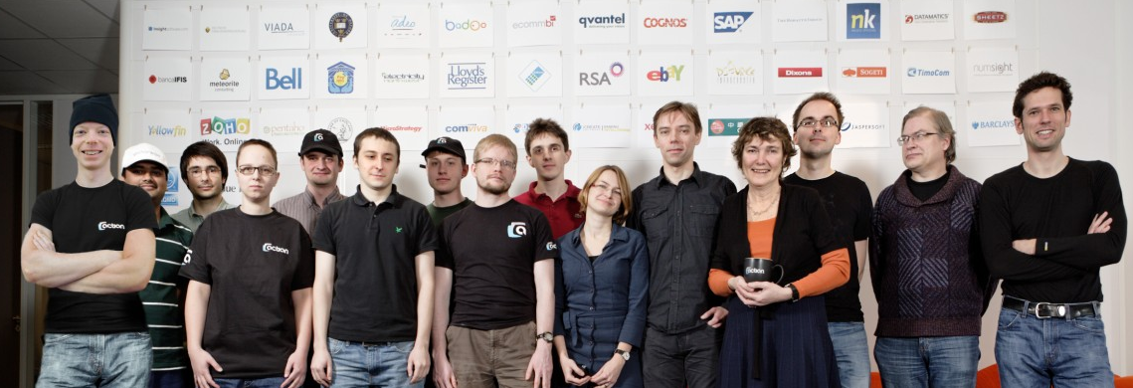
The Start-Up Company Experience
  1996-2003
  2008-
  2013-

Slide 4
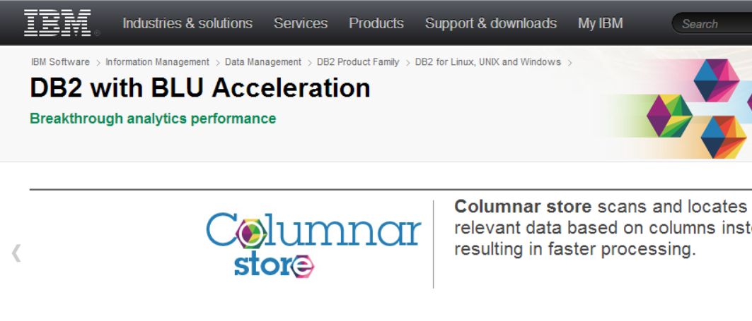
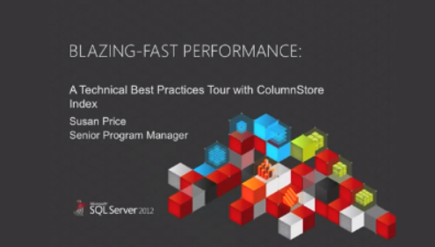
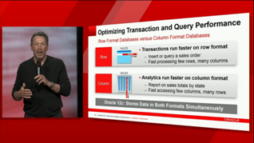
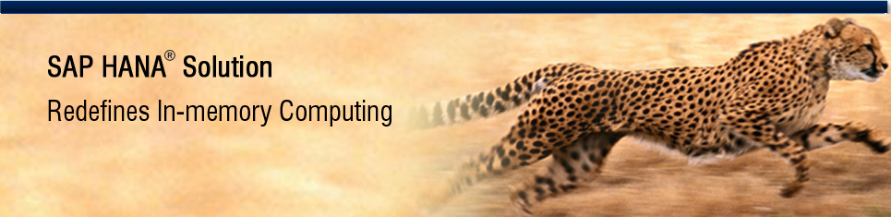
the relational industry has been reshaped...
Notes:
The ultimate form of flattery is imitation. In the past two years, the relational database industry leaders Oracle, SAP, IBM and Microsoft all have been introducing specialized analytical data engines. The first was SAP HANA (formerly T-REX),a project that started by inviting our research group to SAP HQ in Waldorf to give talks about MonetDB. Then Microsoft introduced ColumnStore, IBM introduced BLU and Oracle its in-memory option. All three look a lot like Vectorwise, but we have measured that Vectorwise is in fact still faster.

Slide 5
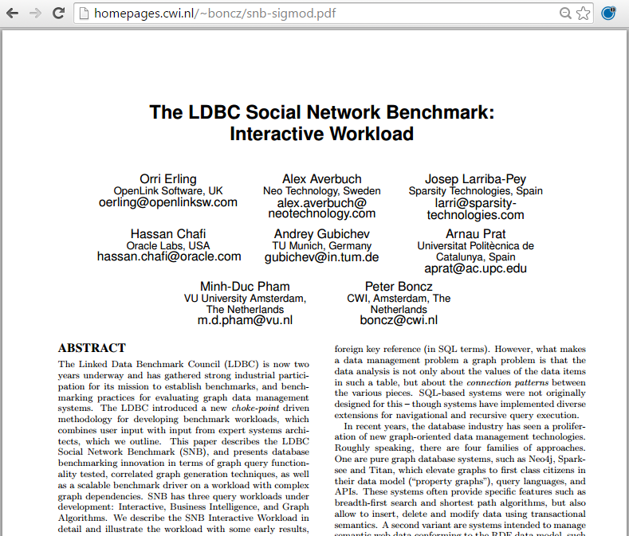

LDBC & The Social Network Benchmark
Peter Boncz
Database Architectures (DA) @ CWI
Special chair “Large-Scale Data Engineering” @ VU
event.cwi.nl/lsde2015

Slide 6
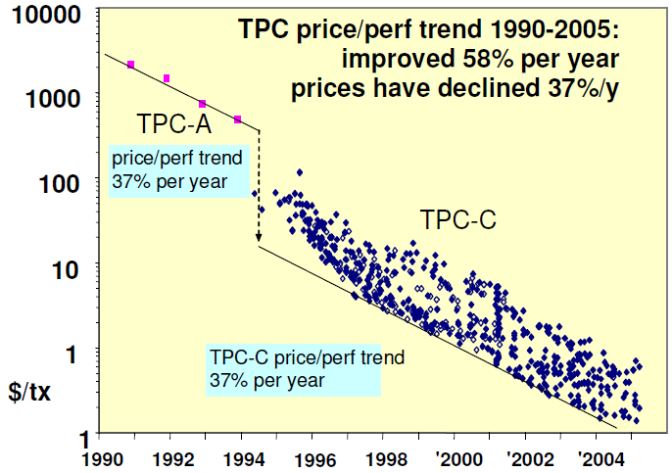
Benchmarking?
a benchmark is a standard
test that measures efficiency
Goal: quantification
make competing systems comparable
  important tool in experimental science
accelerate progress, make technology viable
  social goal, influence a research field

Slide 7
Graph data management
Many Big Data problems revolve around graphs
Social network data
AI methods that build/discover relationships
Wave of new systems (/research):
Graph database systems
  e.g. Neo4j -- graph & paths “first class citizens”
  RDF / SPARQL systems
  Graph extensions to relational systems
    Extensions: e.g. recursive queries, traversals
Graph Programming Frameworks
  leveraging cluster computing for graph algorithms
  e.g. GraphLab – distributed AI algorithms
  Giraph “think like a vertex”

Slide 8
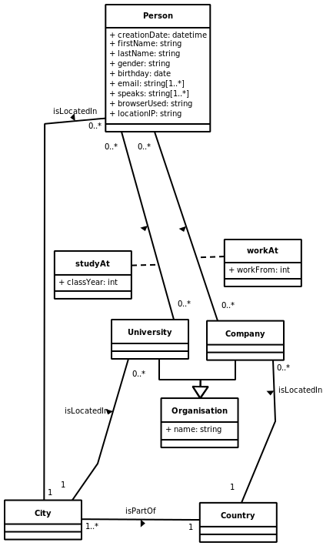
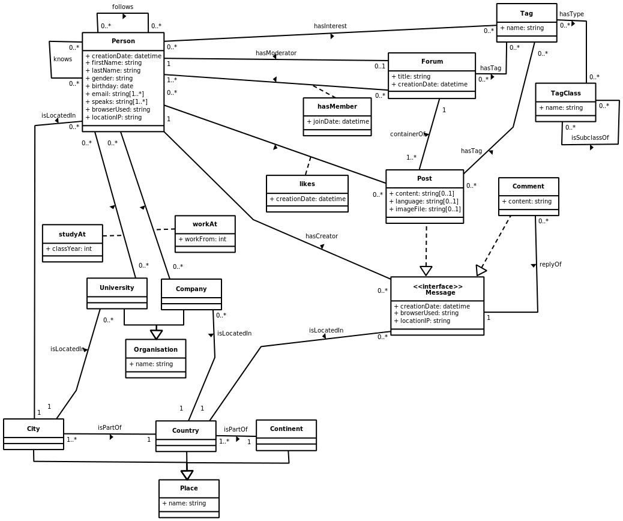
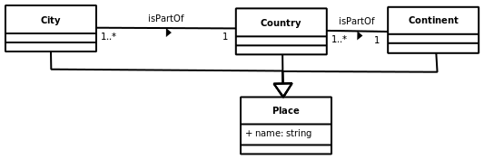
SNB (Social Network Benchmark) schema

Slide 9
SNB Workloads
Interactive: tests a system's throughput with relatively simple queries with concurrent updates
  For one person, recommend a friend based on shared friends and interests
Business Intelligence: consists of complex structured queries for analyzing online behavior
  Who are influential people the topic of open source development?
Graph Analytics: tests the functionality and scalability on most of the data as a single operation
  PageRank, Shortest Paths, Community Detection

Slide 10
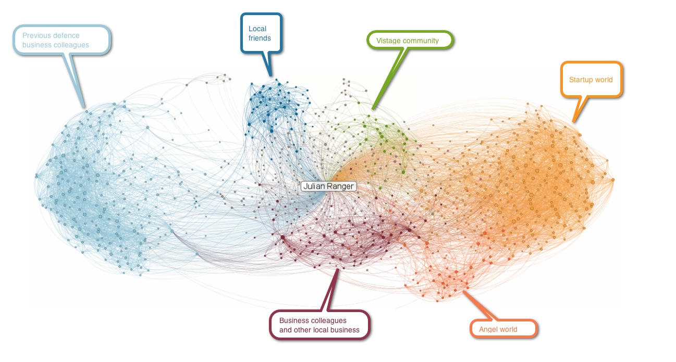

Social Networks
correlation between property values and network structure

Slide 11
SNB datagen: correlated graph structure
<Britney Spears>
“1990”
<like>
P4
Student
“University of Leipzig”
<birthYear>
<knows>
“Anna”
< studyAt >
<is>
<firstname>
<firstname>
<knows>
P5
<liveAt>
“Germany”
“Laura”
P1
<like>
<knows>
<birthYear>
“1990”
<knows>
<Britney Spears>
<studyAt>
P3
P2
“University of Leipzig”
< studyAt >
<birthYear>
<studyAt>
“University of Leipzig”
<liveAt>
“University of Amsterdam”
“1990”
“Netherlands”

Slide 12
SNB datagen: correlated graph structure
<Britney Spears>
<like>
“1990”
Compute similarity of two nodes based on their (correlated) properties.
Use a probability density function wrt to this similarity for connecting nodes
P4
Student
“University of Leipzig”
?
“Anna”
<birthYear>
<is>
< studyAt >
<firstname>
?
P5
<liveAt>
“Germany”
<firstname>
“Laura”
P1
<like>
connection
probability
<birthYear>
?
?
?
?
“1990”
<Britney Spears>
<studyAt>
P3
“University of Leipzig”
P2
< studyAt >
highly similar → less similar
<birthYear>
<studyAt>
“University of Leipzig”
<liveAt>
“University of Amsterdam”
Danger: this is very expensive to compute on a large graph!
(quadratic, random access)
“1990”
“Netherlands”
Notes:
Sources for generating edges correlated with property values

Slide 13
SNB datagen: correlated graph structure
<Britney Spears>
<like>
“1990”
P4
Trick: disregard nodes with too large similarity distance
(only connect nodes in a similarity window)
Student
“University of Leipzig”
<birthYear>
<knows>
“Anna”
< studyAt >
<is>
<firstname>
Window
<firstname>
<knows>
P5
<liveAt>
“Germany”
“Laura”
P1
<like>
connection
probability
<birthYear>
<knows>
“1990”
<knows>
<Britney Spears>
<studyAt>
P3
“University of Leipzig”
P2
< studyAt >
highly similar → less similar
<birthYear>
<studyAt>
“University of Leipzig”
<liveAt>
“University of Amsterdam”
Probability that two nodes are connected is skewed w.r.t the similarity between the nodes (due to probability distr.)
“1990”
“Netherlands”
Notes:
Sources for generating edges correlated with property values

Slide 14
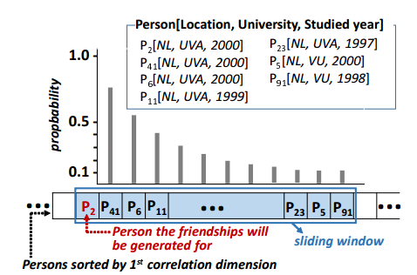
SNB datagen: MapReduce approach

Slide 15
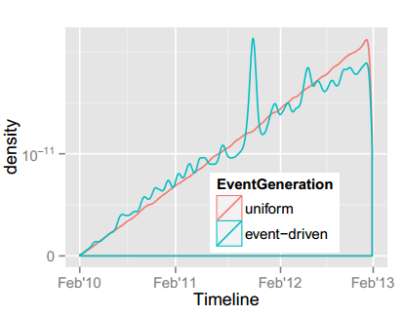
SNB datagen: temporal effects

Slide 16
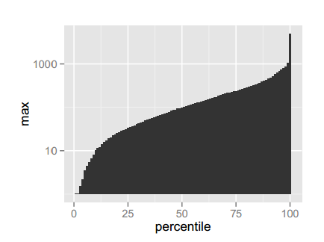
SNB datagen: friend degree distribution
Based on “Anatomy of Facebook” blogpost (2013)
Diameter increases logarithmically with dataset scale factor

Slide 17
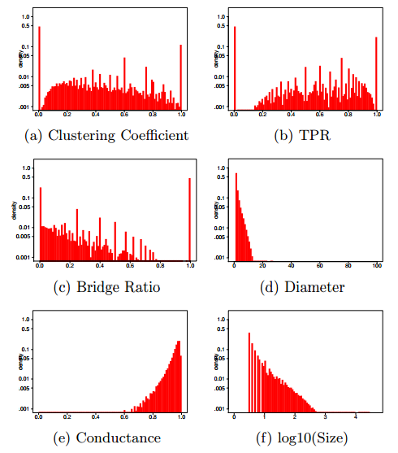
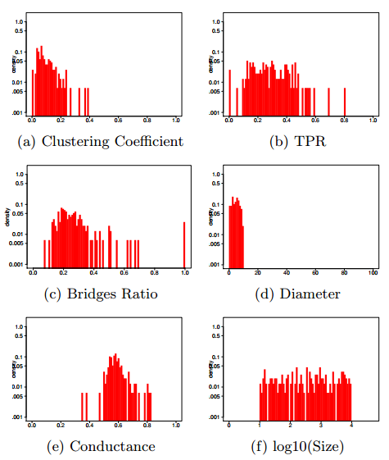
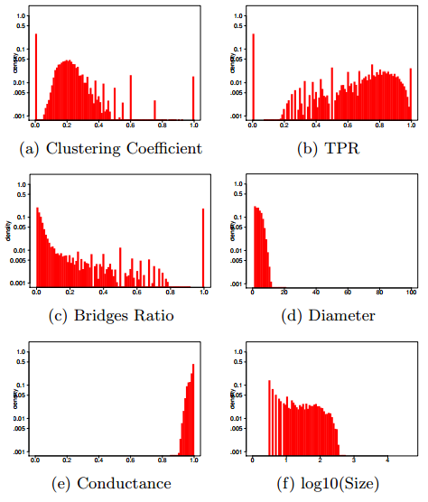
SNB datagen: how realistic is it?
Livejournal
LFR3 (synthetic)
SNB datagen
GRADES2014 “How community-like is the structure of synthetically generated graphs” - Arnau Prat (UPC); David Domínguez-Sal (Sparsity Technologies)

Slide 18
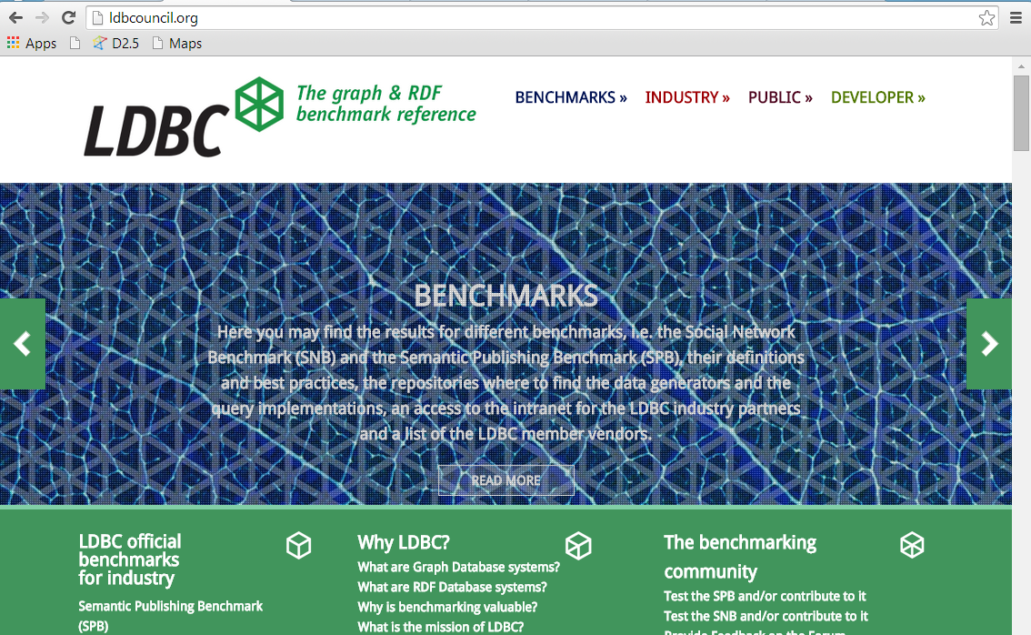
ldbcouncil.org
Code @ github/ldbc

Slide 19








Industry Membership

Slide 20
Summary
LDBC
  Graph and RDF benchmark council
  Choke-point driven benchmark design (user+system expert involvement)
Social Network Benchmark (SNB)
  Advanced social network generator (scale-free,power-laws,clsuetring,correlations)
  Real data distributions from DBpedia
SIGMOD 2015 publication (to appear)

Slide 21
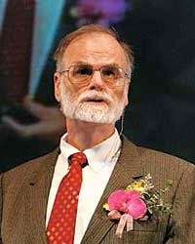

Working with Industry increases impact
Jim Gray Michael Stonebreaker
IEEE Von Neumann Medal 2004
ACM Turing Award 1998
ACM Turing Award 2015
Notes:
Jim Gray Michael Stonebraker
IBM System-R Berkeley Ingres
Foundations of Transaction Processing Object-Oriented DBMS (Illustra)
Foundations of Database Benchmarking Stream DBMS (StreamBase)
4th Paradigm Astronomy (SDDS) C-Store (Vertica) vs H-Store (transactions)
They are the most highly decorated database systems researchers, with a Tuning Award and the Von Neumann medal, even while they spent significant time in the industry. The fact that they were able to prove the merits of their ideas an algorithms in systems that were used and conquered markets, gives their scientific papers about these more weight, credibility and recognition.
I cannot stand in the shoes of these two, but I have tried to continue in their direction.

