Slide 1
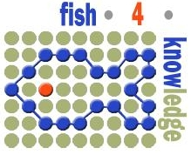
The Fish4Knowledge Project Disclosing Computer Vision Errors to End-Users
Emma Beauxis-Aussalet, Lynda Hardman,
Jacco Van Ossenbruggen, Jiyin He,
Elvira Arslanova, Tiziano Perrucci
CWI Scientific Meeting
Notes:
disclosing CV errors to domain experts

Slide 2
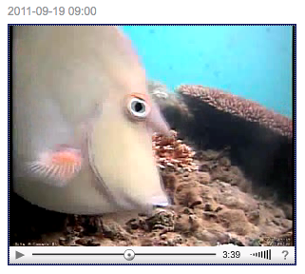
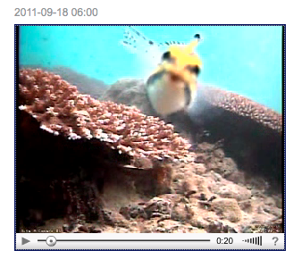
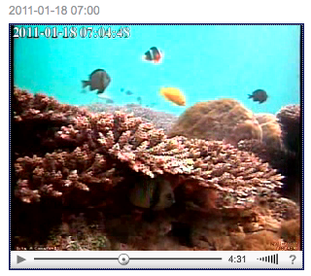
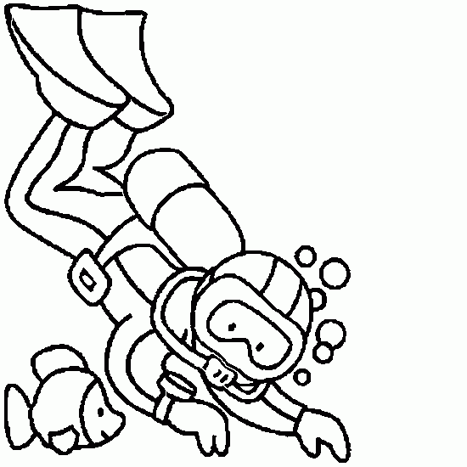
Monitoring Fish Population
We count fish
to study ecosystems
Notes:
Explain project for images
Then why computer vision
and then text bubble.

Slide 3
Monitoring Fish Population
Why use Computer Vision?
It can count fish from each species
It supports short- to long-term research
It is not intrusive, and cost-effective
Notes:
Explain project for images
Then why computer vision
and then text bubble.

Slide 4
Monitoring Fish Population
Why use Computer Vision?
It can count fish from each species
It supports short- to long-term research
It is not intrusive, and cost-effective
But… new practices need to be introduced,
and scientific validity needs to be assessed.
Notes:
Uncertainty

Slide 5
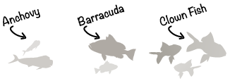
Detecting Fish
Collect examples of fish
(Ground-Truth)
Notes:
Add clicks

Slide 6
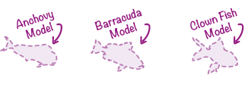
Detecting Fish
Collect examples of fish
(Ground-Truth)
Construct fish models
Notes:
Add clicks

Slide 7
Detecting Fish
Collect examples of fish
(Ground-Truth)
Construct fish models
Classify fish species
as the most similar model
Notes:
Add clicks

Slide 8
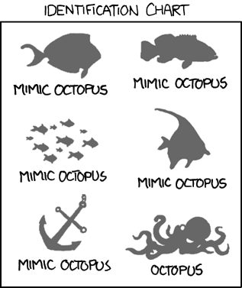
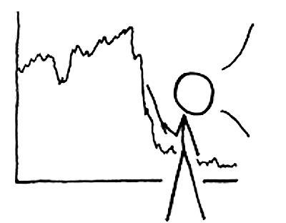
Motivations for HCI Research
Support uncertainty-aware data analysis
What are the uncertainty factors?
How to inform ecologists about each factor?
How to support user assessment of end-results?
Here the Octopus appeared.
How precise is this?
(½Φ )-(π√⅞)

Slide 9
What are the uncertainty factors?
CWI Scientific Meeting

Slide 10
Interactions of Uncertainty Factors
Computer Vision Errors
Notes:
Edit figure!

Slide 11
Interactions of Uncertainty Factors
Computer Vision Errors
Some fish are misclassified
Notes:
Edit figure!

Slide 12
Interactions of Uncertainty Factors
Computer Vision Errors
Ground-Truth Quality
Poor ground-truth
yields poor models
Notes:
Edit figure!

Slide 13
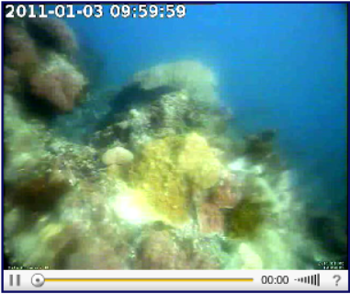
Interactions of Uncertainty Factors
Computer Vision Errors
Image Quality
Ground-Truth Quality
Poor images
yield more errors
Notes:
Edit figure!

Slide 14
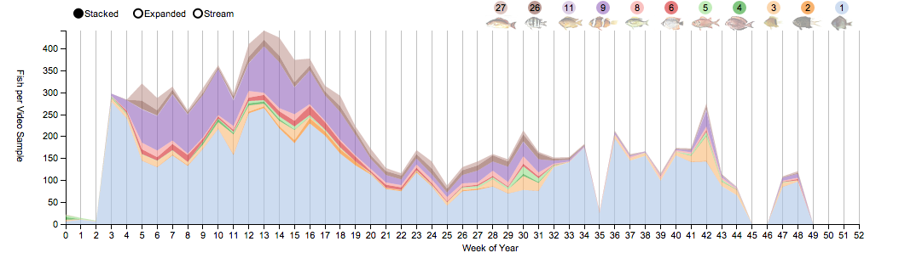
Interactions of Uncertainty Factors
Biases & Noise
in Specific Output
Computer Vision Errors
Image Quality
Ground-Truth Quality
Typhoons yield poor images?
What confidence intervals?
Notes:
Edit figure!

Slide 15
Interactions of Uncertainty Factors
Number of Video Samples
Biases & Noise
in Specific Output
Computer Vision Errors
Image Quality
Ground-Truth Quality
Missing videos?
Notes:
Edit figure!

Slide 16
Interactions of Uncertainty Factors
Some species swim
in & out the field of view
Number of Video Samples
Biases & Noise
in Specific Output
Computer Vision Errors
Duplicated Individuals
Image Quality
Ground-Truth Quality
Notes:
Edit figure!

Slide 17
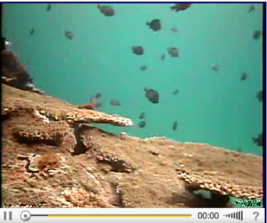
Interactions of Uncertainty Factors
Fields of view
target specific species
Number of Video Samples
Biases & Noise
in Specific Output
Field of View
Computer Vision Errors
Duplicated Individuals
Image Quality
Ground-Truth Quality
Notes:
Field of View Can Shift

Slide 18
Interactions of Uncertainty Factors
Fields of view
target specific species
Number of Video Samples
and shift overtime
Biases & Noise
in Specific Output
Field of View
Computer Vision Errors
Duplicated Individuals
Image Quality
Ground-Truth Quality
Notes:
Field of View Can Shift

Slide 19
Interactions of Uncertainty Factors
Number of Video Samples
Biases & Noise
in Specific Output
Field of View
Computer Vision Errors
Duplicated Individuals
Image Quality
Ground-Truth Quality
Notes:
Edit figure!

Slide 20
Conveying Uncertainty Factors
Number of Video Samples
Confusion
Matrices
Biases & Noise
in Specific Output
Field of View
Computer Vision Errors
Duplicated Individuals
Image Quality
Ground-Truth Quality
Notes:
Edit figure!

Slide 21
Conveying Uncertainty Factors
Logistic
Regression
Number of Video Samples
Confusion
Matrices
Biases & Noise
in Specific Output
Field of View
Computer Vision Errors
Duplicated Individuals
Image Quality
Ground-Truth Quality
Notes:
Edit figure!

Slide 22
Conveying Computer Vision Errors with Confusion Matrices
Here the Octopus appeared.
How precise is this?
(½Φ )-(π√⅞)
CWI Scientific Meeting
Notes:
Put visualization in background

Slide 23
Conveying Computer Vision Errors with Confusion Matrices
Here the Octopus appeared.
How precise is this?
Without torture, no science.
Russian Proverb
(½Φ )-(π√⅞)
CWI Scientific Meeting
Notes:
Put visualization in background

Slide 24
State-of-the-Art
Confusion
Matrix

Slide 25
State-of-the-Art
Typical
Visualization

Slide 26
State-of-the-Art

Slide 27
State-of-the-Art

Slide 28
State-of-the-Art
Diagonals are correct fish (TP).
The rest are errors.

Slide 29
State-of-the-Art
Columns are missed fish.
(FN)

Slide 30
State-of-the-Art
Rows are added fish.
(FP)

Slide 31
State-of-the-Art
Rows & Columns
are cumulated

Slide 32
State-of-the-Art
Advanced
measurements
are repeated

Slide 33
Proposed Metric & Visualization
3 basic concepts: correct, added, missed fish
2 Main sources of errors
Number & Proportions of error
Simple metric for extrapolations

Slide 34
Proposed Metric & Visualization
3 basic concepts: correct, added, missed fish
2 Main sources of errors
Number & Proportions of error
Simple metric for extrapolations

Slide 35
Proposed Metric & Visualization
Numbers
Proportions

Slide 36
Proposed Metric & Visualization
Numbers
Proportions
Improve
Ground-Truth?

Slide 37
Proposed Metric & Visualization
Numbers
Proportions
Improve
algorithm?
Improve
Ground-Truth?

Slide 38
Issues Tackled
Notes:
LEGEND THRESHOLD

Slide 39
Issues Tackled
Large number of TN
conceals uncertainty
Notes:
LEGEND THRESHOLD

Slide 40
Issues Tackled
Large number of TN
conceals uncertainty
Information is lost
about errors interdependence
Notes:
LEGEND THRESHOLD

Slide 41
Issues Tackled
Large number of TN
conceals uncertainty
FP for one class are
FN for another
Information is lost
about errors interdependence
Notes:
LEGEND THRESHOLD

Slide 42
Issues Tackled
Large number of TN
conceals uncertainty
Information is lost
about errors interdependence
Class proportions can vary
Notes:
LEGEND THRESHOLD

Slide 43
Issues Tackled
Large number of TN
conceals uncertainty
Information is lost
about errors interdependence
Class proportions can vary
Using one single type of curve
can hide differences
Notes:
LEGEND THRESHOLD

Slide 44
Conveying Computer Vision Biases with Logistic Regression
Without torture, no science.
Russian Proverb
in collaboration with Bas Boom
CWI Scientific Meeting
Notes:
Put visualization in background

Slide 45
Logistic Regression Method

Slide 46
Logistic Regression Method

Slide 47
Logistic Regression Method

Slide 48
Logistic Regression Method

Slide 49
Logistic Regression Method

Slide 50
Logistic Regression Method

Slide 51
Visualization of Errors
Detail of the chances of biases
Notes:
Make then as cluster? 2-n classes depending on ML algorithm

Slide 52
Achievements & Limitations
Before
After
Notes:
Put Numbers?

Slide 53
Achievements & Limitations
Before
After
Fish counts
are improved
Notes:
Put Numbers?

Slide 54
Achievements & Limitations
Before
After
Fish counts
are improved
Notes:
Put Numbers?

Slide 55
Achievements & Limitations
Before
After
Fish counts
are improved
Notes:
Put Numbers?

Slide 56
Achievements & Limitations
Before
After
Fish counts
are improved
Biases are
reduced
Notes:
Put Numbers?

Slide 57
Achievements & Limitations
Before
After
Fish counts
are improved
Biases are
reduced
But beware further variations
of class proportions!
Notes:
Put Numbers?

Slide 58
Future Work
Integrate Computer Vision errors
into ecologists’ statistical framework
Number of Video Samples
Biases & Noise
in Specific Output
Field of View
Computer Vision Errors
Duplicated Individuals
Image Quality
Ground-Truth Quality
Notes:
Confusion matrix & variance are well-known. But not linked!

Slide 59
Future Work
Integrate Computer Vision errors
into ecologists’ statistical framework
Number of Video Samples
Biases & Noise
in Specific Output
Field of View
Computer Vision Errors
Duplicated Individuals
Image Quality
Ground-Truth Quality
User studies with our visualizations
Notes:
Edit figure!

Slide 60
Future Work
Integrate Computer Vision errors
into ecologists’ statistical framework
Number of Video Samples
Biases & Noise
in Specific Output
Field of View
Computer Vision Errors
Duplicated Individuals
Image Quality
Ground-Truth Quality
Develop measurement methods
User studies with our visualizations
Notes:
Edit figure!

Slide 61
Online Demo:
http://f4k.project.cwi.nl
emma@cwi.nl
CWI Scientific Meeting
Notes:
disclosing CV errors to domain experts

