Slide 1
Energy procurement in the presence of intermittent sources
Jayakrishnan Nair (CWI)
Sachin Adlakha (Caltech)
Adam Wierman (Caltech)

Slide 2
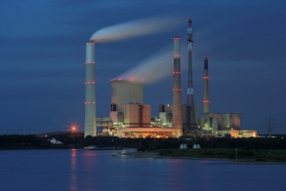
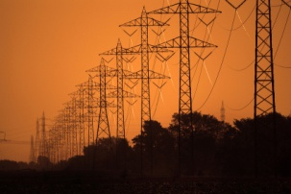

generation
Small supply side uncertainty
will change with high penetration of renewables
transmission
utility
distribution
Small demand side uncertainty
customers
Notes:
Today – small demand uncertainty, small supply-side uncertainty. Matching supply and demand and supply easy

Slide 3

How do we incorporate wind energy?
long
term
day
ahead
real
time
time
Utility buys power
to meet demand

Slide 4
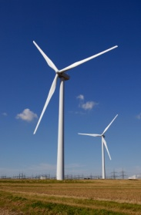
Allow wind producers to participate in real time
and/or day ahead markets
[CAISO PIRP program, Bitar et al. 2011, Cai et al. 2011]
long
term
day
ahead
real
time
time
Utility buys power
to meet demand

Slide 5
2. Utilities form long term contracts with wind producers
to buy all available wind for a fixed payment
[Meyn et al. 2009, Varaiya et al. 2010, Rajagopal et al. 2011]
long
term
day
ahead
real
time
time
Utility buys power
to meet demand

Slide 6
long
term
day
ahead
real
time
time
This talk: What is the impact of long term wind contracts?
As renewable penetration increases:
Should markets be moved closer to real-time?
Should markets be added?

Slide 7




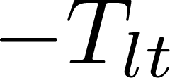

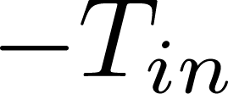


price ↑
wind uncertainty ↓
long
term
real
time
int.
time

Slide 8



Assumption: wind forecasts evolve independently of the past
[Martingale model of forecast evolution, Heath et al. ‘94]
long
term
real
time
int.
time

Slide 9
Objective: minimize average cost of procurement
subject to:
causality constraints.
long
term
real
time
int.
time

Slide 10
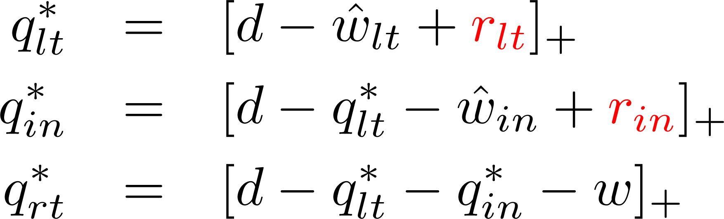
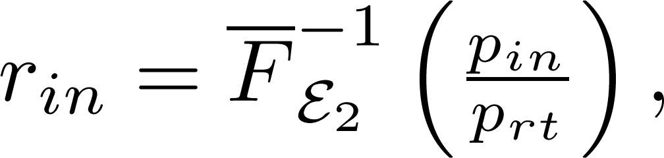
Theorem: The optimal procurement strategy is
characterized by reserve levels r_{lt} and r_{in} such that
where
r_{lt} uniquely solves

Slide 11
long
term
day
ahead
real
time
time
This talk: What is the impact of long term wind contracts?
As renewable penetration increases:
Should markets be moved closer to real-time?
Should markets be added?

Slide 12
long
term
day
ahead
real
time
time
This talk: What is the impact of long term wind contracts?
As renewable penetration increases:
Should markets be moved closer to real-time?
Should markets be added?

Slide 13
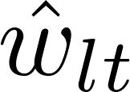
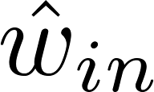

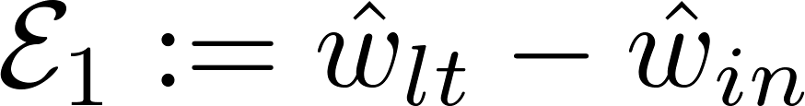
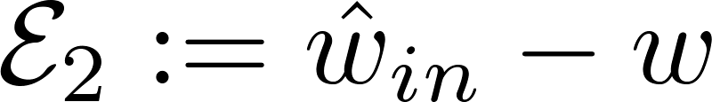
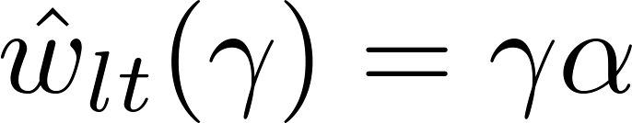
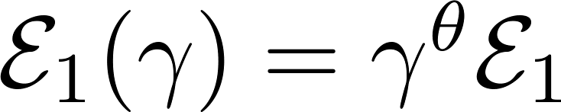
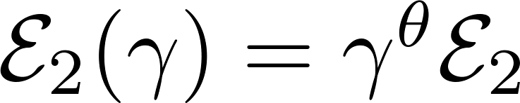
Scaling regime
long
term
real
time
int.
time

Slide 14
Procurement with
no wind uncertainty
extra procurement
due to wind uncertainty

Slide 15
Depends on
wind aggregation
Depends on markets & prediction
Prices
Forecast accuracy

Slide 17
long
term
day
ahead
real
time
time
This talk: What is the impact of long term wind contracts?
As renewable penetration increases:
Should markets be moved closer to real-time?
Should markets be added?

Slide 18
price ↑
wind uncertainty ↓
long
term
real
time
time
int.
Q: Where should the intermediate market be placed to
minimize procurement costs?

Slide 19
price ↑
wind uncertainty ↓
long
term
real
time
time
int.
Q: How does the optimal placement change as
wind penetration grows?

Slide 20
long
term
day
ahead
real
time
time
This talk: What is the impact of long term wind contracts?
As renewable penetration increases:
Should markets be moved closer to real-time?
Should markets be added?

Slide 21
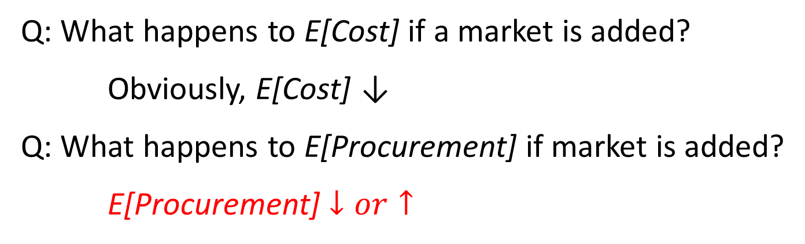
long
term
real
time
v/s
long
term
real
time
int.
Q: What happens to E[Cost] if a market is added?
Obviously, E[Cost] ↓
Q: What happens to E[Procurement] if market is added?
E[Procurement] $↓or↑$

Slide 22






$$ε_{2}\sim Gaussian$$
long
term
real
time
Int.
time
$$p_{lt}=6$$
$${6<p}_{in}<10$$
$$p_{rt}=10$$
2 markets
Intermediate market disappears
$E[Procurement$]
3 markets
$$p_{in}$$

Slide 23





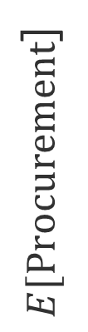
$$ε_{2}\sim Weibull$$
long
term
real
time
Int.
time
$$p_{lt}=6$$
$${6<p}_{in}<10$$
$$p_{rt}=10$$
Higher procurement with 3 markets!
2 markets
$E[Procurement$]
When can this happen?
3 markets
$$p_{in}$$

Slide 24
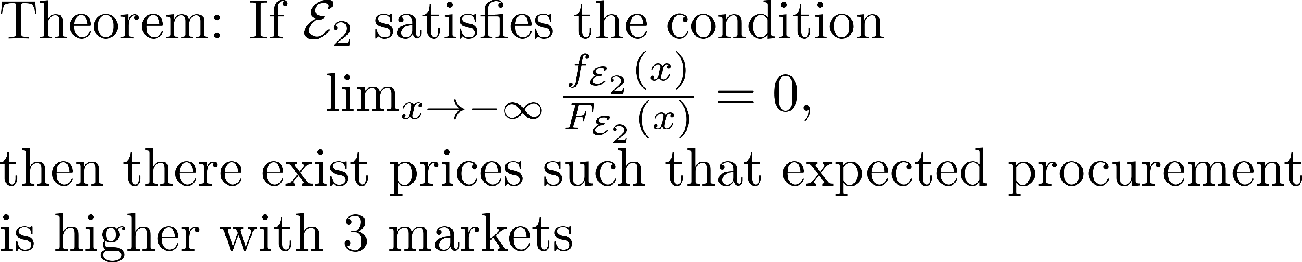
Forecast error is heavy-tailed to the left

Slide 25
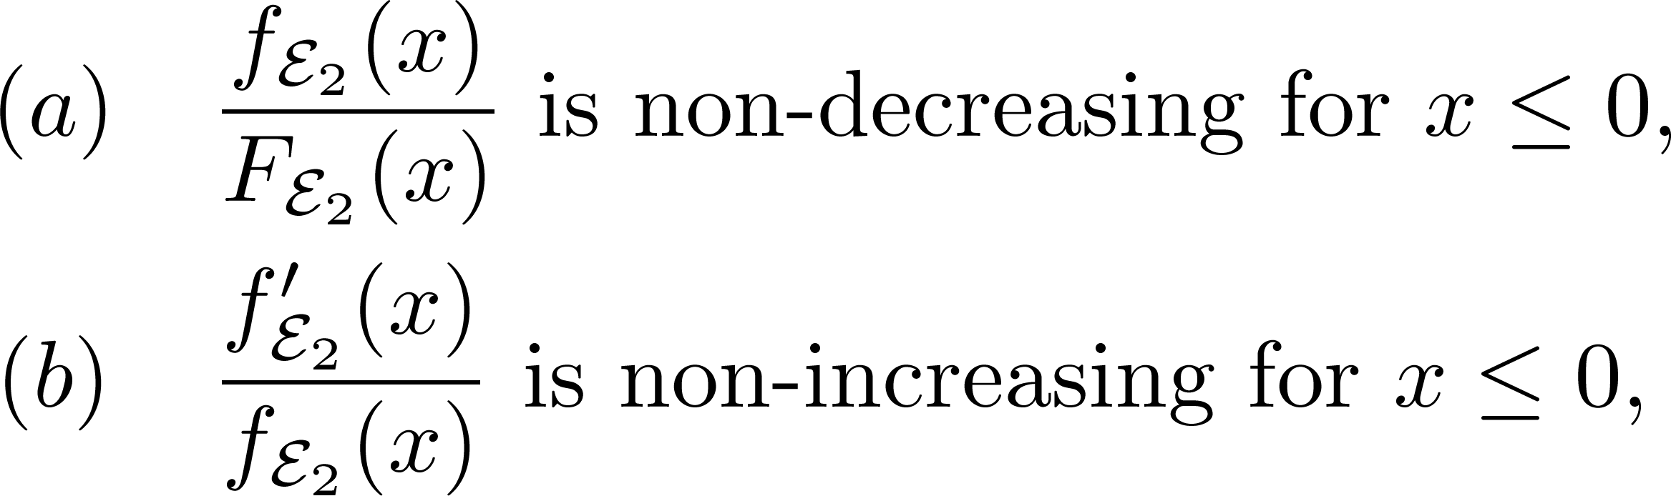
When is an additional market beneficial?
satisfied by the
Gaussian dist.

Slide 26
Opt. placement insensitive to increasing penetration
Depends on forecast error distribution
This talk: What is the impact of long term wind contracts?
As renewable penetration increases:
Should markets be moved closer to real-time?
Should markets be added?

