Slide 1




Quantum Fine-Grained Complexity
Subhasree Patro
Joint work with Harry Buhrman, Florian Speelman and Bruno Loff

Slide 2


Upper and Lower bounds
A
B

Slide 3
Upper and Lower bounds
A
B
Route X

Slide 4

Upper and Lower bounds
A
B
Route X
$$d_{sail}\left(A,B\right)≤D_{X}$$

Slide 5
Upper and Lower bounds
A
B
Route Y
Route X
$$d_{sail}\left(A,B\right)≤D_{X}$$

Slide 6

Upper and Lower bounds
A
B
Route Y
Route X
$d_{sail}\left(A,B\right)≤D_{Y}<D_{X}$

Slide 7

Upper and Lower bounds
A
Geodesic route
B
Route Y
Route X
$${D_{geodesic}≤d}_{sail}\left(A,B\right)≤D_{Y}$$

Slide 8

Upper and Lower bounds
A
Geodesic route
B
Route Y
Route X
$${D_{geodesic}≤d}_{sail}\left(A,B\right)≤D_{Y}$$

Slide 9

Upper and Lower bounds
A
Geodesic route
B
Route Y
Route X

Slide 10

Upper and Lower bounds
A
Geodesic route
B
Route Y
Route X
$$d_{mole}\left(A,B\right)≤D_{geodesic}$$

Slide 11
Upper and Lower bounds
A
Geodesic route
Euclidean route
B
Route Y
Route X
$$d_{mole}\left(A,B\right)≤D_{geodesic}$$

Slide 12

Upper and Lower bounds
A
Geodesic route
Euclidean route
B
Route Y
Route X
$${D_{euclidean}≤ d}_{mole}\left(A,B\right)≤D_{geodesic}$$

Slide 13

Upper and Lower bounds
A
Geodesic route
Euclidean route
B
Route Y
Route X
$${D_{euclidean}≤ d}_{mole}\left(A,B\right)≤D_{geodesic}$$

Slide 14
Upper and Lower bounds
Optimality is reached when upper and lower bounds match
A
Geodesic route
Euclidean route
B
Route Y
Route X
$${D_{euclidean}≤ d}_{mole}\left(A,B\right)≤D_{geodesic}$$

Slide 15
Different computational models could have different upper and lower bounds for the same problem.
Techniques used to find a lower bound is different from finding an upper bound.

Slide 16
Different computational models could have different upper and lower bounds for the same problem.
Techniques used to find a lower bound are different from finding an upper bound.

Slide 17
Upper Bounds and Lower Bounds in Complexity Theory

Slide 18
Upper Bounds and Lower Bounds in Complexity Theory
Consider a computational problem A.
Goal: Find out how much time it takes to solve problem A.

Slide 19
Upper Bounds and Lower Bounds in Complexity Theory
Consider a computational problem A.
Goal: Find out how much time it takes to solve problem A.
Upper-bound:
algorithm runs in
certain time
Lower-bound:
time required for any algorithm

Slide 20
Upper Bounds and Lower Bounds in Complexity Theory
Consider a computational problem A.
Goal: Find out how much time it takes to solve problem A.
Upper-bound:
algorithm runs in
certain time
Complexity: lower-bound = upper-bound
Lower-bound:
time required for any algorithm

Slide 21
Upper Bounds and Lower Bounds in Complexity Theory
Consider a computational problem A.
Goal: Find out how much time it takes to solve problem A.
Upper-bound:
algorithm runs in
certain time
For many problems we don’t know the complexity!
Complexity: lower-bound = upper-bound
Lower-bound:
time required for any algorithm

Slide 22
Upper Bounds and Lower Bounds in Complexity Theory
Consider a computational problem A.
Goal: Find out how much time it takes to solve problem A.
Upper-bound:
algorithm runs in
certain time
For many problems we don’t know the (quantum) complexity!
Complexity: lower-bound = upper-bound
Lower-bound:
time required for any algorithm

Slide 23
How useful are Quantum Computers?

Slide 24
How useful are Quantum Computers?
Quantum computers are a more powerful model of computation than classical computers.

Slide 25
How useful are Quantum Computers?
Quantum computers are a more powerful model of computation than classical computers.
However, quantum speedup is not guaranteed for all problems.

Slide 26

How useful are Quantum Computers?
Quantum computers are a more powerful model of computation than classical computers.
However, quantum speedup is not guaranteed for all problems.
Examples of some computational problems
Finding triangle
Discrete Log
Integer Factorization
Several geometry problems
3SUM
Longest Common Subsequence
Frechet Distance
Edit Distance
CNF-SAT
Orthogonal Vectors
3 Points On a Line
$⨁$CNF-SAT

Slide 27
How useful are Quantum Computers?
Quantum computers are a more powerful model of computation than classical computers.
However, quantum speedup is not guaranteed for all problems.
Examples of some computational problems
Finding triangle
Discrete Log
Integer Factorization
Several geometry problems
3SUM
Longest Common Subsequence
Frechet Distance
Edit Distance
CNF-SAT
Orthogonal Vectors
3 Points On a Line
$⨁$CNF-SAT
Exponential quantum speedup

Slide 28
How useful are Quantum Computers?
Quantum computers are a more powerful model of computation than classical computers.
However, quantum speedup is not guaranteed for all problems.
Examples of some computational problems
Finding triangle
Discrete Log
Integer Factorization
Several geometry problems
3SUM
Longest Common Subsequence
Frechet Distance
Edit Distance
CNF-SAT
Orthogonal Vectors
3 Points On a Line
$⨁$CNF-SAT
Exponential quantum speedup
Polynomial quantum speedup

Slide 29

How useful are Quantum Computers?
Quantum computers are a more powerful model of computation than classical computers.
However, quantum speedup is not guaranteed for all problems.
Examples of some computational problems
Finding triangle
Discrete Log
Integer Factorization
Several geometry problems
3SUM
Longest Common Subsequence
Frechet Distance
Edit Distance
CNF-SAT
Orthogonal Vectors
3 Points On a Line
$⨁$CNF-SAT
Exponential quantum speedup
Polynomial quantum speedup
No quantum speedup

Slide 30
Our contribution
We introduce frameworks that give lower bounds for many computational problems.
Examples of some computational problems
Finding triangle
Discrete Log
Integer Factorization
Several geometry problems
3SUM
Longest Common Subsequence
Frechet Distance
Edit Distance
CNF-SAT
Orthogonal Vectors
3 Points On a Line
$⨁$CNF-SAT
Exponential quantum speedup
Polynomial quantum speedup
No quantum speedup

Slide 31
Our technique: Fine-grained Reduction

Slide 32
Our technique: Fine-grained Reduction
Example of a reduction

Slide 33
Our technique: Fine-grained Reduction
Example of a reduction
Problem A: Given two inputs ‘a’ and ‘b’ output their product, i.e. a*b

Slide 34
Our technique: Fine-grained Reduction
Example of a reduction
Problem A: Given two inputs ‘a’ and ‘b’ output their product, i.e. a*b
Problem B: Given an input ‘a’ output its square, i.e. a*a

Slide 35
Our technique: Fine-grained Reduction
Example of a reduction
Problem A: Given two inputs ‘a’ and ‘b’ output their product, i.e. a*b
Problem B: Given an input ‘a’ output its square, i.e. a*a

Slide 36
Our technique: Fine-grained Reduction
Example of a reduction
Problem A: Given two inputs ‘a’ and ‘b’ output their product, i.e. a*b
Easy!
Problem B: Given an input ‘a’ output its square, i.e. a*a

Slide 37
Our technique: Fine-grained Reduction
Example of a reduction
Problem A: Given two inputs ‘a’ and ‘b’ output their product, i.e. a*b
Easy!
Problem B: Given an input ‘a’ output its square, i.e. a*a

Slide 38
Our technique: Fine-grained Reduction
Example of a reduction
Problem A: Given two inputs ‘a’ and ‘b’ output their product, i.e. a*b
Easy!
Also easy!
Problem B: Given an input ‘a’ output its square, i.e. a*a

Slide 39
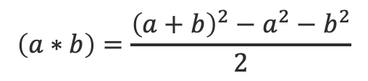
Our technique: Fine-grained Reduction
Example of a reduction
Problem A: Given two inputs ‘a’ and ‘b’ output their product, i.e. a*b
$$\left(a∗b\right)=\frac{{\left(a+b\right)}^{2}−a^{2}−b^{2}}{2}$$
Easy!
Also easy!
Problem B: Given an input ‘a’ output its square, i.e. a*a

Slide 40







Fine-grained reduction
Step 1
Pick a problem A whose hardness you (presumably) know
Step 3
Prove lower bound for B using lower bound of A
Step 2
Reduce problem A to problem B

Slide 41



Fine-grained reduction
Step 1
Pick a problem A whose hardness you (presumably) know
Step 3
Prove lower bound for B using lower bound of A
Step 2
Reduce problem A to problem B

Slide 42
Fine-grained reduction
Step 1
Pick a problem A whose hardness you (presumably) know
Step 3
Conclude lower bound for B using lower bound of A
Step 2
Reduce problem A to problem B

Slide 43
Fine-Grained Complexity Result
Step 1
Pick a problem A whose hardness you (presumably) know
Step 2
Reduce problem A to problem B
Step 3
Conclude lower bound for B using lower bound of A
Problem A = Satisfiability problem
Problem B = Longest Common Subsequence (or the Edit Distance problem)

Slide 44
Satisfiability problem (SAT)
($x_{1}$ or $x_{2}$or.. ${\overline{x}}_{n}$) and ($x_{3}$ or ${\overline{x}}_{5}$or.. $x_{n}$) and..($x_{4}$or $x_{n−3}$or.. ${\overline{x}}_{n}$)
$n$ variables, $m$ clauses
Is there an assignment of $n$ variables that satisfies this formula?
Clause 1
Clause 2
Clause $m$

Slide 45
CNF-SAT problem
($x_{1}$ or $x_{2}$or.. ${\overline{x}}_{n}$) and ($x_{3}$ or ${\overline{x}}_{5}$or.. $x_{n}$) and..($x_{4}$or $x_{n−3}$or.. ${\overline{x}}_{n}$)
$n$ variables, $m$ clauses
Is there an assignment of $n$ variables that satisfies this formula?
Clause 1
Clause 2
Clause $m$

Slide 46
CNF-SAT problem
Current known upper bound is the $2^{n}$ time algorithm that checks satisfiability for each assignment
($x_{1}$ or $x_{2}$or.. ${\overline{x}}_{n}$) and ($x_{3}$ or ${\overline{x}}_{5}$or.. $x_{n}$) and..($x_{4}$or $x_{n−3}$or.. ${\overline{x}}_{n}$)
$n$ variables, $m$ clauses
Is there an assignment of $n$ variables that satisfies this formula?
Huge gap!
Clause 1
Clause 2
Clause $m$
Current known lower bound is $n$

Slide 47
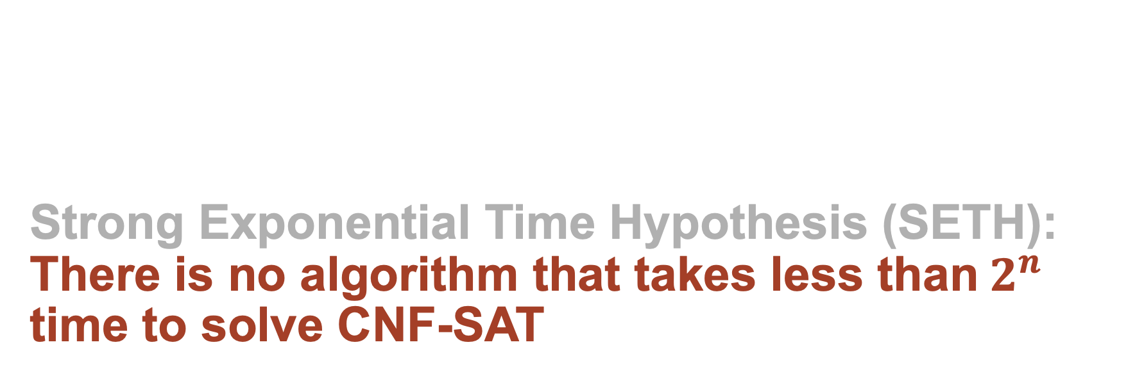
Strong Exponential Time Hypothesis (SETH):
There is no algorithm that takes less than$2^{n}$ time to solve CNF-SAT

Slide 48








Classical Reductions from CNF-SAT
CNF-SAT
Zero-Edge-Weight Triangle Finding Problem
Virginia V. Williams IPEC 2015

Slide 49

Observations
SETH fails in the quantum regime, because using Grover search algorithm one can solve CNF-SAT on a quantum computer in $2^{n/2}$ time, therefore the classical lower bounds cannot be directly used.

Slide 50
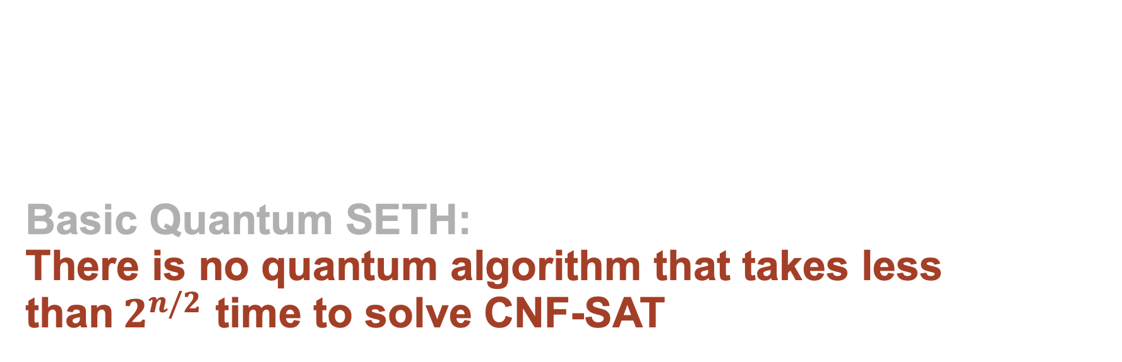
Basic Quantum SETH:
There is no quantum algorithm that takes less than$2^{n/2}$ time to solve CNF-SAT

Slide 51

Observations
SETH fails in the quantum regime, because using Grover search algorithm one can solve CNF-SAT on a quantum computer in $2^{n/2}$ time, therefore the classical lower bounds cannot be directly used.
Using the basic QSETH, the quantum lower bounds achieved for LCS and Edit Distance are linear in $n$.

Slide 52
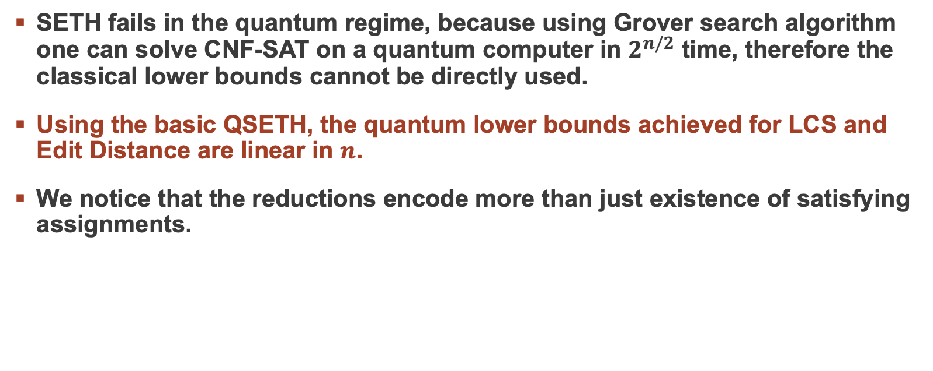
Observations
SETH fails in the quantum regime, because using Grover search algorithm one can solve CNF-SAT on a quantum computer in $2^{n/2}$ time, therefore the classical lower bounds cannot be directly used.
Using the basic QSETH, the quantum lower bounds achieved for LCS and Edit Distance are linear in $n$.
We notice that the reductions encode more than just existence of satisfying assignments.

Slide 53
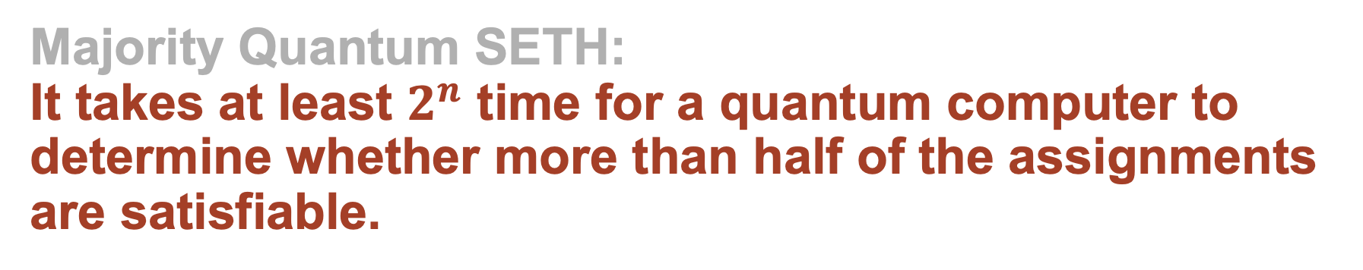
Majority Quantum SETH:
It takes at least $2^{n}$ time for a quantum computer to determine whether more than half of the assignments are satisfiable.

Slide 54
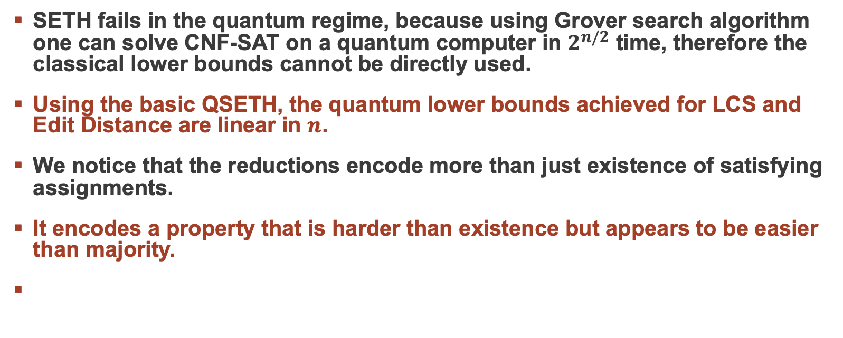
Observations
SETH fails in the quantum regime, because using Grover search algorithm one can solve CNF-SAT on a quantum computer in $2^{n/2}$ time, therefore the classical lower bounds cannot be directly used.
Using the basic QSETH, the quantum lower bounds achieved for LCS and Edit Distance are linear in $n$.
We notice that the reductions encode more than just existence of satisfying assignments.
It encodes a property that is harder than existence but appears to be easier than majority.
We give evidence that this property is hard for quantum computers when compared to searching for a satisfying assignment.

Slide 55
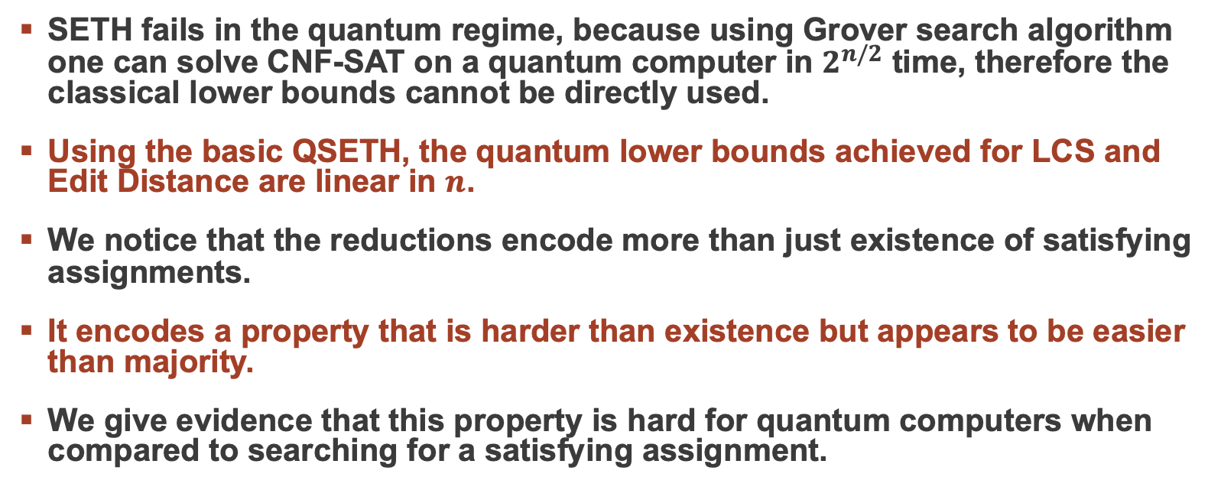
Observations
SETH fails in the quantum regime, because using Grover search algorithm one can solve CNF-SAT on a quantum computer in $2^{n/2}$ time, therefore the classical lower bounds cannot be directly used.
Using the basic QSETH, the quantum lower bounds achieved for LCS and Edit Distance are linear in $n$.
We notice that the reductions encode more than just existence of satisfying assignments.
It encodes a property that is harder than existence but appears to be easier than majority.
We give evidence that this property is hard for quantum computers when compared to searching for a satisfying assignment.

Slide 56





Quantum Reductions from CNF-SAT
$n^{1.5}$ (not optimal)
$n$ (optimal)
CNF-SAT
Zero-Edge-Weight Triangle Finding Problem
Virginia V. Williams IPEC 2015

Slide 57
More Fine-Grained Complexity Results
Step 1
Pick a problem A whose hardness you (presumably) know
Step 2
Reduce problem A to problem B
Step 3
Prove lower bound for B using lower bound of A
Problem A = 3SUM problem
Problem B = Geometry Problems, Finding Zero-edge-weight triangle

Slide 58

3SUM problem
Given a list $S$ of $n$ integers are there $a,b,c∈S$ such that $a+b+c=0$?
For example: This is a list of 6 integers
1
5
-2
4
-5
7

Slide 59

3SUM problem
Given a list $S$ of $n$ integers are there $a,b,c∈S$ such that $a+b+c=0$?
For example: This is a list of 6 integers
Solution(s): {a=1, b=1, c=-2}
1
5
-2
4
-5
7

Slide 60

3SUM problem
Given a list $S$ of $n$ integers are there $a,b,c∈S$ such that $a+b+c=0$?
For example: This is a list of 6 integers
Solution(s): {a=1, b=4, c=-5}
1
5
-2
4
-5
7

Slide 61
Classical algorithm for 3SUM

Slide 62

Classical algorithm for 3SUM
There is a trivial $n^{3}$ algorithm.

Slide 63

Classical algorithm for 3SUM
There is a trivial $n^{3}$ algorithm. There is a slightly less trivial $n^{2}$ algorithm as well.

Slide 64
Classical algorithm for 3SUM
There is a trivial $n^{3}$ algorithm. There is a slightly less trivial $n^{2}$ algorithm as well.
1
5
-2
4
-5
7

Slide 65
Classical algorithm for 3SUM
There is a trivial $n^{3}$ algorithm. There is a slightly less trivial $n^{2}$ algorithm as well.
1
5
-2
4
-5
7
1
5
-2
4
-5
7

Slide 66
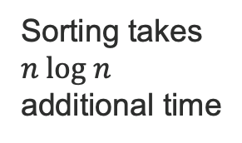
Classical algorithm for 3SUM
There is a trivial $n^{3}$ algorithm. There is a slightly less trivial $n^{2}$ algorithm as well.
1
5
-2
4
-5
7
1
5
-2
4
-5
7
Sorting takes $n log n$ additional time
-5
-2
1
4
5
7

Slide 67
Classical algorithm for 3SUM
There is a trivial $n^{3}$ algorithm. There is a slightly less trivial $n^{2}$ algorithm as well.
1
5
-2
4
-5
7
1
5
-2
4
-5
7
-5
-2
1
4
5
7

Slide 68
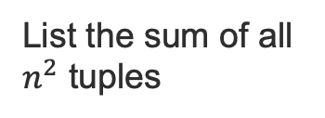
Classical algorithm for 3SUM
There is a trivial $n^{3}$ algorithm. There is a slightly less trivial $n^{2}$ algorithm as well.
1
5
-2
4
-5
7
List the sum of all $n^{2}$ tuples
1
5
-2
4
-5
7
-5
-2
1
4
5
7

Slide 69

Classical algorithm for 3SUM
There is a trivial $n^{3}$ algorithm. There is a slightly less trivial $n^{2}$ algorithm as well.
1
5
-2
4
-5
7
List the sum of all $n^{2}$ tuples
1
5
-2
4
-5
7
Then check if negative of any sum exists in the sorted list in $log n$ time
-5
-2
1
4
5
7

Slide 70
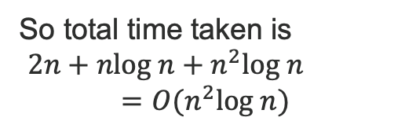
Classical algorithm for 3SUM
There is a trivial $n^{3}$ algorithm. There is a slightly less trivial $n^{2}$ algorithm as well.
1
5
-2
4
-5
7
1
5
-2
4
-5
7
So total time taken is
$2n+nlog n+n^{2}log n$
$$=O(n^{2}log n)$$
-5
-2
1
4
5
7

Slide 71

Quantum algorithm for 3SUM
The classical $n^{2}$ algorithm can be sped up using Grover search algorithm giving an $O\left(nlogn\right)$ quantum algorithm for 3SUM.

Slide 72

Quantum algorithm for 3SUM
The classical $n^{2}$ algorithm can be sped up using Grover search algorithm giving an $O(nlogn)$ quantum algorithm for 3SUM.
-5
-2
1
4
5
7

Slide 73

Quantum algorithm for 3SUM
The classical $n^{2}$ algorithm can be sped up using Grover search algorithm giving an $O(nlogn)$ quantum algorithm for 3SUM.
Sorting takes $n log n$ additional time quantumly as well
-5
-2
1
4
5
7

Slide 74

Quantum algorithm for 3SUM
The classical $n^{2}$ algorithm can be sped up using Grover search algorithm giving an $O(nlogn)$ quantum algorithm for 3SUM.
-5
-2
1
4
5
7
1
5
-2
4
-5
7
Grover’s search over all $n^{2}$ tuples
1
5
-2
4
-5
7

Slide 75
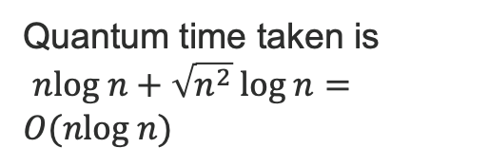
Quantum algorithm for 3SUM
The classical $n^{2}$ algorithm can be sped up using Grover search algorithm giving an $O(nlogn)$ quantum algorithm for 3SUM.
-5
-2
1
4
5
7
1
5
-2
4
-5
7
Quantum time taken is
$nlog n+{\sqrt{n^{2}}}^{ }log n=O(nlog n)$
1
5
-2
4
-5
7

Slide 76
Classical lower bound for 3SUM

Slide 77
Classical lower bound for 3SUM
Classical 3SUM conjecture
3SUM requires $n^{2}$ time on a classical computer.

Slide 78

Quantum lower bounds for 3SUM
Classical 3SUM conjecture
3SUM requires $n^{2}$ time on a classical computer.
Quantum 3SUM conjecture
3SUM requires $n$ time on a quantum computer.

Slide 79


Quantum lower bounds for 3SUM
Classical 3SUM conjecture
3SUM requires $n^{2}$ time on a classical computer.
Quantum 3SUM conjecture
3SUM requires $n$ time on a quantum computer.

Slide 80






Classical Reductions from 3SUM
CNF-SAT
Zero-Edge-Weight Triangle Finding Problem
Virginia V. Williams IPEC 2015

Slide 81

Observations
Most of the reductions from 3SUM problem require ‘sorting’ the input as an intermediate step for which there is no speedup in the quantum setting.
Therefore, these classical reductions fail to directly hold in the quantum setting.
We present reductions from 3SUM to these problems that is inherently quantum and uses the quantum walk algorithm.

Slide 82
Observations
Most of the reductions from 3SUM problem require ‘sorting’ the input as an intermediate step for which there is no speedup in the quantum setting.
Therefore, these classical reductions fail to directly hold in the quantum setting.
We present reductions from 3SUM to these problems that is inherently quantum and uses the quantum walk algorithm.

Slide 83
Observations
Most of the reductions from 3SUM problem require ‘sorting’ the input as an intermediate step for which there is no speedup in the quantum setting.
Therefore, these classical reductions fail to directly hold in the quantum setting.
We present reductions from 3SUM to these problems that are inherently quantum and uses the quantum walk algorithm.

Slide 84





Quantum Reductions from 3SUM
$n$ (optimal)
CNF-SAT
Zero-Edge-Weight Triangle Finding Problem
$n^{1.5}$ (optimal)

Slide 85







Summary of our results
$n^{1.5}$ (not optimal)
$n$ (optimal)
$n$ (optimal)
CNF-SAT
Zero-Edge-Weight Triangle Finding Problem
$n^{1.5}$ (optimal)

Slide 86
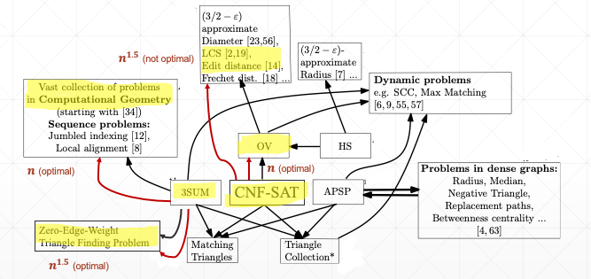
Summary of our results

Slide 87
Summary of our results
Classical complexity uses Strong Exponential-Time Hypothesis (SETH) and Classical-3SUM-Conjecture with fine-grained reductions to obtain precise complexity statements for various computational problems.

Slide 88
Summary of our results
Classical complexity uses Strong Exponential-Time Hypothesis (SETH) and Classical-3SUM-Conjecture with fine-grained reductions to obtain precise complexity statements for various computational problems.
We notice that these conjectures are false in the quantum setting and we introduce quantum analogues namely the QSETH framework and the Quantum-3SUM-Conjecture.

Slide 89
Summary of our results
Classical complexity uses Strong Exponential-Time Hypothesis (SETH) and Classical-3SUM-Conjecture with fine-grained reductions to obtain precise complexity statements for various computational problems.
We notice that these conjectures are false in the quantum setting and we introduce quantum analogues namely the QSETH framework and the Quantum-3SUM-Conjecture.
These quantum conjectures when combined with some fine-grained quantum reductions give us conditional lower bounds for various computational problems

Slide 90
Thank you
Summary of our results
Classical complexity uses Strong Exponential-Time Hypothesis (SETH) and Classical-3SUM-Conjecture with fine-grained reductions to obtain precise complexity statements for various computational problems.
We notice that these conjectures are false in the quantum setting and we introduce quantum analogues namely the QSETH framework and the Quantum-3SUM-Conjecture.
These quantum conjectures when combined with some fine-grained quantum reductions give us conditional lower bounds for various computational problems.

