Slide 1
DP3T – Distributed Privacy Preserving Contact Tracing
https://github.com/DP-3T/documents
Notes:
Different title

Slide 2
Goal: Privacy & Logging Proximity Events
What do we mean by privacy?
Contact Tracing without Tracing App:
Dutch Health Center (GGD) asks infected individuals for when and who they have been in contact with over the last 14 days
Provides a contact history of (time,identity) proximity events of infected individuals
Contacts are notified: A high risk indicates a need for testing
All these contact histories can be combined in order to analyze how the virus propagates, whether additional measures need to be in place, where extra resources are needed, etc.
Healthy individuals remain anonymous to the GGD
Only information about what can be extracted from the combination of contact histories of infected people is revealed (to the GGD / Government)
Can we automate contact tracing by using a Tracing App without leaking more privacy?
Leading to quick notification with small # false positives?
Notes:
Quick Notification / Small # false positives

Slide 3
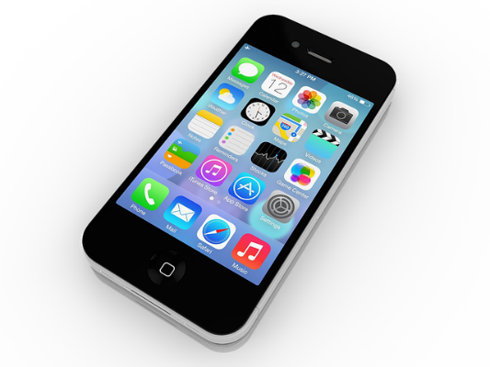
DP3T – Bluetooth Anonymous Exchanges
Device A:
SK_{t-1}
H
Day t:
SK_{t}
EphID₁ EphID₂ … EphID_{n}
H
Bluetooth
SK_{t+1}
(3) Local risk scoring:
Overlap? How much?
Voluntary
Device B:
(1) Adds to Log: EphID₇ EphID₈ … EphID₁₃
t = first day considered contagious
(t, SK_{t})
SK_{t}
…
Broadcast
H
(2) Compute
2nd solution: Cuckoo filter over EphIDs
Etc.
Health Authority Backend
…
SK_{now}

Slide 4
Effectiveness?
Depends on (Voluntary) Adoption
Privacy Preserving
Supported Mobile Platforms
Battery Consumption
Small # False Positives
Enough test capacity?
No unnecessary self quarantine
Quick Notifications
No Denial of Service attacks
App resists hacks

Slide 5
Thank You!

