Slide 1
Discrepancy and Optimization
Nikhil Bansal
(CWI and TU/e)

Slide 2
Discrepancy: What is it?
Study of irregularities in approximating the continuous by the discrete.
Original motivation: Numerical Integration/ Sampling
How well can you approximate a region by discrete points ?

Slide 3
Discrepancy: What is it?
Problem: How uniformly can you distribute n points in a grid.
“Uniform” : For every axis-parallel rectangle R
| (# points in R) - (Area of R) | should be low.
Discrepancy:
Max over rectangles R
|(# points in R) – (Area of R)|
R
n^{1/2}
n^{1/2}

Slide 4
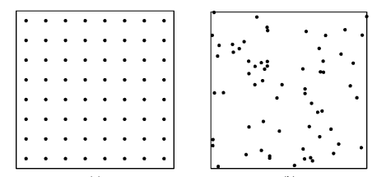
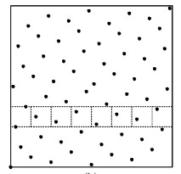
Distributing points in a grid
Problem: How uniformly can you distribute n points in a grid.
“Uniform” : For every axis-parallel rectangle R
| (# points in R) - (Area of R) | should be low.
n= 64
points
Uniform
Random
Van der Corput Set
n^{1/2} discrepancy
n^{1/2} (loglog n)^{1/2}
O(log n) discrepancy!

Slide 5
Quasi-Monte Carlo Methods
n random samples (Monte Carlo) : Error $∝ \frac{1}{\sqrt{n}}$
Quasi-Monte Carlo Methods* : $∝\frac{Disc}{n}$
Extensive research area.
*Different constant
of proportionality

Slide 6
Combinatorial Discrepancy
S₃
Universe: U= [1,…,n]
Subsets: S₁,S₂,…,S_{m}
Color elements red/blue so each
set is colored as evenly as possible.
Given χ: [n] ! { -1,+1}
Disc ($χ$) = max_{S} |∑_{i2S} χ(i)| = max_{S} $\left(S\right)$
Disc (set system) = min$χ$ max_{S} $\left(S\right)$
S₁
S₄
S₂

Slide 7
Tusnady’s problem
Input: n points placed arbitrarily in a grid.
Sets = axis-parallel rectangles
Discrepancy: max over rect. R ( |# red in R - # blue in R| )
Random gives about O(n^{1/2} log^{1/2} n)
Very long line of work
O(lo$g^{4}$ n) [Beck 80’s]
...
O(log^{2.5} n) [Matousek’99]
O($\log^{2}{n}$) [B., Garg’16]
O(log^{1.5} n) [Nikolov’17]

Slide 8
Application: Dynamic Data Structures
N weighted points in a 2-d region.
Weights updated over time.
Query: Given an axis-parallel rectangle R,
determine the total weight on points in R.
Goal: Preprocess (in a data structure)
Low query time
Low update time (upon weight change)

Slide 9
Example
Line: Interval queries
Trivial: Query Time= O(n) Update Time = 1
Query = 1 Update = O($n^{2}$) (Table of entries W[a,b] )
Query = 2 Update = O(n) (W[a,b] = W[0,b] – W[0,a])
Query = O(log n) Update = O(log n)
Recursively for 2-d.
$$O\left(\log^{2}{n},\log^{2}{n}\right)$$

Slide 10
What about other queries?
Circles arbitrary rectangles aligned triangle
Turns out $t_{q}t_{u} ≥\frac{n^{1/2}}{\log^{2}{n}}$
Reason: Set system S formed by query sets & points has large discrepancy (about $n^{1/4}$)
Larsen-Green’11$: t_{q}t_{u}≥\frac{disc{\left(S\right)}^{2}}{\log^{2}{n}}$

Slide 11
Applications
CS: Computational Geometry, Approximation, Complexity, Differential Privacy, Pseudo-Randomness, …
Math: Combinatorics, Finance, Dynamical Systems, Number Theory, Ramsey Theory, Algebra, Measure Theory, …

Slide 12
Matrix View
Rows: sets
Columns: elements
Given any matrix A,
find coloring $x ∈{\left\{−1,1\right\}}^{n},$ to minimize ${\left|Ax\right|}_{∞}$

Slide 13
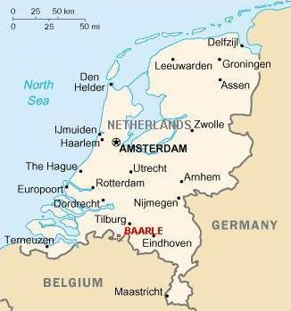
Optimization
Jobs
Machines
Travelling Salesman
Scheduling
Clustering
NP-Hard
Min cx
Ax = b
x $∈${0,1}
Polynomial time
Min cx
Ax = b
x $∈$ [0,1]
relaxation
rounding

Slide 14
Rounding
Lovasz-Spencer-Vesztermgombi’86: Given any matrix A, and $x∈R^{n},$can round x to $\tilde{x}∈Z^{n}$s.t. ${\left|Ax –A\tilde{x}\right|}_{∞}< Herdisc\left(A\right)$
Proof: Round the bits of x one by one.
$x_{1}$: blah .0101101
$x_{2}$: blah .1101010
…
$x_{n}$: blah .0111101
Error = herdisc(A) ( $\frac{1}{2^{k}}+\frac{1}{2^{k−1}} + … +\frac{1}{2}$)
$$\tilde{x}$$
x
Ax=b
(-1)
Key Point: Low discrepancy
coloring guides our updates!
A
(+1)

Slide 15
Rounding: The Catch
LSV’86 result guarantees existence of good rounding.
But, how to find it efficiently (poly time)?
Nothing known until recently.

Slide 16
Questions around Discrepancy bounds
Combinatorial: Show good coloring exists
Algorithmic: Find coloring in poly time
Lower bounds on discrepancy (do not focus here)

Slide 17
Combinatorial (3 generations)
0) Linear Algebra (Iterated Rounding)
[Steinitz, Beck-Fiala, Barany, …]
1) Partial Coloring Method:
Beck/Spencer early 80’s: Probabilistic Method + Pigeonhole
Gluskin’87: Convex Geometric Approach
Very versatile (black-box)
Loss adds over O(log n) iterations
2) Banaszczyk’98: Based on a deep convex geometric result
Produces full coloring directly (also black-box)

Slide 18
Brief History (combinatorial)
Method | Tusnady (rectangles) | Beck-Fiala (low deg. system)
Linear Algebra | $\log^{4}{n}$ | t
Partial Coloring | $$\log^{2.5}{n}$$ [Matousek’99] | t^{1/2} log n
Banaszczyk | $$\log^{1.5}{n}$$ [Nikolov’17] | (t log n)^{1/2} [Banaszczyk’98]
Lower bound | $$\log^{}{n}$$ | t^{1/2}

Slide 19
Algorithmic history
Linear Algebraic Methods: Already algorithmic
Partial Coloring now constructive
Bansal’10: SDP + Random walk
Lovett Meka’12: Random walk + linear algebra
Rothvoss’14: Convex geometric
Many others by now [Harvey, Schwartz, Singh], [Eldan, Singh]
Banaszczyk based approaches:
[B.-Dadush-Garg’16]: ${\left(t\log{n}\right)}^{1/2}$ algorithm for (specific) Beck-Fiala problem
[B.-Garg’17]: A more general framework, e.g. $O\left(\log^{2}{n}\right)$ for Tusnady.
[B. Dadush Garg Nikolov’ 18]: Algorithm for general Banaszczyk.

Slide 20
Several Successes
Meta-Problem: Ideas for discrepancy lead to new rounding techniques for optimization problems
Bin Packing
Combines randomized and iterated rounding [B., Nagarajan’16, …]
(two very powerful but quite orthogonal approaches)
Big Goal:
Currently algorithm design: quite adhoc, problem specific approaches.
Discover general principles that unify + improve existing approaches
4
3
1
2
4
!
2
3
1

Slide 21
Optimization in Practice
Model your program as (mixed) integer program.
Use solver like CPLEX or Gurobi
Various heuristics: Branch & bound, Cutting planes, Preprocessing, …
Big mystery why they work so well (on real world instances)
Could we explain/understand this success theoretically?
Could techniques from discrepancy help in improving heuristics?
Workshop: Discrepancy theory and Integer Prog. (Jun 11-15, CWI)
(more info on Daniel Dadush’s webpage)

Slide 22
Questions!

