Slide 1
Better, Faster, and more Insightful Semi-Automatic Brachytherapy Treatment Planning for Prostate Cancer with Multi-objective Gene-pool Optimal Mixing Evolutionary Algorithms
Peter A.N. Bosman
Centrum Wiskunde & Informatica (CWI)
(Center for Mathematics and Computer Science)
Life Sciences and Health Research Group
Amsterdam, The Netherlands

Slide 2
Radiation Therapy for Cancer
Cancer is a world-wide major health concern

Slide 3
Radiation Therapy for Cancer
Cancer is a world-wide major health concern
More than 1 in 3 people in The Netherlands

Slide 4
Radiation Therapy for Cancer
Cancer is a world-wide major health concern
More than 1 in 3 people in The Netherlands
Incidence expected to rise (70%, next 2 decades)

Slide 5
Radiation Therapy for Cancer
Cancer is a world-wide major health concern
More than 1 in 3 people in The Netherlands
Incidence expected to rise (70%, next 2 decades)
Radiation therapy pillar of modern treatment
Use ionizing radiation to kill cancer cells (tumor)
Impossible to not also hit healthy cells (organs at risk)

Slide 6
Radiation Therapy for Cancer
Cancer is a world-wide major health concern
More than 1 in 3 people in The Netherlands
Incidence expected to rise (70%, next 2 decades)
Radiation therapy pillar of modern treatment
Use ionizing radiation to kill cancer cells (tumor)
Impossible to not also hit healthy cells (organs at risk)
Brachytherapy form of internal radiation therapy
By radiating inside-outward, can potentially achieve
Higher conformality
Higher dose to tumor (region)

Slide 7
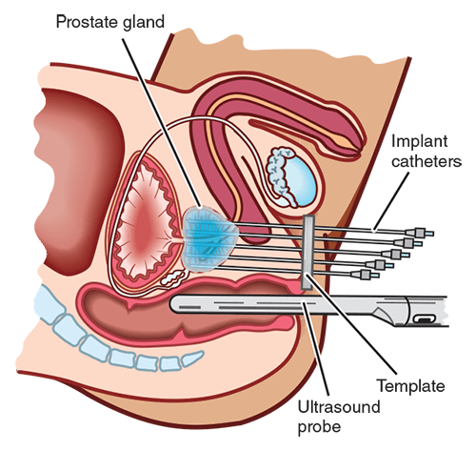
High-Dose-Rate Prostate Brachytherapy

Slide 8
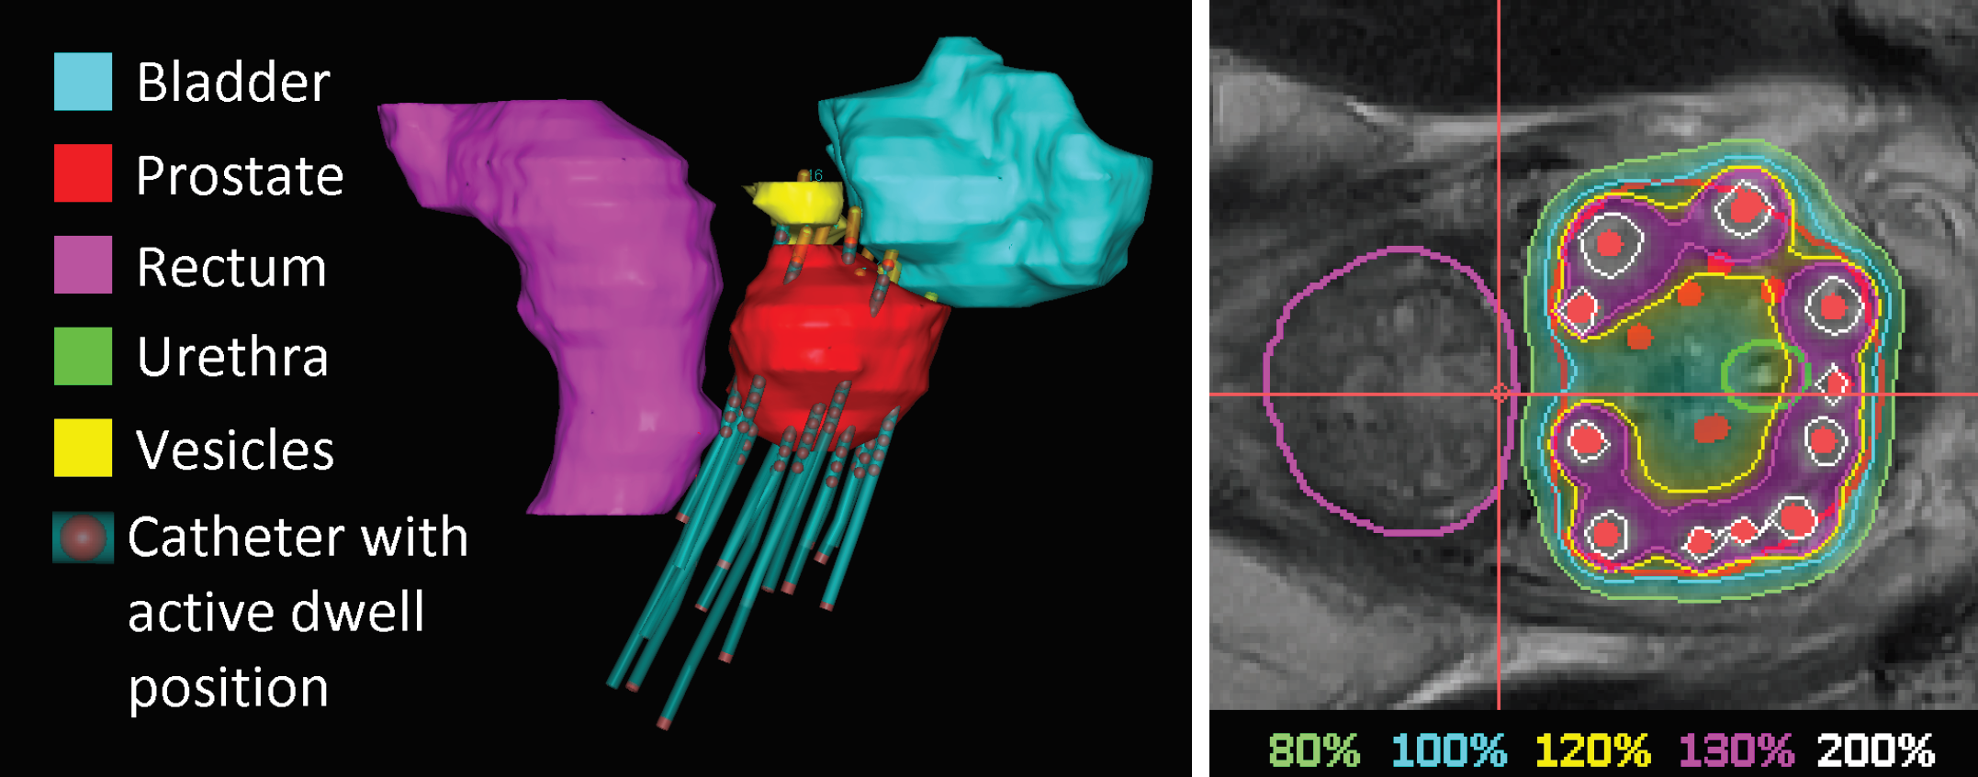
Treatment Planning
Isodose lines in % of planning-aim dose

Slide 9
Clinical Protocol

Slide 10
Clinical Protocol
A (crucial!) note on notation:
Mathematician: hard constraints
Physician: aspirations

Slide 11
Clinical Protocol
A (crucial!) note on notation:
Mathematician: hard constraints
Physician: aspirations
Currently
Plan construction time 30-60 minutes
Partially auto construction, partially manual tuning

Slide 12
Modern RT plan optimization
Modern RT plan optimization uses
convex objectives ≠ evaluation criteria
weighted single-objective scalarizations

Slide 13
Modern RT plan optimization
Modern RT plan optimization uses
convex objectives ≠ evaluation criteria
weighted single-objective scalarizations
Enables high-quality problem solving with .classical mathematical optimization techniques

Slide 14
Modern RT plan optimization
Modern RT plan optimization uses
convex objectives ≠ evaluation criteria
weighted single-objective scalarizations
Enables high-quality problem solving with .classical mathematical optimization techniques
Comes at the cost of loss of intuition of steering to ultimate goal

Slide 15
Toward direct RT plan optimization
From indirect optimization to direct optimization
What you optimize is what you get

Slide 16
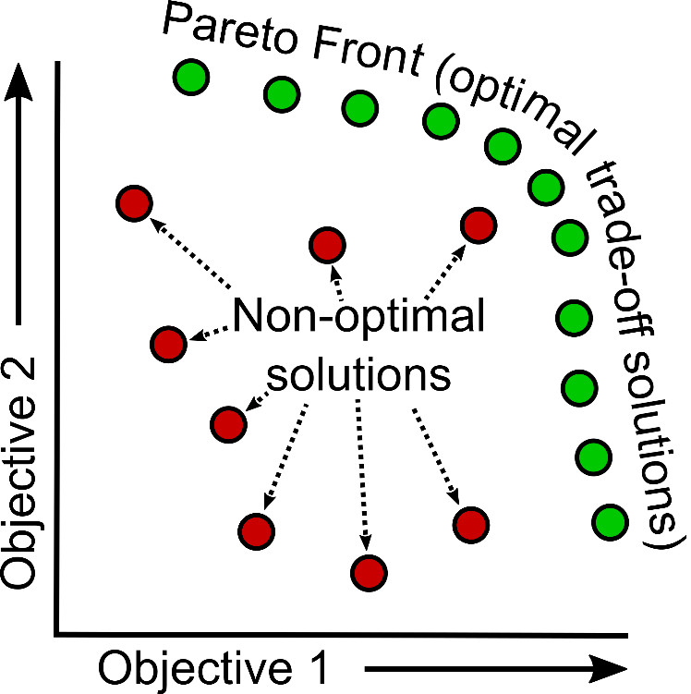
Toward direct RT plan optimization
From indirect optimization to direct optimization
From single-objective to multi-objective optimization
What you optimize is what you get

Slide 17
Toward direct RT plan optimization
Challenges with direct optimization
Non-convex objectives
Non-smooth objectives
More optimization variables

Slide 18
Toward direct RT plan optimization
Challenges with direct optimization
Non-convex objectives
Non-smooth objectives
More optimization variables
Need powerful, scalable non-convex optimization

Slide 19
Toward direct RT plan optimization
Challenges with direct optimization
Non-convex objectives
Non-smooth objectives
More optimization variables
Need powerful, scalable non-convex optimization
Turn to evolutionary algorithms (EAs)

Slide 20
Evolutionary Algorithms: What?
Evolutionary Algorithms (EAs)
Evolution as loose metaphor for designing algorithms

Slide 21
Evolutionary Algorithms: What?
Evolutionary Algorithms (EAs)
Evolution as loose metaphor for designing algorithms
Three main ingredients:
A set/population of (candidate) solutions
Selection (to select better solutions)
Variation (to combine and alter selected solutions)

Slide 22
Evolutionary Algorithms: How?
Generation t
Generation t+1
Solution₀ – Fitness₀
Solution₁ – Fitness₁
Solution₂ – Fitness₂
.
.
.
Solution_{N-1} – Fitness_{N-1}
Solution₀ – Fitness₀
Solution₁ – Fitness₁
Solution₂ – Fitness₂
.
.
.
Solution_{N-1} – Fitness_{N-1}
Sort
Select (e.g. best 50%)
Variation (generate new)
Solution₈ – Fitness₈
Solution₂ – Fitness₂
Solution₅ – Fitness₅
.
.
.
Solution₁ – Fitness₁
Solution₈ – Fitness₈
Solution₂ – Fitness₂
Solution₅ – Fitness₅
.
.
.
.
Solution₈ – Fitness₈
Solution₂ – Fitness₂
Solution₅ – Fitness₅
.
.
.

Slide 23
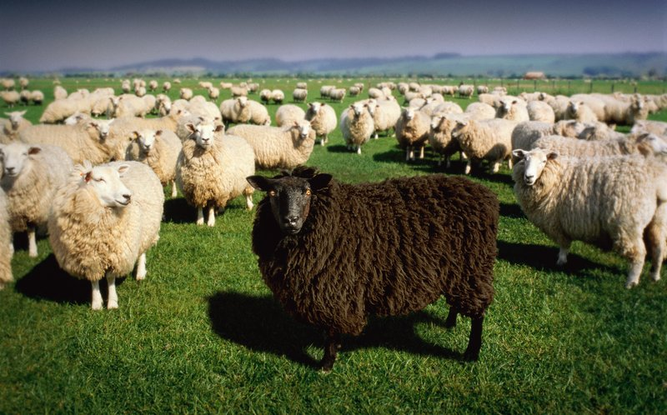
Evolutionary Algorithms: How?
Indeed, much like breeding (sheep)!

Slide 24
Evolutionary Algorithms: Why?
Generalization of any single-solution algorithm

Slide 25
Evolutionary Algorithms: Why?
Generalization of any single-solution algorithm
In addition:
Can exchange information between solutions
Can learn about problem from population

Slide 26
Evolutionary Algorithms: Why?
Generalization of any single-solution algorithm
In addition:
Can exchange information between solutions
Can learn about problem from population
Moreover, more robust against
Noise
Discontinuities
Local optima
Unreliable gradients (e.g. numerical instabilities)
. . .

Slide 27
Multi-objective EAs
EAs really good at solving multi-objective problems

Slide 28
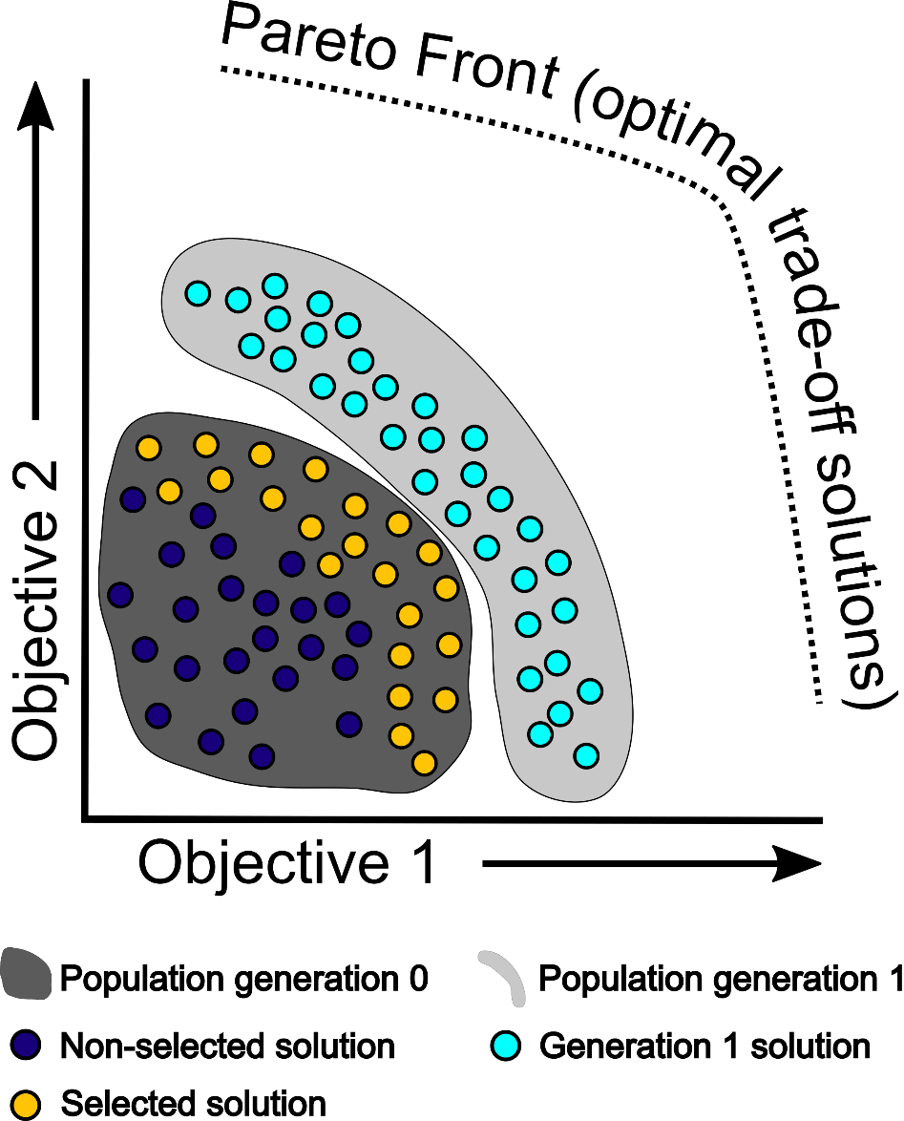
Multi-objective EAs
EAs really good at solving multi-objective problems

Slide 29
Model-based EAs
Model-based EAs
Assumption: problems are somehow structured
Learn and exploit structure (during optimization)
Preferable to enumeration or random sampling

Slide 30
Model-based EAs
Model-based EAs
Assumption: problems are somehow structured
Learn and exploit structure (during optimization)
Preferable to enumeration or random sampling
Specific model-based EA: GOMEA
Gene-pool Optimal Mixing Evolutionary Algorithm
(Thierens and Bosman, Proc. GECCO, 2011)

Slide 31
Model-based EAs
Model-based EAs
Assumption: problems are somehow structured
Learn and exploit structure (during optimization)
Preferable to enumeration or random sampling
Specific model-based EA: GOMEA
Gene-pool Optimal Mixing Evolutionary Algorithm
(Thierens and Bosman, Proc. GECCO, 2011)
GOMEA = EA + LS + ML
Faster and more powerful model building than older EAs
O(ℓ) per evaluation vs O(ℓ²) to O(ℓ³)
(ℓ: number of variables)

Slide 32
The GOMEA Family
Single-objective
Multi-objective
Binary variables
(Thierens and Bosman, Proc. GECCO, 2011)
Categorical integer variables
(Luong, La Poutré and Bosman, Proc. GECCO, 2015)
Permutations
(Bosman, Luong and Thierens, Proc. GECCO, 2016)
Real-valued variables
(Bouter et al., Proc. GECCO, 2017)
Program trees
(Virgolin et al., Proc. GECCO, 2017)
Binary variables
(Luong, La Poutré, Bosman, Proc. GECCO, 2014)
Categorical integer variables
(Luong et al., Proc. IEEE PES GM, 2015)
Real-valued variables
(Bouter et al., Proc. GECCO, 2017)
Many-objective
Real-valued variables
(Luong, Alderliesten, Bosman, Proc. GECCO, 2018)

Slide 33
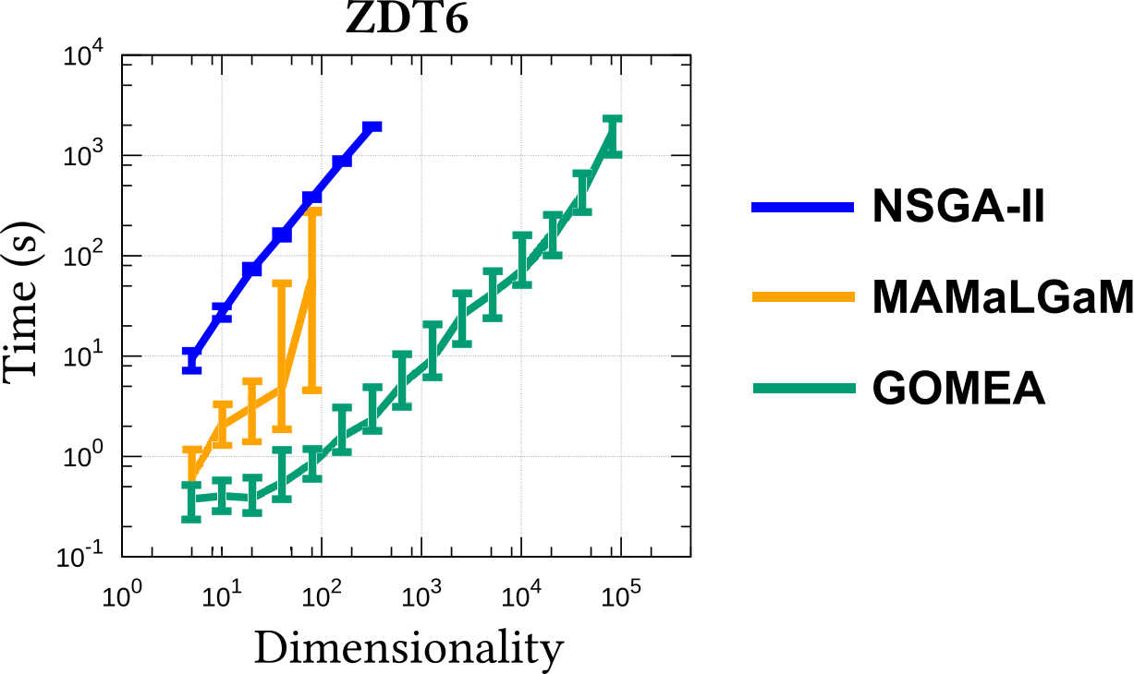
Multi-objective Real-Valued GOMEA
Gene-pool
Optimal
Mixing Evolutionary Algorithm

Slide 34
Real real-world applications
Benchmark problems are nice for comparisons

Slide 35
Real real-world applications
Benchmark problems are nice for comparisons
What about real real-world applications?

Slide 36
Real real-world applications
Benchmark problems are nice for comparisons
What about real real-world applications?
Brachytherapy treatment planning

Slide 37
GOMEA for brachytherapy

Slide 38
GOMEA for brachytherapy
General idea:
Create an intuitive, insightful, think-like-a-planner optimization model

Slide 39
GOMEA for brachytherapy
MAXIMIZE these 2 “worst-case” objectives

Slide 40
GOMEA for brachytherapy
Example:
$V_{100\%}^{prostate}=$98%
$V_{80\%}^{vesicles} =$96%
MAXIMIZE these 2 “worst-case” objectives

Slide 41
GOMEA for brachytherapy
98 – 95 = 3
Example:
$V_{100\%}^{prostate}=$98%
$V_{80\%}^{vesicles} =$96%
MAXIMIZE these 2 “worst-case” objectives

Slide 42
GOMEA for brachytherapy
98 – 95 = 3
96 – 95 = 1
Example:
$V_{100\%}^{prostate}=$98%
$V_{80\%}^{vesicles} =$96%
MAXIMIZE these 2 “worst-case” objectives

Slide 43
GOMEA for brachytherapy
98 – 95 = 3
96 – 95 = 1
Example:
$V_{100\%}^{prostate}=$98%
$V_{80\%}^{vesicles} =$96%
min{3,1} = 1%
MAXIMIZE these 2 “worst-case” objectives

Slide 44
GOMEA for brachytherapy
Non-linear,.non-convex.objectives

Slide 45
GOMEA for brachytherapy
Non-linear,.non-convex.objectives
Optimize directly.with.MO-RV-GOMEA

Slide 46
GOMEA for brachytherapy
0.03 0.53 0.98 1.32 …………………………………. 0.99 1.63 1.98 2.02

Slide 47
GOMEA for brachytherapy
LCI LSI
0.03 0.53 0.98 1.32 …………………………………. 0.99 1.63 1.98 2.02 0.91 1.21

Slide 48
GOMEA for brachytherapy
LCI LSI
0.03 0.53 0.98 1.32 …………………………………. 0.99 1.63 1.98 2.02 0.91 1.21
0.41 0.71 0.18 0.98 …………………………………. 1.05 0.83 2.51 1.14 1.31 0.01
0.18 0.21 1.31 0.54 …………………………………. 3.14 2.21 0.91 1.31 1.41 -0.51
0.62 0.99 0.43 1.42 …………………………………. 1.31 1.03 1.33 1.02 1.11 1.31
1.33 0.21 1.90 0.88 …………………………………. 1.54 0.94 0.91 1.11 0.55 2.01
………………………………….…………………………………………………………………………. .……. ……..

Slide 49
GOMEA for brachytherapy
LCI LSI
0.03 0.53 0.98 1.32 …………………………………. 0.99 1.63 1.98 2.02 0.91 1.21
0.41 0.71 0.18 0.98 …………………………………. 1.05 0.83 2.51 1.14 1.31 0.01
0.18 0.21 1.31 0.54 …………………………………. 3.14 2.21 0.91 1.31 1.41 -0.51
0.62 0.99 0.43 1.42 …………………………………. 1.31 1.03 1.33 1.02 1.11 1.31
1.33 0.21 1.90 0.88 …………………………………. 1.54 0.94 0.91 1.11 0.55 2.01
………………………………….…………………………………………………………………………. .……. ……..

Slide 50
GOMEA for brachytherapy
Figure out dependencies between variables
LCI LSI
0.03 0.53 0.98 1.32 …………………………………. 0.99 1.63 1.98 2.02 0.91 1.21
0.41 0.71 0.18 0.98 …………………………………. 1.05 0.83 2.51 1.14 1.31 0.01
0.18 0.21 1.31 0.54 …………………………………. 3.14 2.21 0.91 1.31 1.41 -0.51
0.62 0.99 0.43 1.42 …………………………………. 1.31 1.03 1.33 1.02 1.11 1.31
1.33 0.21 1.90 0.88 …………………………………. 1.54 0.94 0.91 1.11 0.55 2.01
………………………………….…………………………………………………………………………. .……. ……..

Slide 51
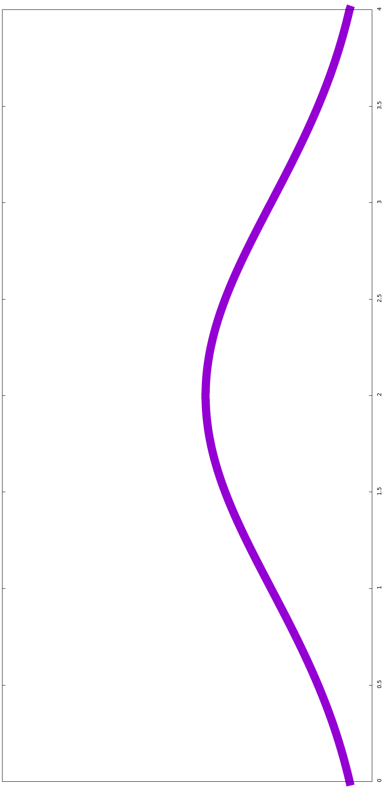
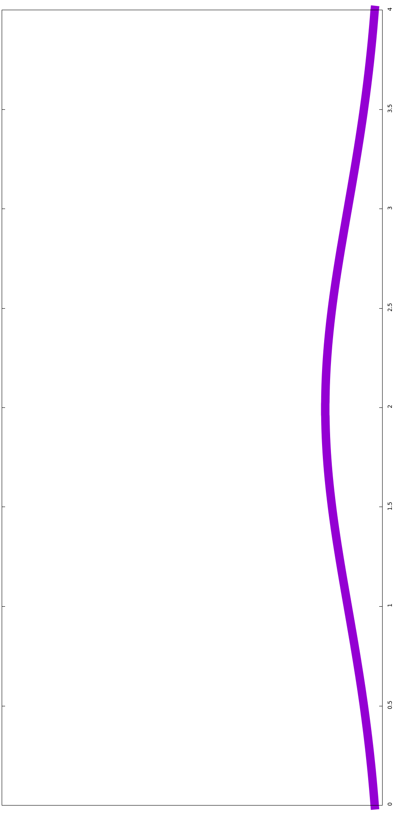
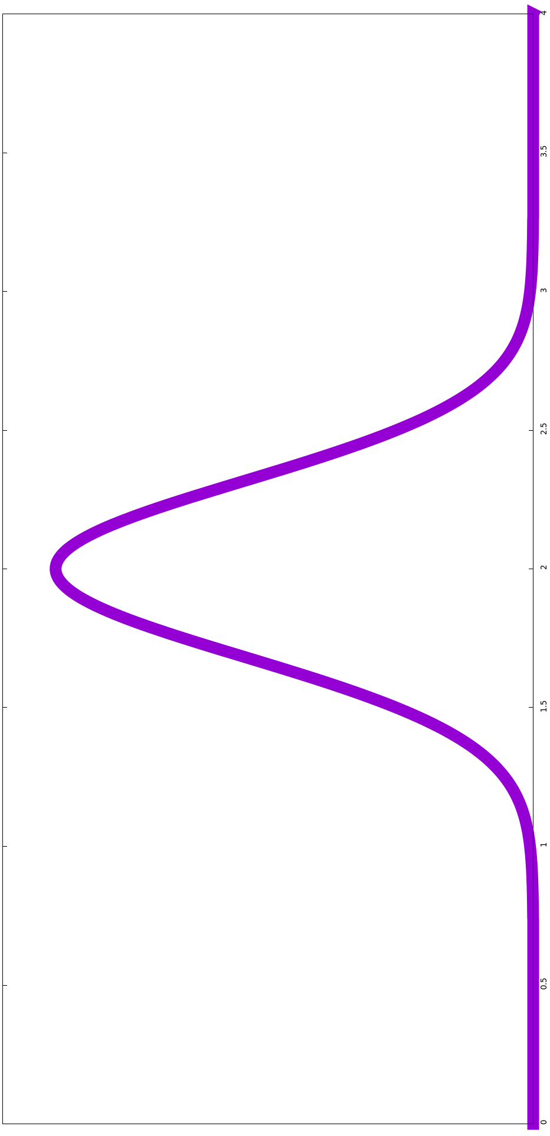
GOMEA for brachytherapy
Figure out dependencies between variables
Estimate and sample from Gaussian distributions
Univariately
LCI LSI
0.03 0.53 0.98 1.32 …………………………………. 0.99 1.63 1.98 2.02 0.91 1.21
0.41 0.71 0.18 0.98 …………………………………. 1.05 0.83 2.51 1.14 1.31 0.01
0.18 0.21 1.31 0.54 …………………………………. 3.14 2.21 0.91 1.31 1.41 -0.51
0.62 0.99 0.43 1.42 …………………………………. 1.31 1.03 1.33 1.02 1.11 1.31
1.33 0.21 1.90 0.88 …………………………………. 1.54 0.94 0.91 1.11 0.55 2.01
………………………………….…………………………………………………………………………. .……. ……..

Slide 52
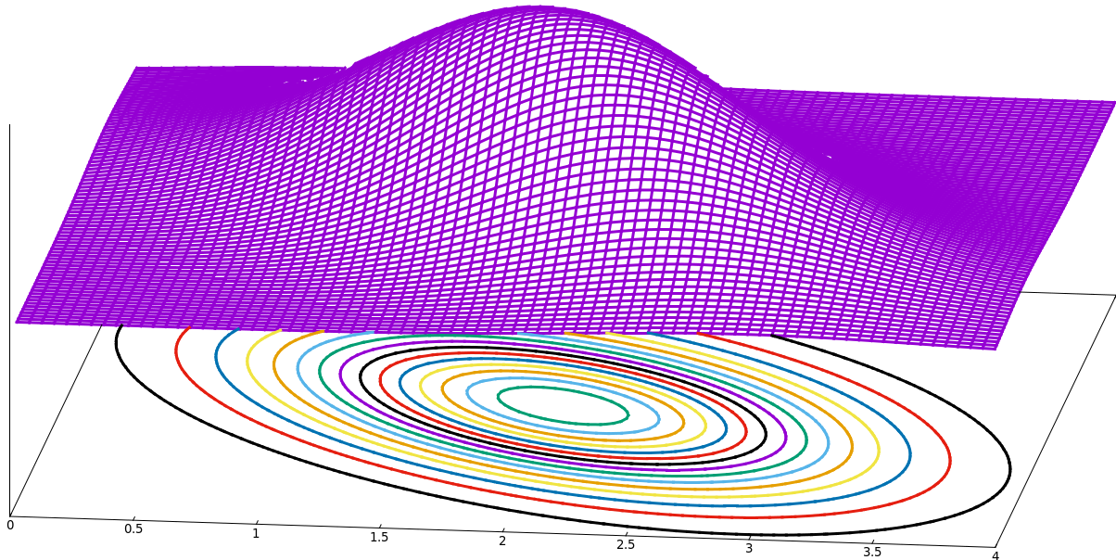
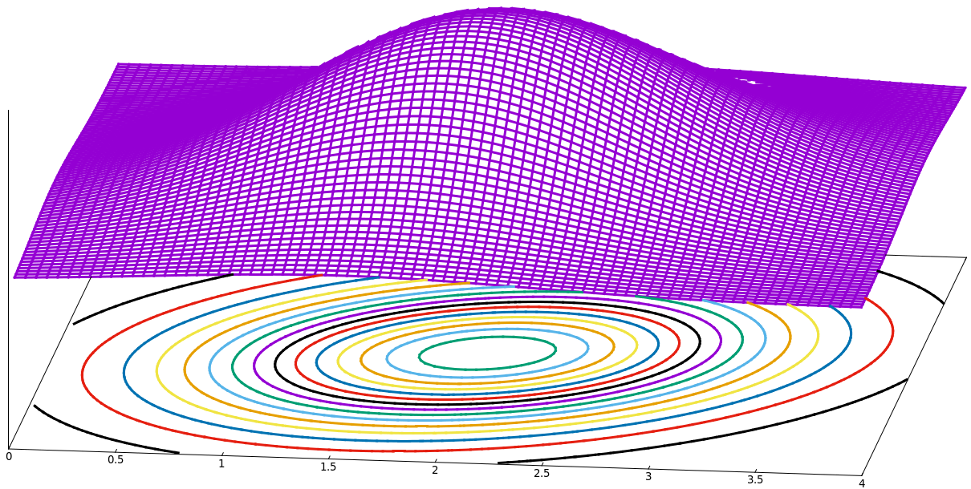
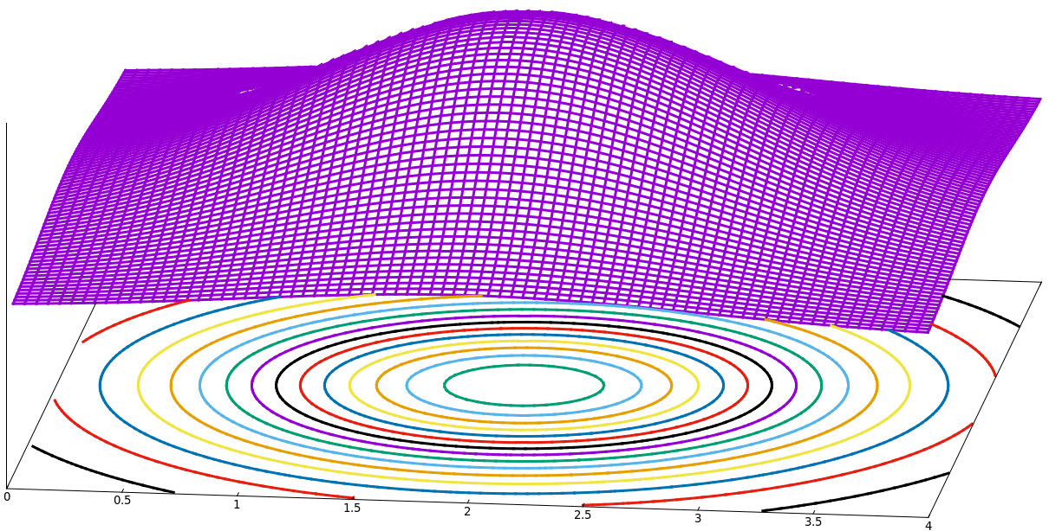
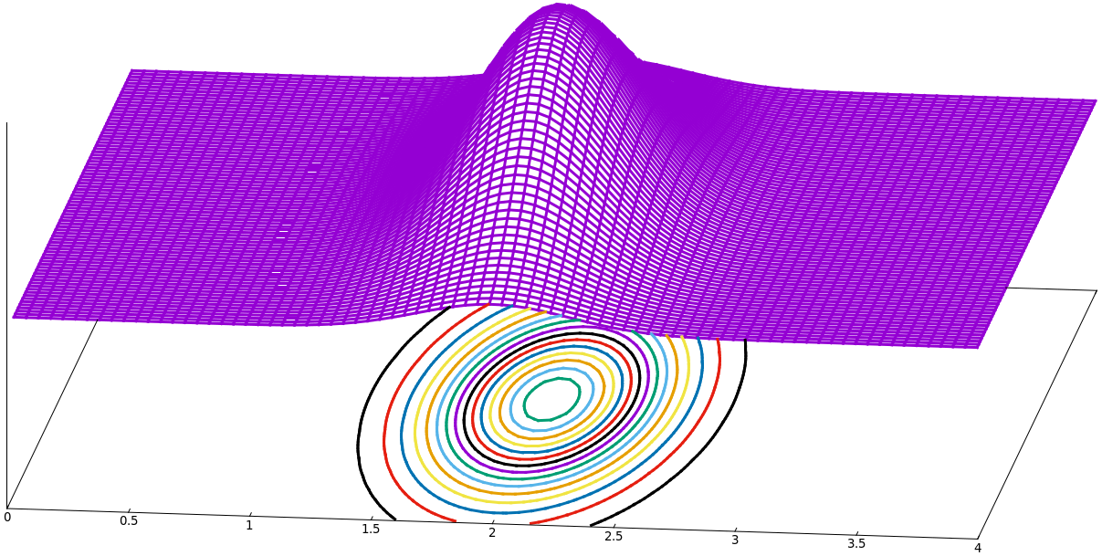
GOMEA for brachytherapy
Figure out dependencies between variables
Estimate and sample from Gaussian distributions
Univariately
Bivariately
LCI LSI
0.03 0.53 0.98 1.32 …………………………………. 0.99 1.63 1.98 2.02 0.91 1.21
0.41 0.71 0.18 0.98 …………………………………. 1.05 0.83 2.51 1.14 1.31 0.01
0.18 0.21 1.31 0.54 …………………………………. 3.14 2.21 0.91 1.31 1.41 -0.51
0.62 0.99 0.43 1.42 …………………………………. 1.31 1.03 1.33 1.02 1.11 1.31
1.33 0.21 1.90 0.88 …………………………………. 1.54 0.94 0.91 1.11 0.55 2.01
………………………………….…………………………………………………………………………. .……. ……..

Slide 53
GOMEA for brachytherapy
Figure out dependencies between variables
Estimate and sample from Gaussian distributions
Univariately
Bivariately
Multivariately
LCI LSI
0.03 0.53 0.98 1.32 …………………………………. 0.99 1.63 1.98 2.02 0.91 1.21
0.41 0.71 0.18 0.98 …………………………………. 1.05 0.83 2.51 1.14 1.31 0.01
0.18 0.21 1.31 0.54 …………………………………. 3.14 2.21 0.91 1.31 1.41 -0.51
0.62 0.99 0.43 1.42 …………………………………. 1.31 1.03 1.33 1.02 1.11 1.31
1.33 0.21 1.90 0.88 …………………………………. 1.54 0.94 0.91 1.11 0.55 2.01
………………………………….…………………………………………………………………………. .……. ……..

Slide 54
GOMEA for brachytherapy
Better & faster than other state-of-the-art EAs
(Luong et al., Swarm and Evolutionary .Computation, 2017)

Slide 55
GOMEA for brachytherapy
Better & faster than other state-of-the-art EAs
(Luong et al., Swarm and Evolutionary .Computation, 2017)
What about clinical quality?
(Maree et al., under review)

Slide 56
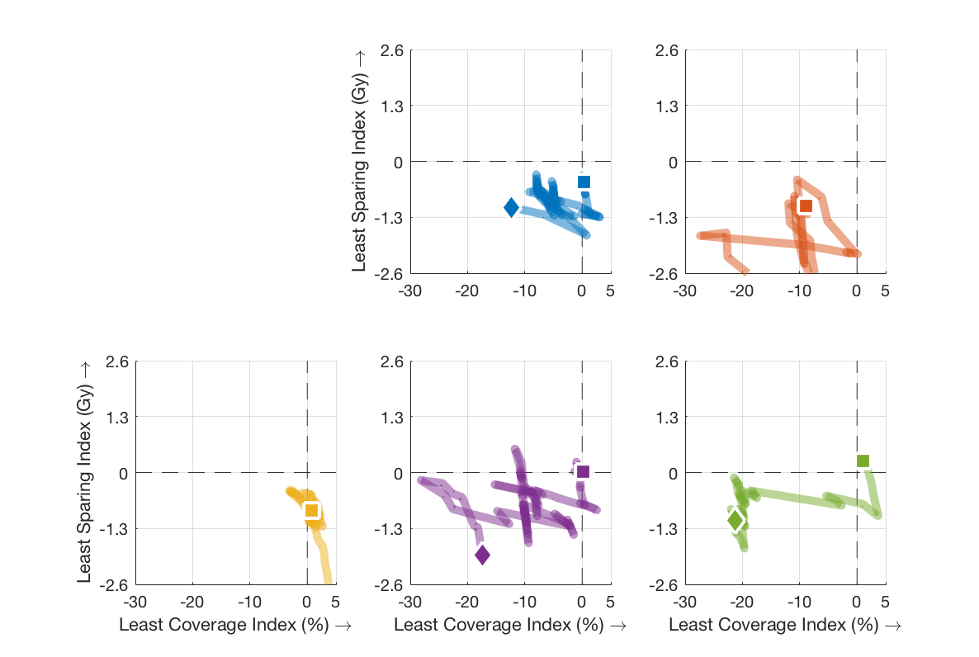
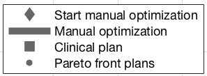
GOMEA for brachytherapy
Least Sparing Index (Gy)
Least Coverage Index (%)

Slide 57
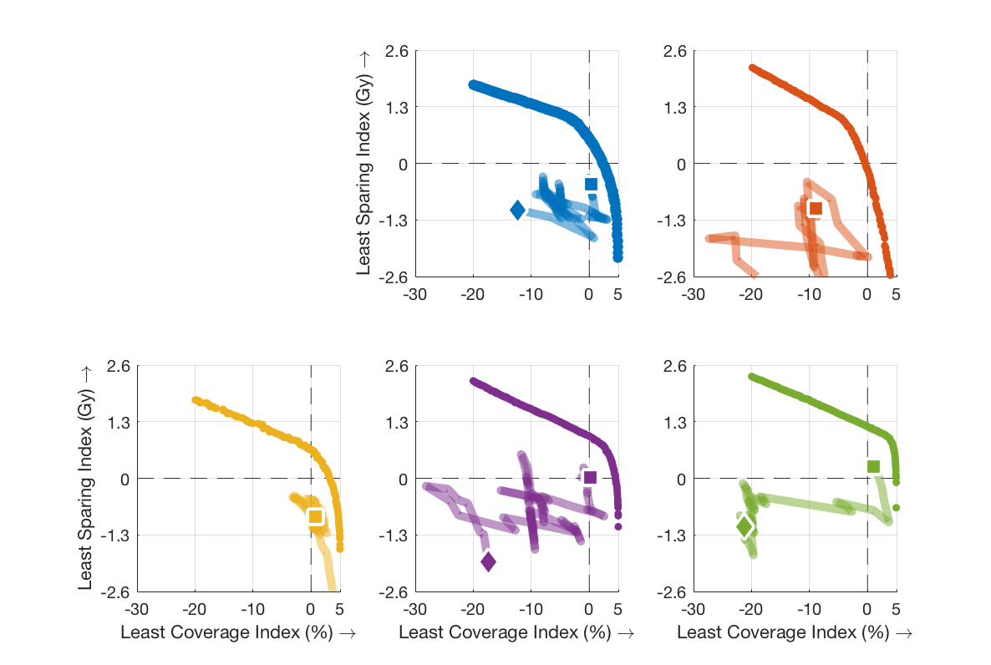
GOMEA for brachytherapy
Least Sparing Index (Gy)
Least Coverage Index (%)

Slide 58
GOMEA for brachytherapy
Blinded observer study at AMC: how often is a GOMEA outcome a preferred treatment plan?
?
Least Sparing Index (Gy)
Least Coverage Index (%)

Slide 59
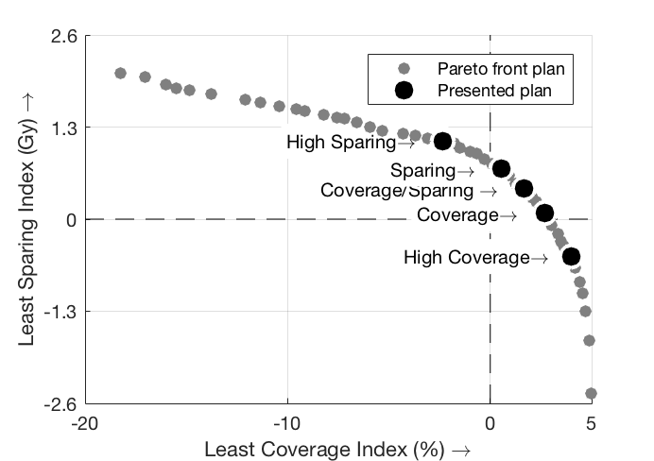
GOMEA for brachytherapy
Blinded observer study at AMC: how often is a GOMEA outcome a preferred treatment plan?
?
Least Sparing Index (Gy)
Least Coverage Index (%)

Slide 60
GOMEA for brachytherapy
Blinded observer study at AMC: how often is a GOMEA outcome a preferred treatment plan?
> 98%
Least Sparing Index (Gy)
Least Coverage Index (%)

Slide 61
GOMEA for brachytherapy - extensions
GPU speedup: from 60 minutes to 30 seconds
(Bouter et al., in preparation)
REAL TIME
10x SPEED

Slide 62
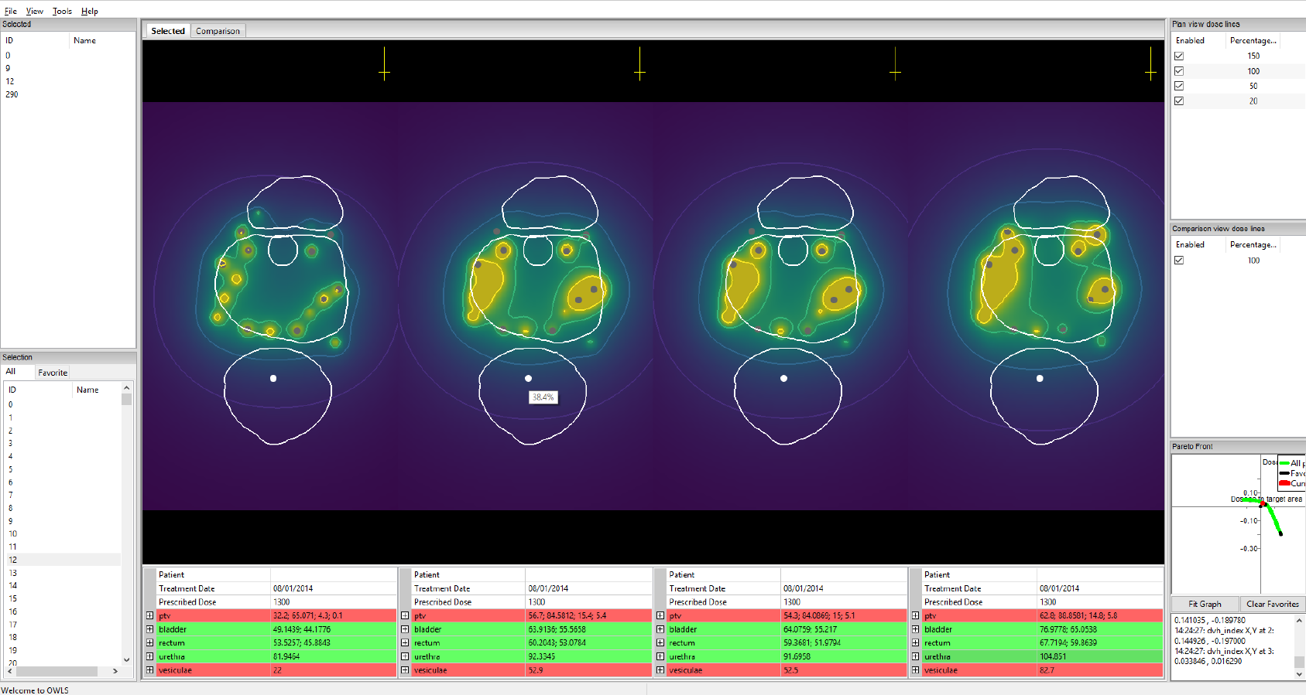
GOMEA for brachytherapy - extensions
Good user interface

Slide 63
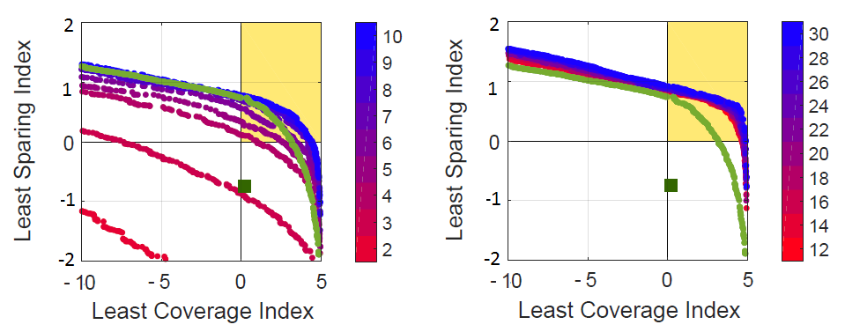
GOMEA for brachytherapy - extensions
Optimize also positions and number of catheters
(van der Meer et al., proc. GECCO, 2018)
There exist treatment plans satisfying all clinical criteria
for 4 catheters.
Clinical treatment plan
Clinical catheters with
dwell time optimization

Slide 64
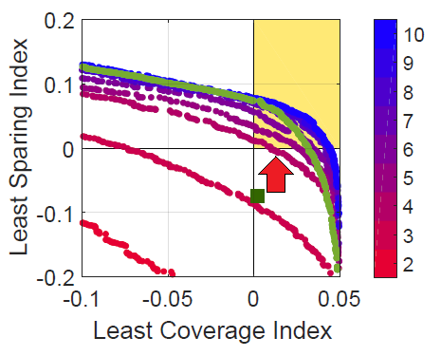
GOMEA for brachytherapy - extensions
Optimize also positions and number of catheters
(van der Meer et al., proc. GECCO, 2018)

Slide 65
Take Home Messages
GOMEA is a versatile, state-of-the-art, family of +(linkage-)model-based evolutionary algorithms

Slide 66
Take Home Messages
GOMEA is a versatile, state-of-the-art, family of +(linkage-)model-based evolutionary algorithms
GOMEA for semi-automated and insightful
brachytherapy treatment planning
is very promising

Slide 67
Thanks
B.Sc./M.Sc. Students, PhD Students, Postdocs
Anton Bouter, Naomi Buntsma, Hoang Luong, Ernst Kooreman, Stef Maree, Marjolein van der Meer, Krzysztof Sadowski, Matthijs Verzijl
Senior Researchers
Tanja Alderliesten, Arjan Bel, Dirk Thierens, Cees Witteveen
Support-, Industry-, Consultant-, Medical Staff
Danique Barten, Karel Hinnen, Rob van der Laarse, Yury Niatsetski, Kees Koedooder, Bradley Pieters, Coen Rasch, Joost Schillings, Bob van Veelen, Henrike Westerveld, Niek van Wieringen
Funding

