Slide 1
Linksight
a TNO MPC spin-off

Slide 2
Create data-driven insights together, without sharing sensitive data.

Slide 3
Governance needed to set conditions for analysis

Slide 4
Combine MPC and blockchain for governance
Blockchain network for governance & auditlog
Smart contract with governance rules
MPC computation servers
B
B
A
A
C
C
Result

Slide 5
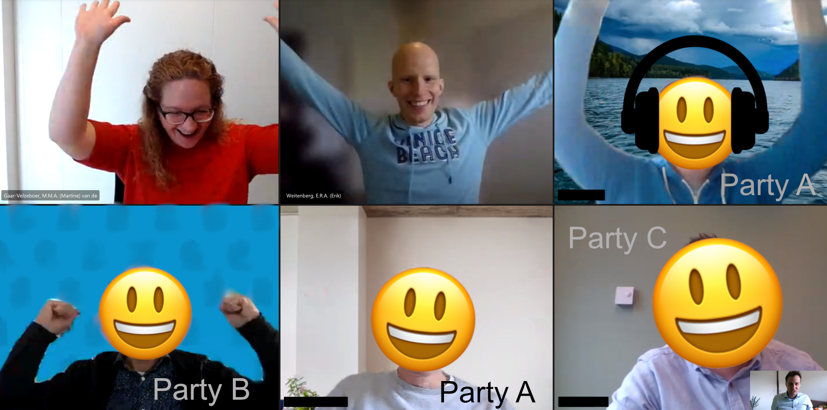
First in NL to apply MPC on real patient data

Slide 6
No real data, no real learning
Legal
Security
Business
Data subjects

Slide 7
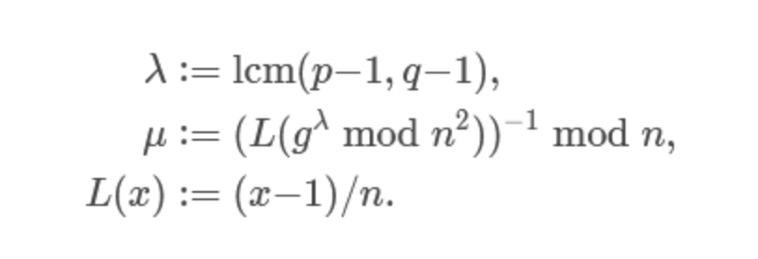
Explain MPC at different levels

Slide 8
Take the next step

Slide 9
Contact
Martine van de Gaar
martine@linksight.nl
0615621883
www.linksight.nl

