Slide 1
Quantum Software Copy Protection
Joint work with:
Anne Broadbent
Sébastien Lord
Supartha Podder
Aarthi Sundaram
Stacey Jeffery
Notes:
15 min. plus questions

Slide 2
Quantum States Can’t be Copied

Slide 3
Uncloneable Authenticity
Quantum Money

Slide 4
Uncloneable Information
Uncloneable Encryption

Slide 5
Uncloneable Functionality
Copy-protected Software

Slide 6
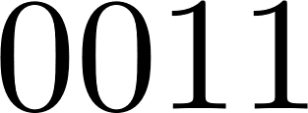
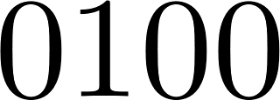
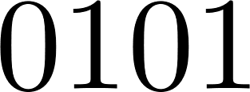
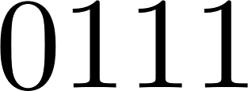
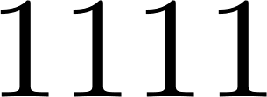
Point Functions

Slide 7
What is copy protection?
$$f_{p}(x)$$
$$x$$
$$f_{p}$$
$\operatorname{Pr}\left[x=p\right]=\frac{1}{2}$
$\operatorname{Pr}\left[x=p′\right]=\frac{1}{2(2^{n}−1)}$
Average Correctness:
Correct with high probability in $x$

Slide 8
What is copy protection?
What is $f_{p}\left(x_{1}\right)$?
0
1
$$f_{p}$$
What is $f_{p}(x_{2})$?

Slide 9
Honest-user Copy Protection
What is $f_{p}\left(x_{1}\right)$?
0
1
$$f_{p}$$
What is $f_{p}(x_{2})$?

Slide 10
Malicious-user Copy Protection
What is $f_{p}\left(x_{1}\right)$?
0
1
$$f_{p}$$
What is $f_{p}(x_{2})$?

Slide 11
Malicious-user Copy Protection
What is $f_{p}\left(x_{1}\right)$?
0
1
$$f_{p}$$
What is $f_{p}(x_{2})$?

Slide 12
Honest-Malicious Copy Protection
What is $f_{p}\left(x_{1}\right)$?
0
1
$$f_{p}$$
What is $f_{p}(x_{2})$?

Slide 13
Secure Software Leasing
You may use my software for one week

Slide 14
Quantum Total Authentication
$$m$$

Slide 15
Quantum Total Authentication
$$m$$
$$\tilde{m}$$
Fake news!

Slide 16
Quantum Total Authentication
$$m$$
$$m$$

Slide 17
Quantum Total Authentication
$$m$$
nothing to do with $m$

Slide 18
Summary of Results
Honest-Malicious,
Avg Correct
Copy-protected Point Functions
Secure
Software
Leasing of
Point
Functions
Quantum Total Authentication
Thanks again to my co-authors:
Anne Broadbent
Sébastien Lord
Supartha Podder
Aarthi Sundaram
Malicious-Malicious,
Avg Correct
Copy-protected Point Functions
Malicious-Malicious,
Fully Correct
Copy-protected Point Functions
???
???

