Slide 1
Toward Evolutionary Intelligence
Prof.dr. Peter A.N. Bosman
Life Sciences and Health research group @ CWI
Notes:
Mijnheer de Rector Magnificus,
leden van het College van Bestuur,
collegae hoogleraren en andere leden van de universitaire gemeenschap.
Zeer gewaardeerde toehoorders.
Dames en Heren,
Vanwege de internationale samenstelling van de aanwezigen hier vandaag en vanwege het feit dat deze rede ook later nog te zien zal zijn voor een wereldwijd publiek via internet, zal ik mijn rede verder in het Engels houden, waarvoor ik hoop op uw begrip.
If all went well, then a few minutes before I entered the room, there was a Star Wars crawl on this screen that teaser trailed my speech. As some of you already knew, and I guess all of you now understand, I'm quite the Star Wars fan, and a science fiction fan in general.
However, we are gathered here today for a serious academic, scientific event that has nothing to do with the wonders and excitement of science fiction. Rather, it is all about science fact. And those two are not the same, or are they?

Slide 2
What is Evolutionary Intelligence?
Artificial Intelligence (AI) that employs Evolutionary Algorithms (EAs)
Where AI $≈$ algorithms that exhibit intelligent behavior
Often with nature-inspired paradigm
For, if nature is considered to be intelligent, …
Paradigm underlying EAs: natural evolution
How does natural evolution establish complex lifeforms?
Notes:
With the benefits of a lean model-based approach becoming very clear, we started to extend the family. In the last few years, we extended the family to different types of variables as well as for multi-objective optimization problems, all the while showing similar superior scalability to other approaches, ultimately leading also the graph on the left hand side that I started my speech with.

Slide 3
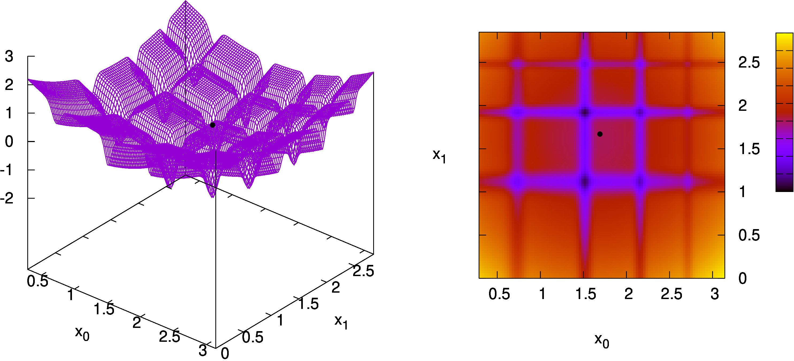
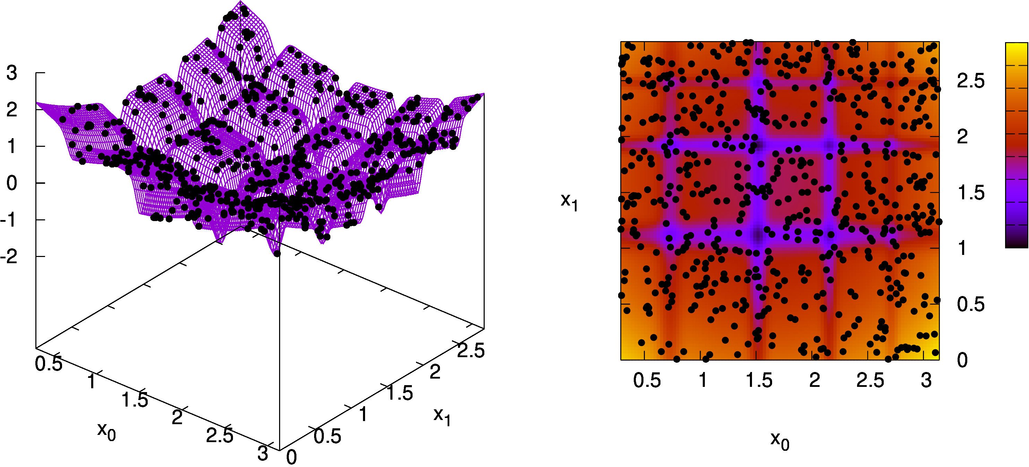
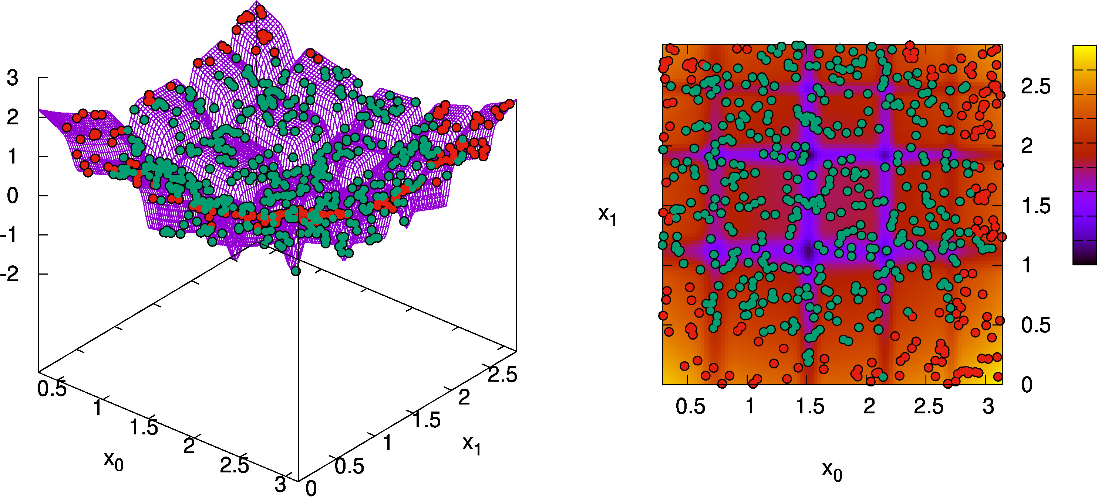
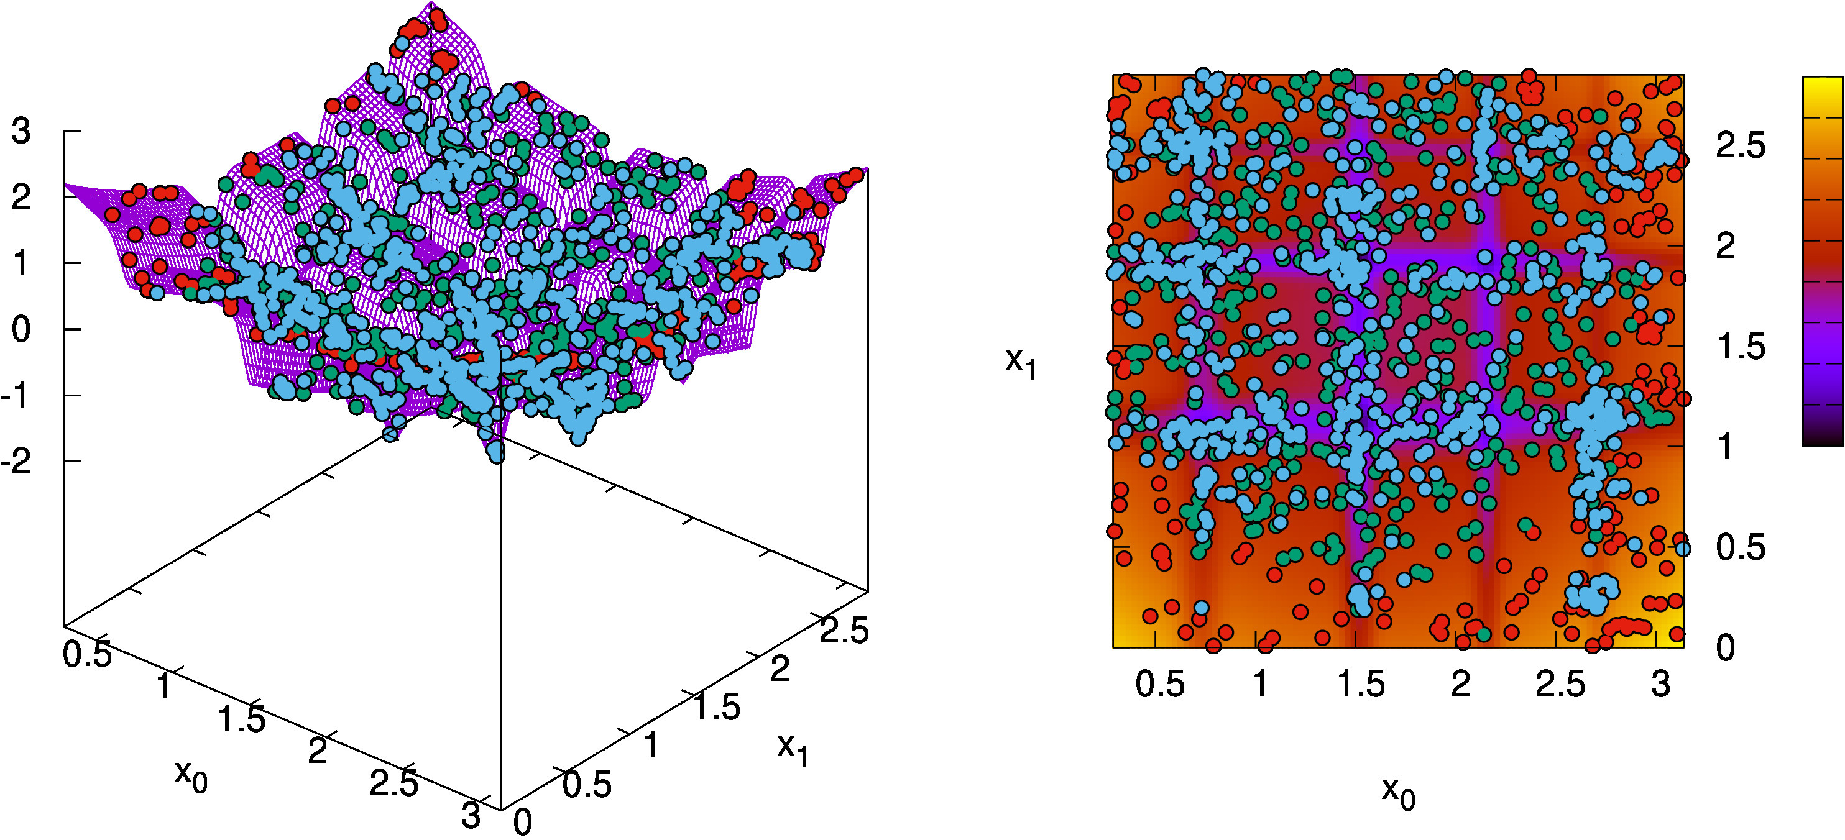
How do EAs Work?
EAs have 3 main ingredients:
1. Population
2. Selection
3. Variation
Repeat!
Notes:
What then are these evolutionary algorithms?
To me, they are a form of search, which is often formulated as an optimization task.
For that, consider having to real-valued variables x0 and x1 and a response curve, as you can see on the left-hand side, that gives you a value for combination of values for x0 and x1. The task now is to find the lowest point in this landscape. On the right-hand side, you see a heatmap where yellow indicates the worst possible values and deep purple indicates good values.
A typical point-based search algorithm now uses a single search point and moves that point around to find the nearest local optimum. An evolutionary algorithm instead is based on three main ingredients. First, it uses a population of search points rather than a single point. Second, it uses selection to select the better points in the population and discard the rest, representing the effect of survival of the fittest as observed in nature. Third, it uses variation to make combinations of the selected solutions to inherit important traits of better solutions, thereby passing on the things that make them good to the next generation.
Finally, we repeat this cycle. This results then in a search behavior like so. You can see that in this case, over time, the evolution finds all 12 local optima in this search space in one run, including the lowest point in the landscape.

Slide 4
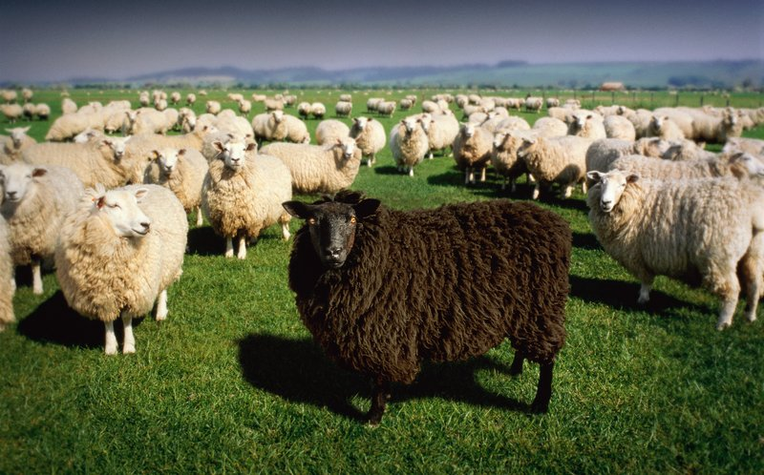
What are EAs?
Indeed, much like breeding sheep!
Notes:
With the benefits of a lean model-based approach becoming very clear, we started to extend the family. In the last few years, we extended the family to different types of variables as well as for multi-objective optimization problems, all the while showing similar superior scalability to other approaches, ultimately leading also the graph on the left hand side that I started my speech with.

Slide 5
EAs, why?
More robust against
Noise
Numerical instabilities
Discontinuities
Local optima
…
Notes:
So, we can simulate a simple version of evolution on a computer. That is great, but why should we care?
Well, if all optimization problems in the world would look like this, a simple hill with only one clearly defined peak, we could use various kinds of single-point optimization algorithms and always efficiently find the optimum.
However, real-world problems tend to be far more complex, exhibiting things like noise, numerical instabilities, discontinuities and local optima. Evolutionary algorithms, by virtue of using a population, are typically far more robust against such problem characteristics. Ultimately, it is these kinds of problems that I want to solve.

Slide 6
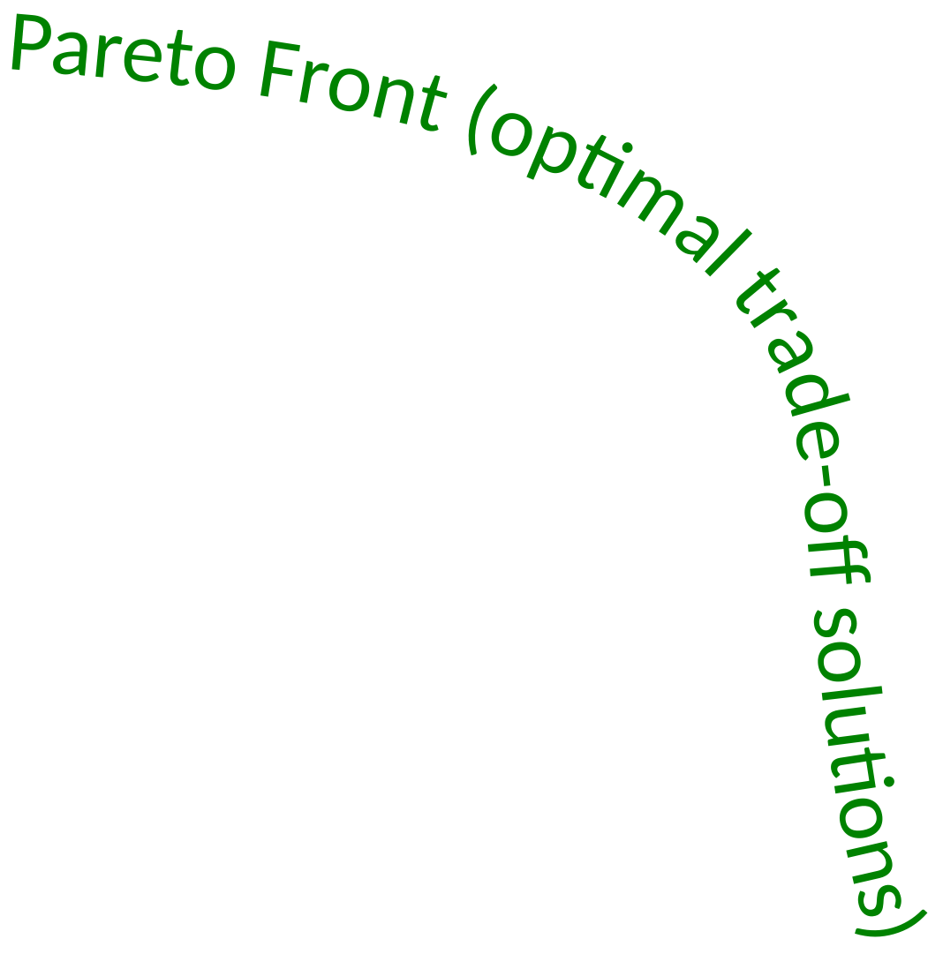
EAs, why?
State-of-the-art for multi-objective problems
Objective 1
Non-optimal
solutions
Objective 2
Notes:
Another reason why I like evolutionary algorithms is that they are state-of-the-art for multi-objective optimization.
Everyone intuitively knows what a multi-objective optimization problem is, as we all buy new products from time to time, like a mobile phone. There are those products that cost very little, but also have very low quality. Then there are those products that cost very much but are also of very high quality. There are also solutions that sit somewhere in the middle. But the kind of solutions that we want to stay away from, are those that are of less quality and at the same time more expensive.
The optimum of such a problem is a set of solutions, the so-called Pareto front. Ultimately, it is really these solutions that we are interested in. As evolutionary algorithms already use a set of solutions, they can spread their search bias to find effectively and efficiently such a Pareto front in a single optimization run. This provides unique insight into a problem because it tells us first what our best options are, before we must ultimately make a choice what to go with.

Slide 7
EA Design Philosophy
Effective evolution is all about patterns
Notes:
Before I can tell you all about what we can do with these algorithms, I perhaps need to explain the title of my inaugural speech a bit better, starting with: what is Evolutionary Intelligence?
My definition is: Artificial Intelligence (AI) that employs Evolutionary Algorithms (EAs).
Of course, a definition like that really needs further explanation, as it may be unclear to you what these terms AI and EA are exactly.

Slide 8
EA Design Philosophy
Model-based Evolutionary Algorithms
Dedicated research line @CWI
Leading technology: GOMEA - Gene-pool
Optimal
Mixing
Evolutionary
Algorithm
Notes:
Before I can tell you all about what we can do with these algorithms, I perhaps need to explain the title of my inaugural speech a bit better, starting with: what is Evolutionary Intelligence?
My definition is: Artificial Intelligence (AI) that employs Evolutionary Algorithms (EAs).
Of course, a definition like that really needs further explanation, as it may be unclear to you what these terms AI and EA are exactly.

Slide 9
GOMEA Family
GOMEA is a fast-growing algorithm family
Different problem variable types
Modern CPU and GPU parallelization
Problem-knowledge-specific accelerations
Can tackle vastly larger problems than with classic EAs, better and faster
Opens the door to new possibilities!
Notes:
Before I can tell you all about what we can do with these algorithms, I perhaps need to explain the title of my inaugural speech a bit better, starting with: what is Evolutionary Intelligence?
My definition is: Artificial Intelligence (AI) that employs Evolutionary Algorithms (EAs).
Of course, a definition like that really needs further explanation, as it may be unclear to you what these terms AI and EA are exactly.

Slide 10
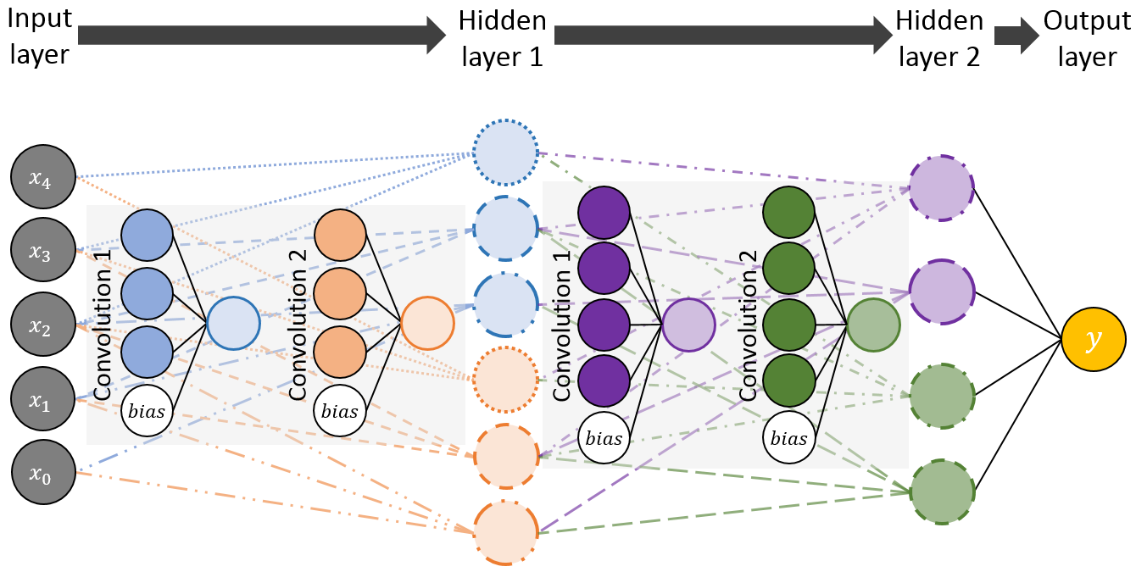
Neuro-GOMMING
Neuro-evolution evolves (deep) neural networks
There is exploitable structure!
Evolvable connections
→ GOMEA for DAGs
(Orphanou et al., Proc.
GECCO 2018
[nominated best paper])
Evolvable small “cells”
→ GP-GOMEA

Slide 11
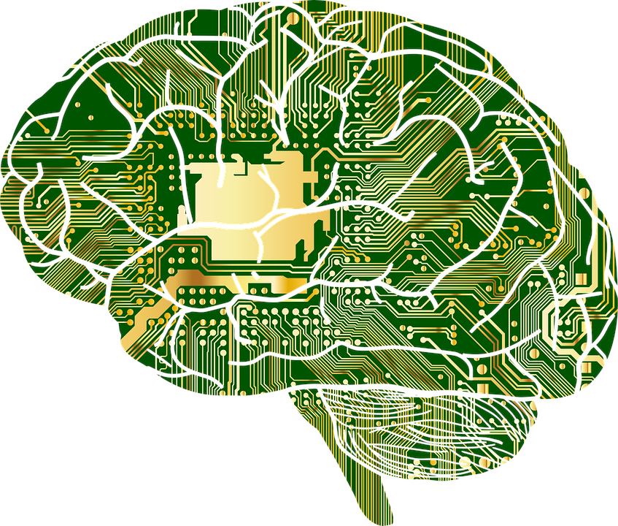
Toward Evolutionary Intelligence
Build better EAs through learning
Build better learners through evolution
Synergetic gears of AI innovation!

Slide 12
What is it all good for?
Many EA projects @CWI in the past, present, and future
Some with demonstrable societal impact

Slide 13
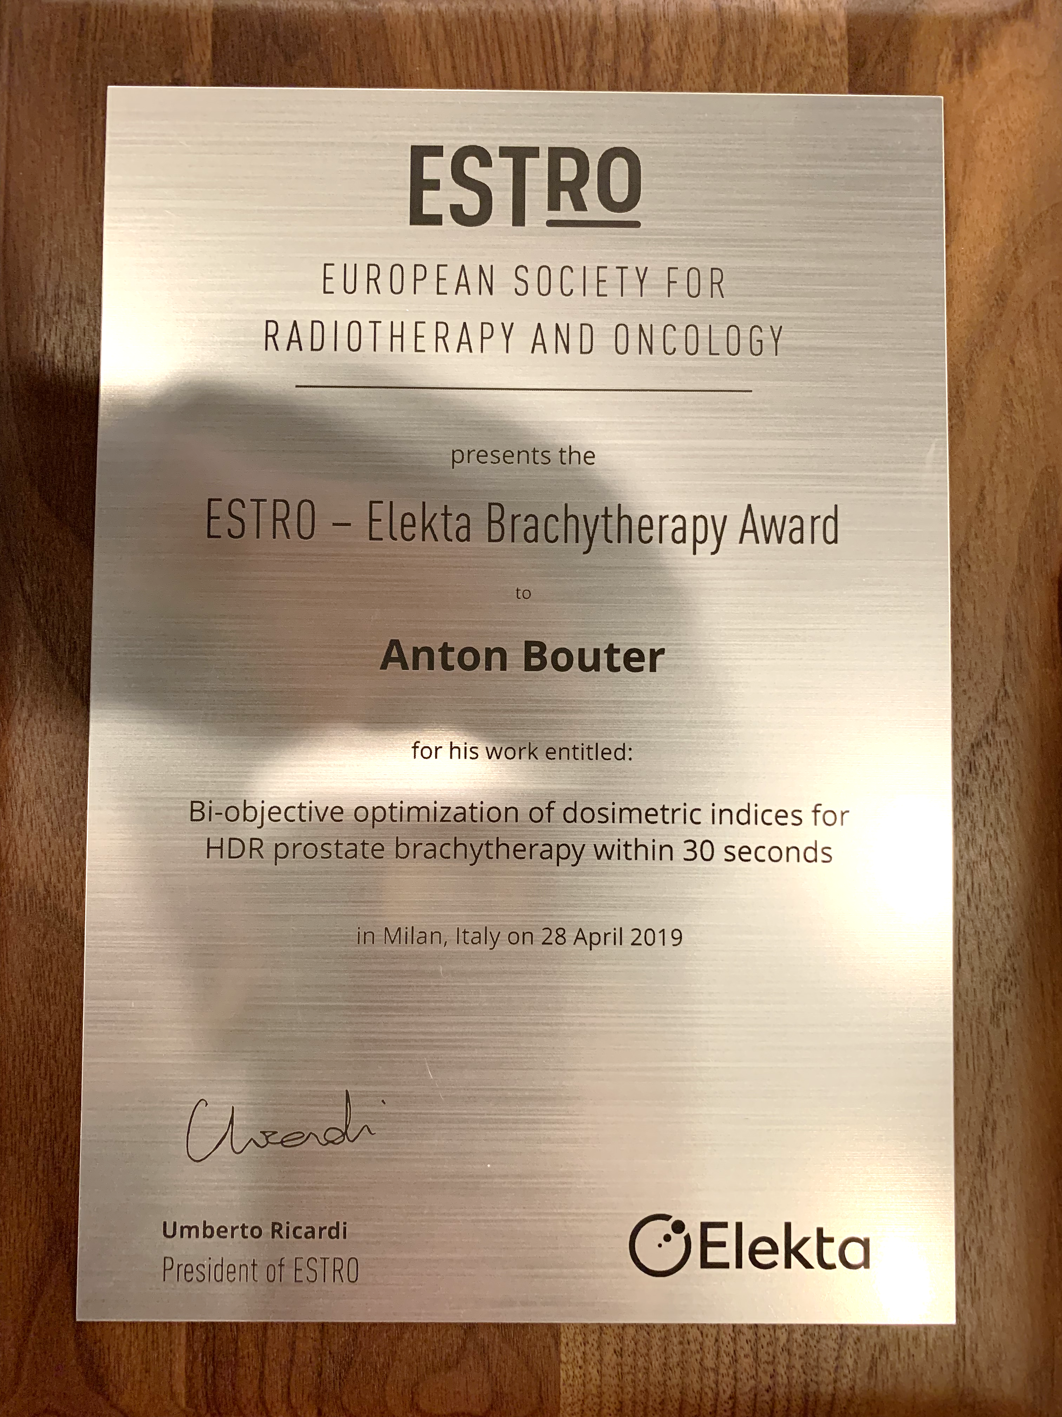
Use-case: Prostate Brachytherapy
Multi-award-winning “real real-world” application
Notes:
With the benefits of a lean model-based approach becoming very clear, we started to extend the family. In the last few years, we extended the family to different types of variables as well as for multi-objective optimization problems, all the while showing similar superior scalability to other approaches, ultimately leading also the graph on the left hand side that I started my speech with.

Slide 14
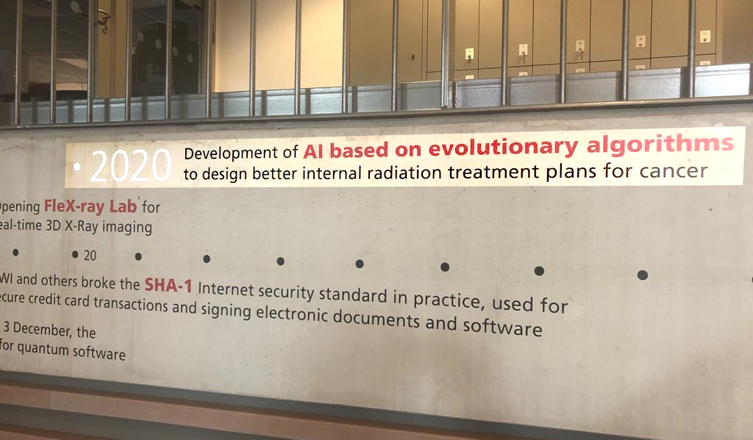
Use-case: Prostate Brachytherapy
Added to CWI “Hall of fame”
Notes:
With the benefits of a lean model-based approach becoming very clear, we started to extend the family. In the last few years, we extended the family to different types of variables as well as for multi-objective optimization problems, all the while showing similar superior scalability to other approaches, ultimately leading also the graph on the left hand side that I started my speech with.

Slide 15
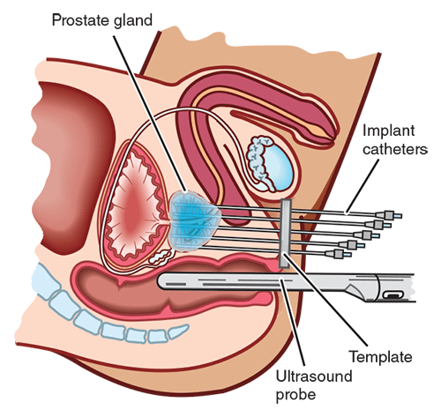
Use-case: Prostate Brachytherapy
Prostate Cancer Foundation of Australia
Notes:
With the benefits of a lean model-based approach becoming very clear, we started to extend the family. In the last few years, we extended the family to different types of variables as well as for multi-objective optimization problems, all the while showing similar superior scalability to other approaches, ultimately leading also the graph on the left hand side that I started my speech with.

Slide 16
Use-case: Prostate Brachytherapy
Current software manual-labor intensive
Unintuitive and results in one treatment plan
Trade-off nature of problem hidden
Reformulated optimization problem
Virtually no manual labor
Intuitive outcomes
Notes:
Before I can tell you all about what we can do with these algorithms, I perhaps need to explain the title of my inaugural speech a bit better, starting with: what is Evolutionary Intelligence?
My definition is: Artificial Intelligence (AI) that employs Evolutionary Algorithms (EAs).
Of course, a definition like that really needs further explanation, as it may be unclear to you what these terms AI and EA are exactly.

Slide 17
Use-case: Prostate Brachytherapy
But… optimization model is not “nice”
Non-convex
Non-linear
Non-smooth
Multi-objective
Solving to optimality can take days
Planning to be done in < 1 hour
Enter multi-objective real-valued GOMEA
Notes:
Before I can tell you all about what we can do with these algorithms, I perhaps need to explain the title of my inaugural speech a bit better, starting with: what is Evolutionary Intelligence?
My definition is: Artificial Intelligence (AI) that employs Evolutionary Algorithms (EAs).
Of course, a definition like that really needs further explanation, as it may be unclear to you what these terms AI and EA are exactly.

Slide 18
Use-case: Prostate Brachytherapy
GOMEA in action (high-precision mode; GPU)
Real-Time
10x Speed
Notes:
Before I can tell you all about what we can do with these algorithms, I perhaps need to explain the title of my inaugural speech a bit better, starting with: what is Evolutionary Intelligence?
My definition is: Artificial Intelligence (AI) that employs Evolutionary Algorithms (EAs).
Of course, a definition like that really needs further explanation, as it may be unclear to you what these terms AI and EA are exactly.

Slide 19
Use-case: Prostate Brachytherapy
Resulting plans almost always considered clinically more desirable (>98%, retrospective)
March 17, 2020, AUMC starts clinically using BRIGHT - BRachytherapy via Artificially Intelligent GOMEA- Heuristic based Treatment planning
Notes:
Before I can tell you all about what we can do with these algorithms, I perhaps need to explain the title of my inaugural speech a bit better, starting with: what is Evolutionary Intelligence?
My definition is: Artificial Intelligence (AI) that employs Evolutionary Algorithms (EAs).
Of course, a definition like that really needs further explanation, as it may be unclear to you what these terms AI and EA are exactly.

Slide 20
Use-case: Prostate Brachytherapy
Continue in new KWF-funded project
Expand to include cervical cancer
Perform nation-wide validation study
And there is still so much more (to come)…
Notes:
Before I can tell you all about what we can do with these algorithms, I perhaps need to explain the title of my inaugural speech a bit better, starting with: what is Evolutionary Intelligence?
My definition is: Artificial Intelligence (AI) that employs Evolutionary Algorithms (EAs).
Of course, a definition like that really needs further explanation, as it may be unclear to you what these terms AI and EA are exactly.

Slide 21
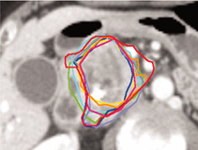
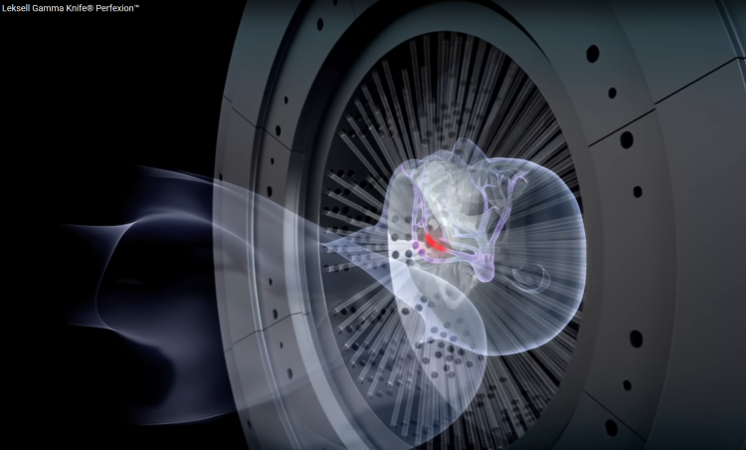
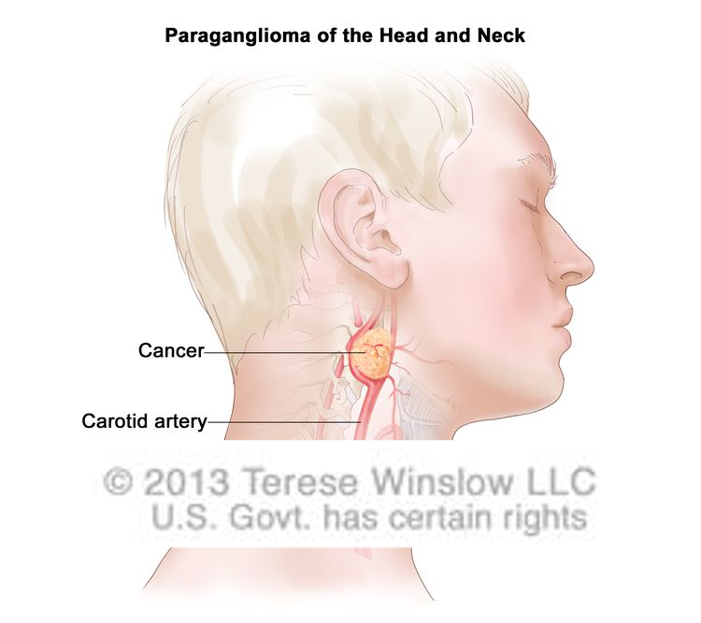
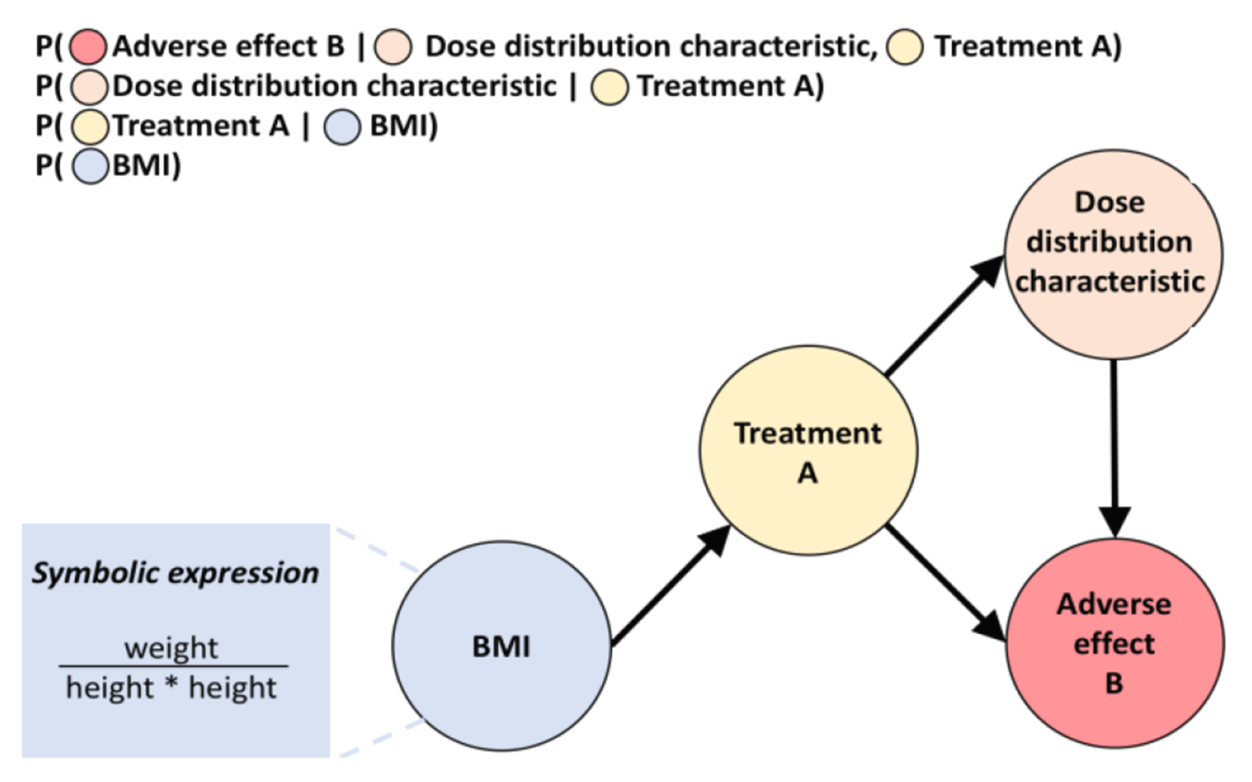
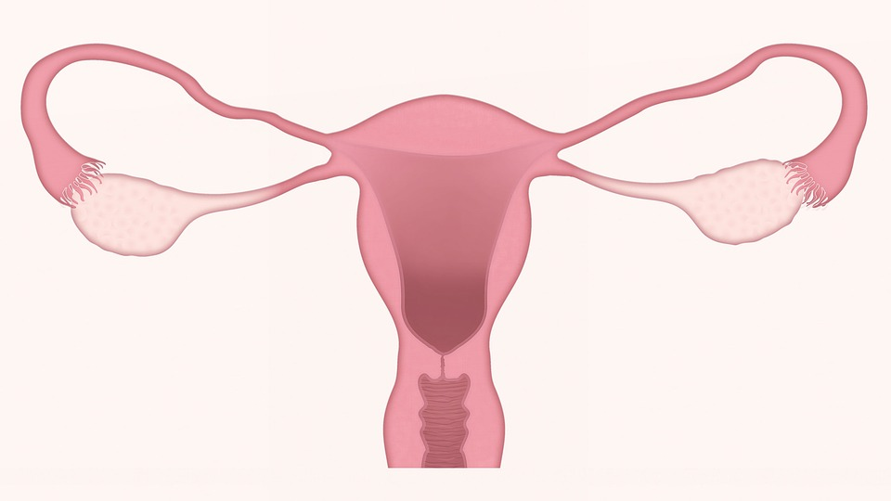
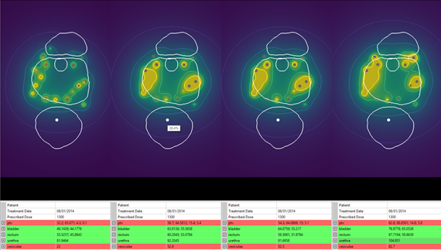
The Future is BEYOND BRIGHT!

Slide 22
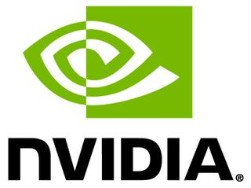
Thank you
Co-authors (so far!)
G. Aalvanger, T. Alderliesten, P.J.M. Bakker, B.V. Balgobind, P. Bauer, A. Bel, I. Blonk-Altena, S.M. Bohte, P.A. Bouter, T. Brys, M. Castelli, F. Claessen, R. de Bokx, K.F. Crama, M. De Cock, T.M. Deist, E.D. de Jong, W. den Besten, M. Drugan, A. Dushatskiy, S.G. Elkhuizen, M. Gallagher, I. Gonçalves, J. Grahl, M. Grewal, M.O.W. Grond, K.A. Hinnen, D.C. Hodgson, N. Höning, A.K. Hutzschenreuter, N.N.Y. Janssen, G.O. Janssens, G. Katsouris, C. Koedooder, E.S. Kooreman, P.S. Kroon, J.A. La Poutré, B. Liefers, C.E. Loo, N.H. Luong, S.C. Maree, E. Medvet, A.M. Mendrik, E.A. Meulman, S. Minner, J. Morren, Y. Niatsetski, W. Niessen, A. Nowé, C. Olieman, F. Oldenburger, K. Orphanou, T.D. den Ottelander, E. Pauwels, J. Pierik, B.R. Pieters, R.T. Pinto, K. Pirpinia, S. Ramezani, C.R.N. Rasch, C. Restrepo, E.C.M. Rodenburg, S.F. Rodrigues, C.M. Ronckers, F. Rothlauf, N.S. Russell, K.L. Sadowski, A.N. Scholten, H. Slootweg, M. Soleimanzadeh, J.-J. Sonke, A.-A. Tantar, E. Tantar, D. Thierens, T. Tušar, J. van Aarle, R. van der Laarse, M.C. van der Meer, I.W.E.M. van Dijk, M. van Herk, N. van Wieringen, I.B. Vermeulen, M. Virgolin, Z. Wang, H. Westerveld, J. Wiersma, G. Winter-Warnars, C. Witteveen, L.Z. Zaletel
Industry partners and funding bodies (so far!)
Maurits en Anna de Kock stichting

Slide 23
Thank you

