Slide 1
Quality of experience for immersive communication
Irene Viola

Slide 2
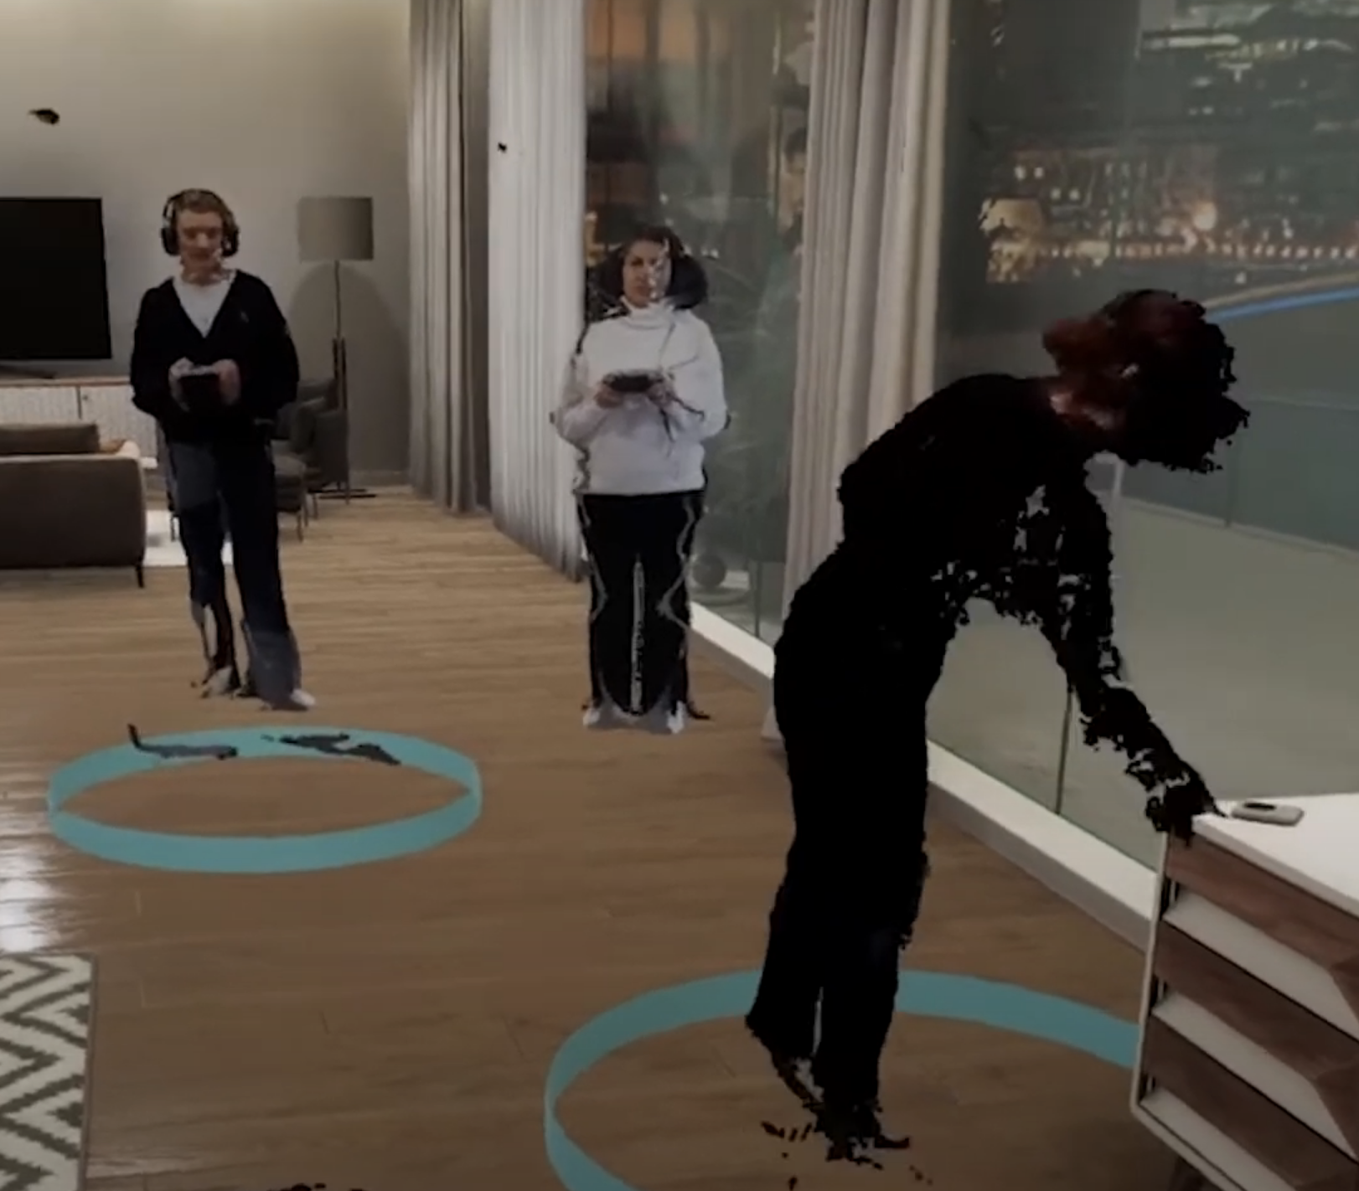
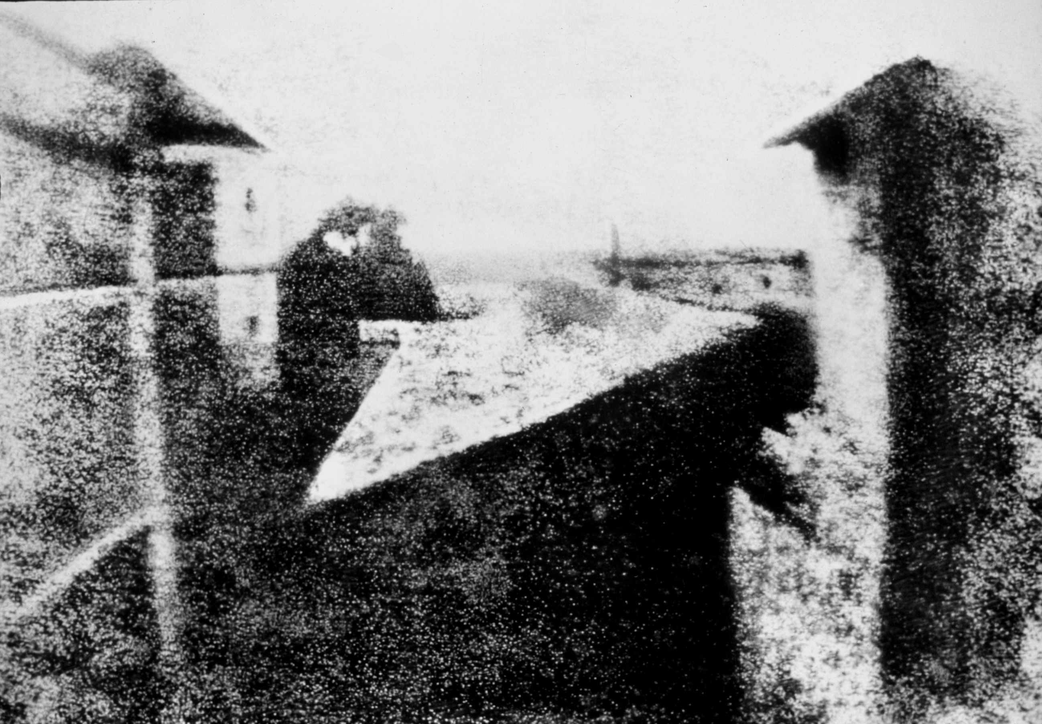
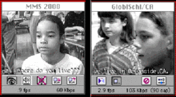
CWI is founded in 1946!
?
1
2
3
4
1826
1951
1993
2021
2046
Photo: Joseph Nicéphore Niépce
Photo: Royal Philips
Original screen capture of Global Schoolhouse students collaborating via CU-SeeMe taken by Yvonne Marie Andres.
Original screen capture of multiparty photorealistic teleconferencing in VR, via VRTogether platform.

Slide 3
Communication: establish a connection between entities, in order to exchange information
Technological advances: more ways of connecting remote entities
How can we make the connection more natural and life-like?

Slide 4
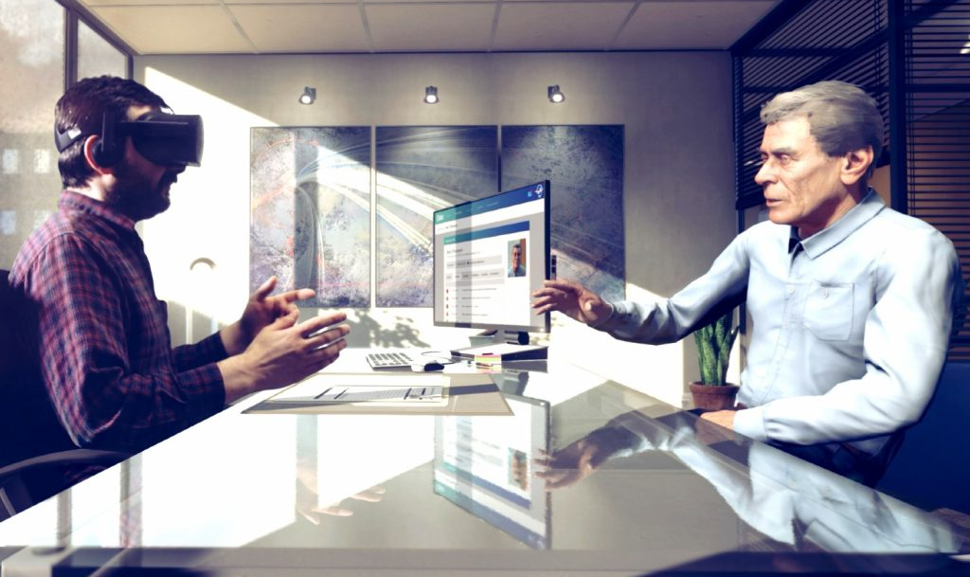
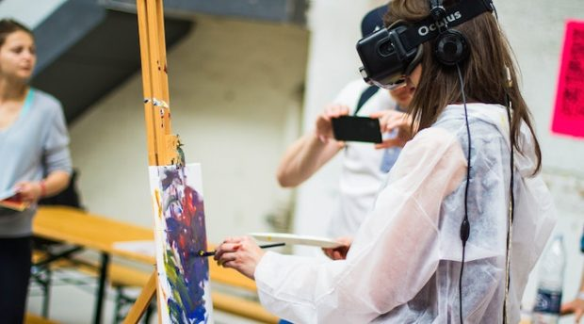
Immersive communication: “enable natural experiences and interactions with remote people and environments in ways that suspend disbelief in being there”¹
Through new immersive representations (360 degree, light field, point cloud, …) and new technologies (VR, AR, …)
How do we ensure the best possible experience and interaction, given the technological constraints?
1. Apostolopoulos, J. G., Chou, P. A., Culbertson, B., Kalker, T., Trott, M. D., & Wee, S. (2012). The road to immersive communication. Proceedings of the IEEE, 100(4), 974-990.

Slide 5
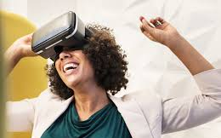
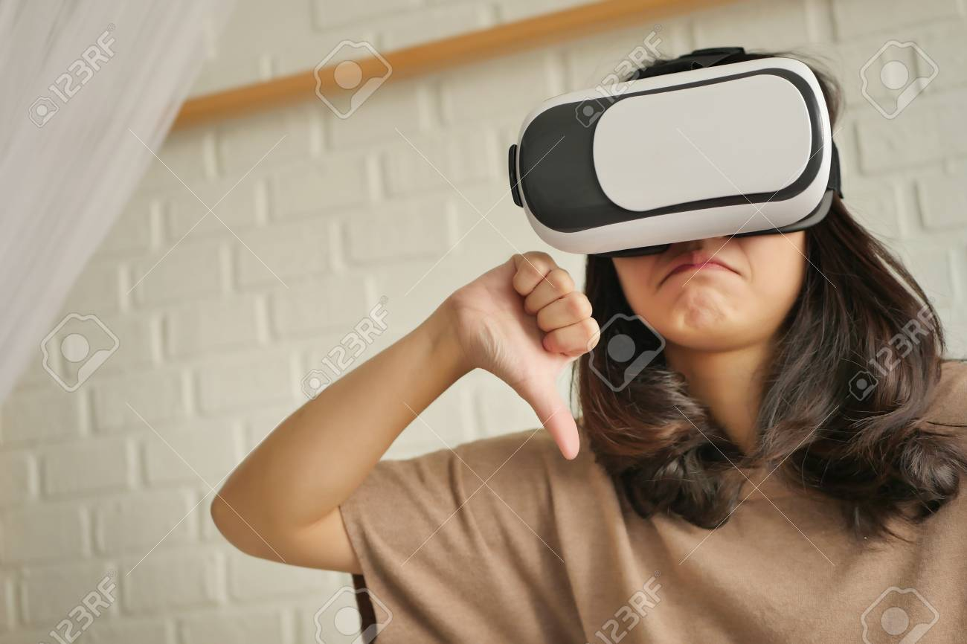
Quality of Experience (QoE): “the degree of delight or annoyance of the user of an application or service”¹
Human-centric perspective: quality is determined by the reaction of the user
Influencing factor may be external to the system
1. Brunnström, K., Beker, S. A., De Moor, K., Dooms, A., Egger, S., Garcia, M. N., ... & Lawlor, B. (2013). Qualinet white paper on definitions of quality of experience.

Slide 6
Measure and model QoE to understand and optimize immersive communication

Slide 7
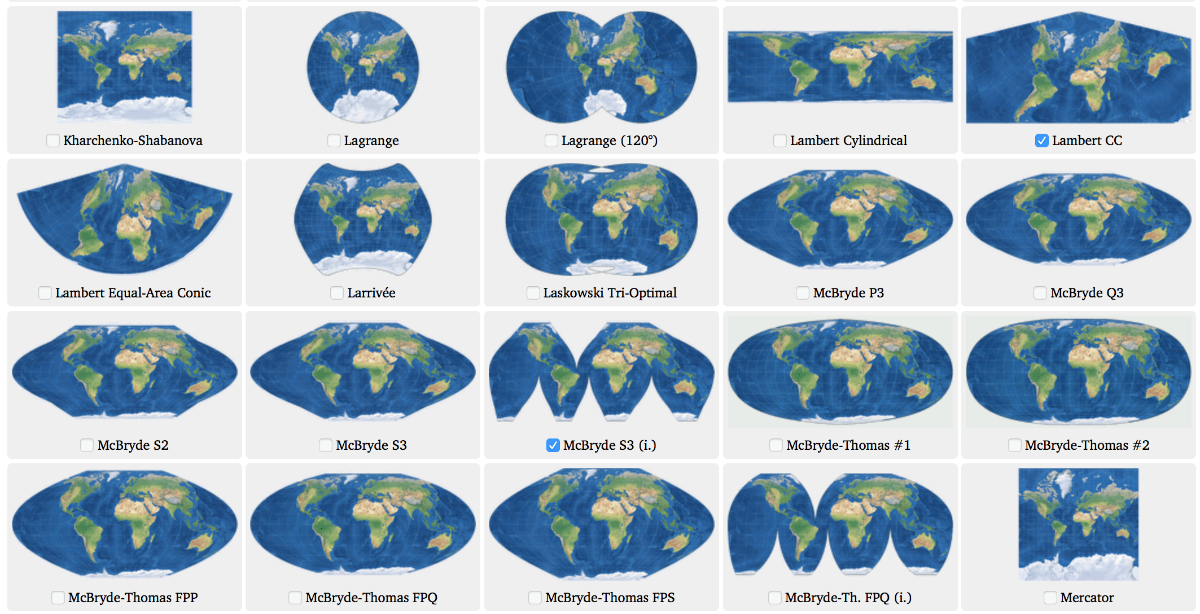
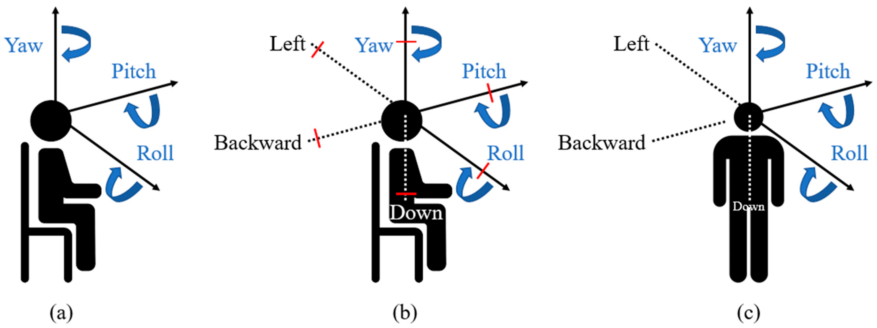
Challenges
Immersive media = higher complexity
Multidimensional, irregular data
Multiple representations available
More degrees of freedom
No one-size-fits-all strategy

Slide 8
Three pillars
Quantify user experience
Model user experience
Optimize user experience

Slide 9
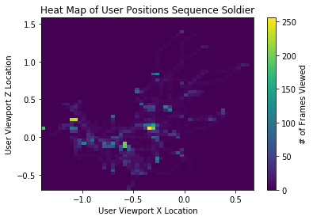
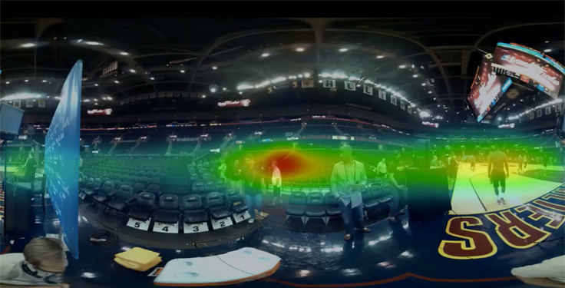
Quantify user experience
User-centric perspective: analysis of user behaviour
Saliency: identify regions of interest
Navigation: analyse how users explore the space
Interaction: understand how people engage

Slide 10
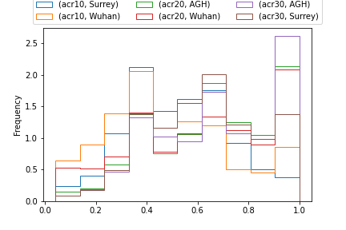
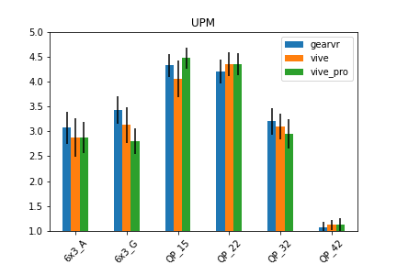
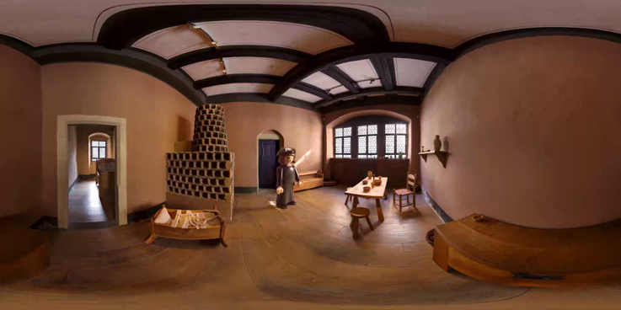
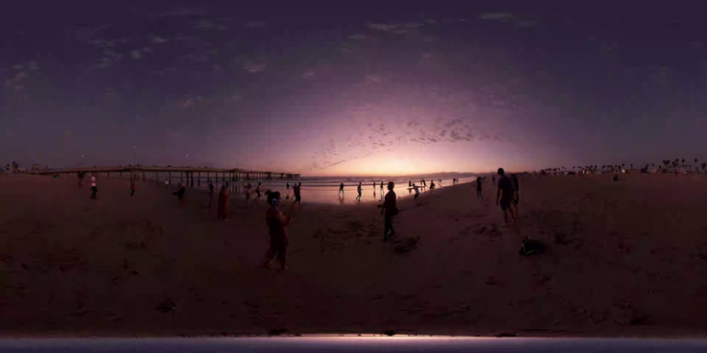
Quantify user experience
Large-scale interlab test to understand user behaviour and quality perception
Influence of methodology, display technology, sequence duration…
Included in the ITU-T Recommendation P.919
Gutierrez, J. et al. (2020). Subjective evaluation of visual quality and simulator sickness of short 360º videos: ITU-T Rec. P.919. Submitted to IEEE Transactions on Multimedia.

Slide 11
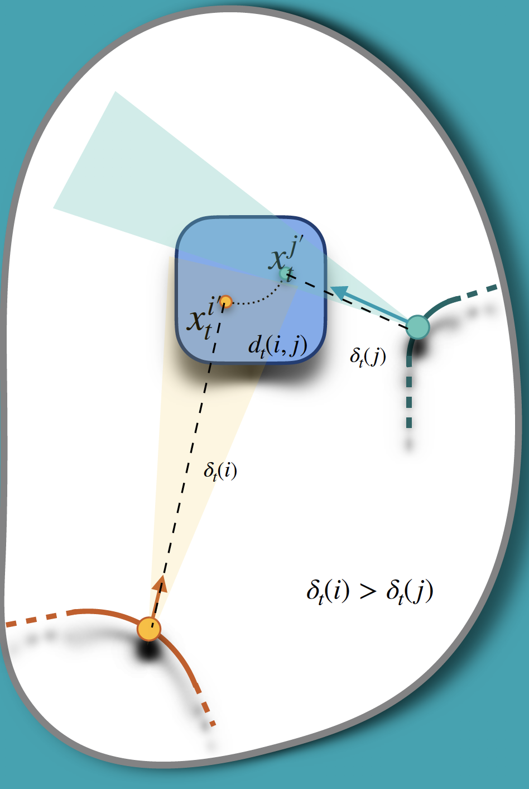
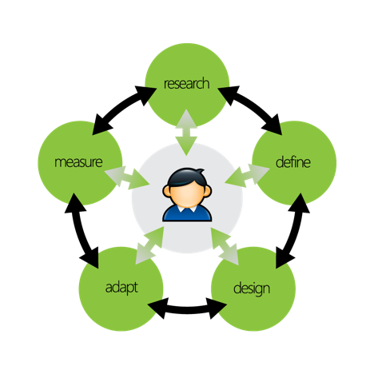
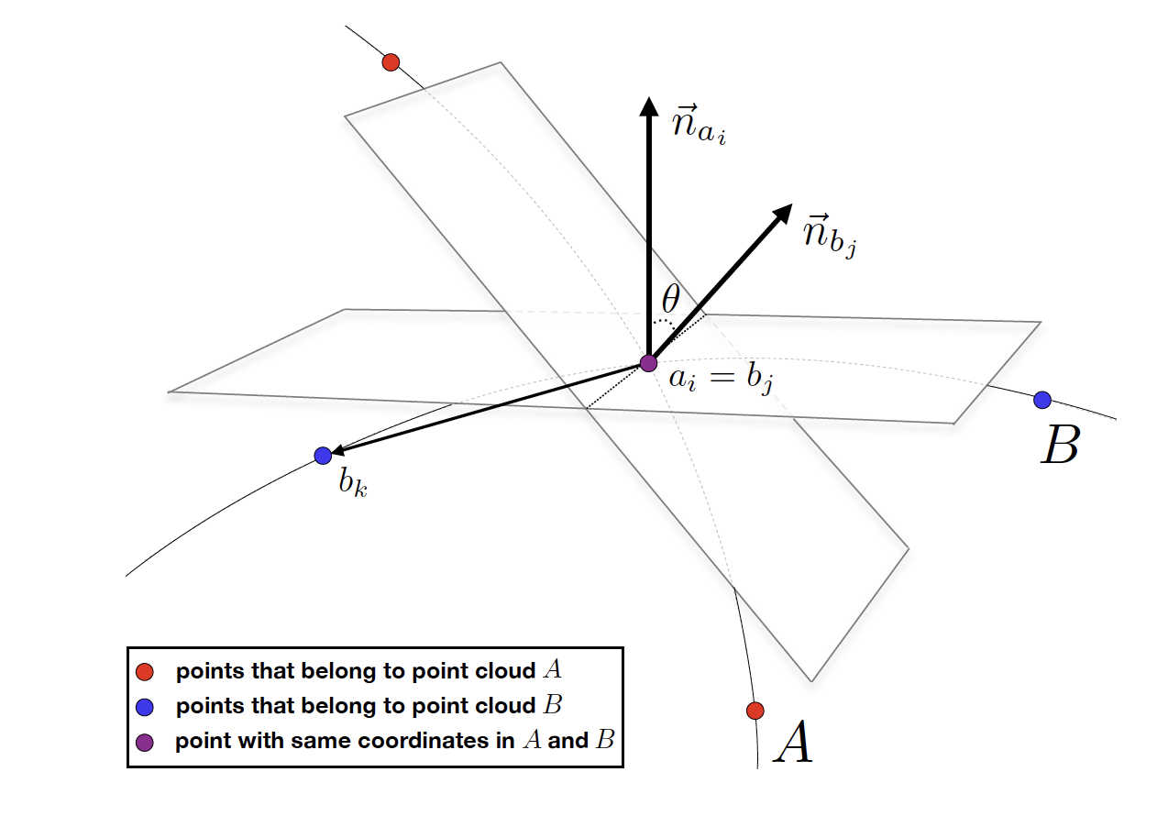
Model user experience
Predict user behaviour
Understand influencing factors in visual perception
Infer how users will react to a given content
Model visual quality and enjoyment

Slide 12
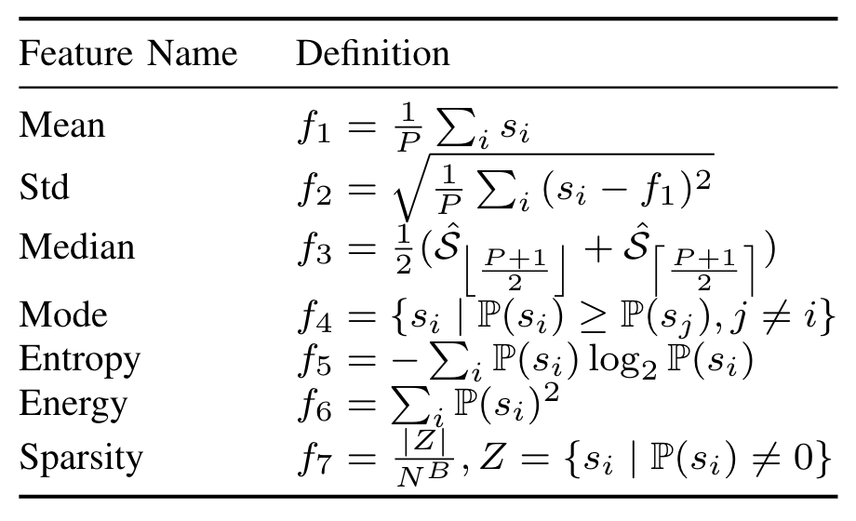
Model user experience
We proposed a reduced reference metric for point cloud contents, $PCM_{RR}$
Features in geometry, color, and normal vector domain, to capture distortions in texture and structure
First metric not to leverage full reference content
Viola, I. & Cesar, P. (2020). A reduced reference metric for visual quality evaluation of point cloud contents. IEEE Signal Processing Letters.

Slide 13
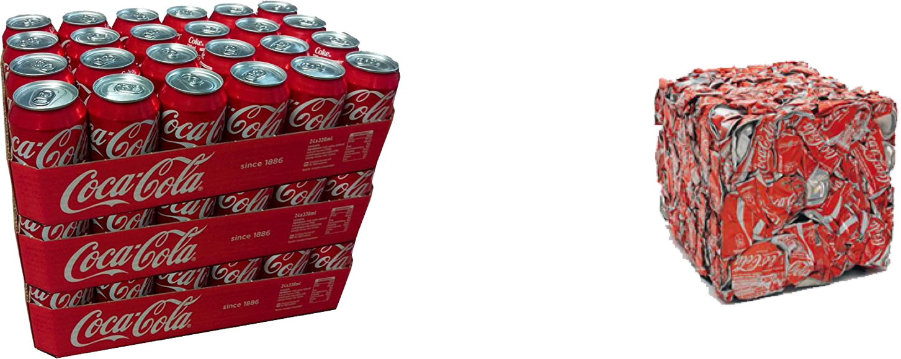
Optimize user experience
Improve delivery by predicting user navigation and perception
Improve compression by using saliency and quality information

Slide 14
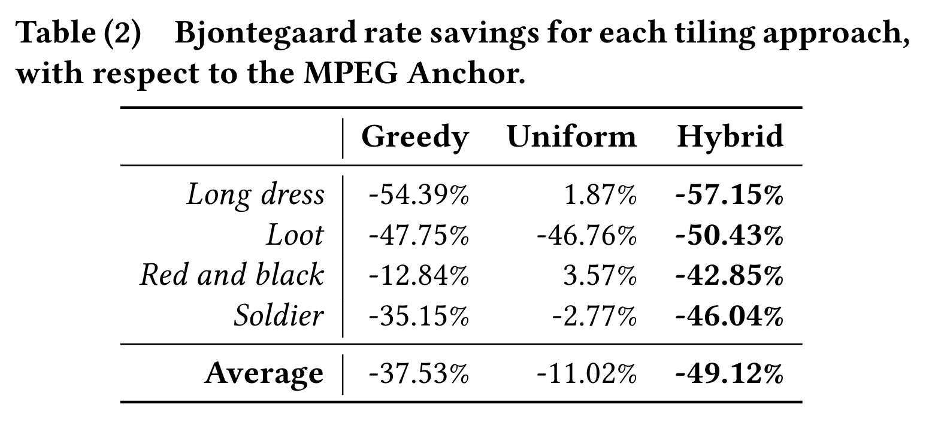
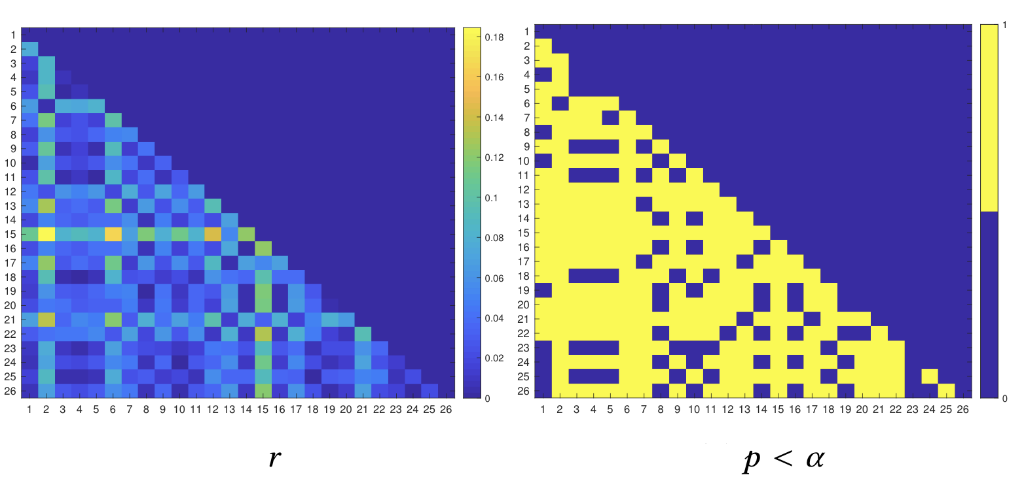
Optimize user experience
We proposed a low-complexity tiling for real-time point cloud adaptive streaming
Using real navigation data in 6 degrees of freedom VR
User-adaptive streaming leads to 57% bitrate savings with respect to conventional solutions
Subramanyam, S., Viola, I., Hanjalic, A., & Cesar, P. (2020). User Centered Adaptive Streaming of Dynamic Point Clouds with Low Complexity Tiling. In Proceedings of the 28th ACM International Conference on Multimedia.

Slide 15
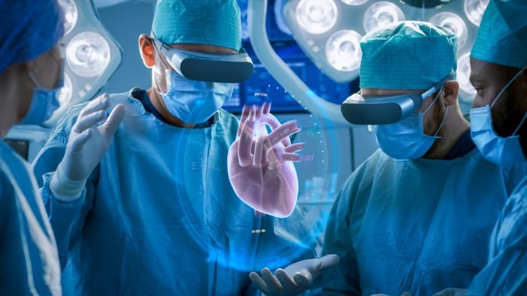
Context-adaptive modelling
Consider the end user when modeling and optimizing for QoE
Optimize QoE models for intermediate AI engines
Synergy between QoE and AI, in order to make AI human-centered

Slide 16
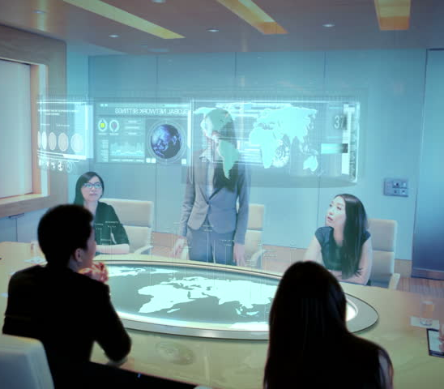
CWI is founded in 1946!
1
2
3
4
1826
1951
1993
2021
2046
Photo: Joseph Nicéphore Niépce
Photo: Royal Philips
Original screen capture of Global Schoolhouse students collaborating via CU-SeeMe taken by Yvonne Marie Andres.
Original screen capture of multiparty photorealistic teleconferencing in VR, via VRTogether platform.

Slide 17
Thank you!

