Slide 1
Structure!
Predicting the future with models and data
Benjamin Sanderse
Scientific Computing
11th February 2021
Notes:
Hello, good afternoon everyone!
My name is Benjamin Sanderse and I’m very happy to share some thoughts and ideas about the work in our group, today on the 75th anniversary celebration of CWI.
[Pause] I work in the scientific computing group at CWI, and in our group we work on developing new algorithms that, simply said, help to predict the future. Today I want to explain to you how the concept of ‘Structure’ can be used to combine physical models and data-driven techniques to make such predictions robust.

Slide 2
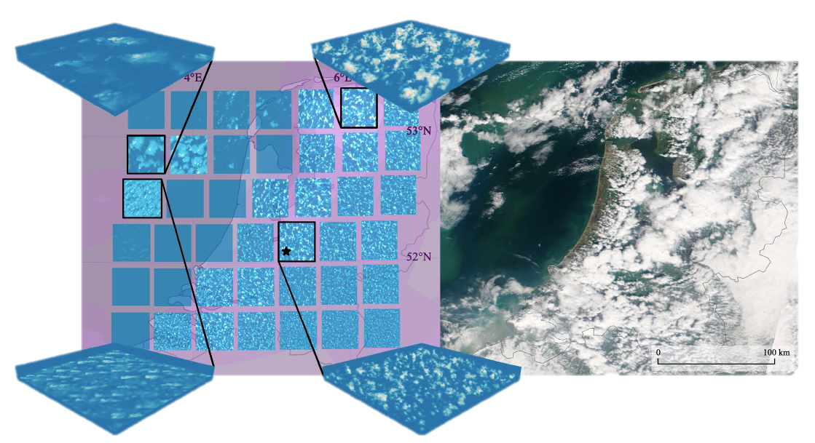
Predicting the future: weather and climate
Source: Jansson et al., Regional Superparameterization in a Global Circulation Model Using Large Eddy Simulations, JAMES, 2019
Notes:
For example, our group works on the development of algorithms that will help us to predict the future of our weather and our climate. A particularly important question that needs to be answered is how to represent clouds in climate models. This is a difficult problem, because the simulation of clouds on a computer based on physical models is computationally very expensive, and at the same time the amount of measurement data is too limited to rely on purely data-driven techniques.

Slide 3
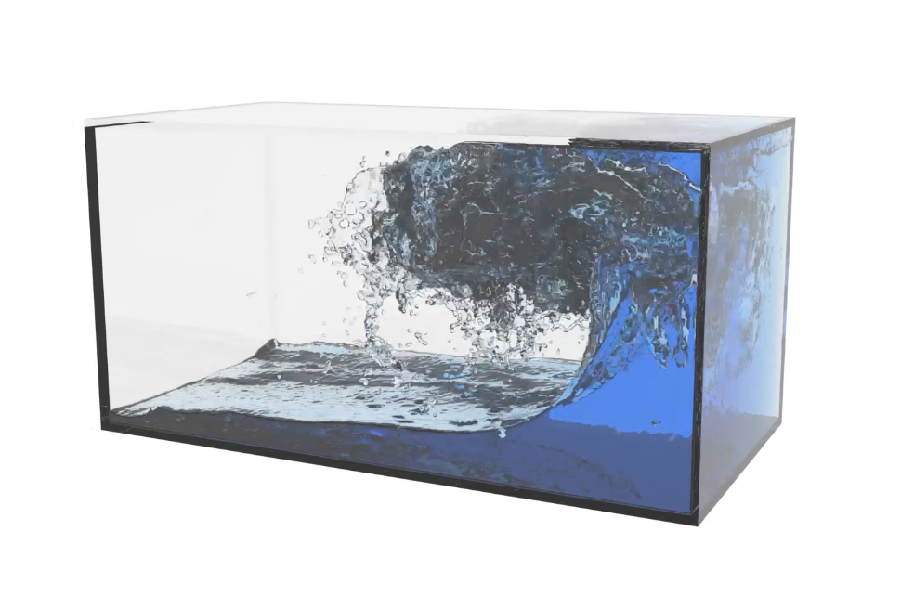
Predicting the future: energy
Sloshing of LNG
Offshore wind farms
Source: Yous van Halder, CWI
Source: Bel Air Aviation
Notes:
A second example in which we wish to make accurate predictions of the future, given the state of today, is in the prediction of fluid flow in energy systems, such as sloshing of liquefied natural gas in large tanker ships, or wind turbine wakes in large offshore wind farms. In wind farms, we want to predict what the effect of the weather will be on the electricity production of a farm, and how the turbines in the farm can be controlled in order to maximize power or to address the needs of the electricity grid.

Slide 4
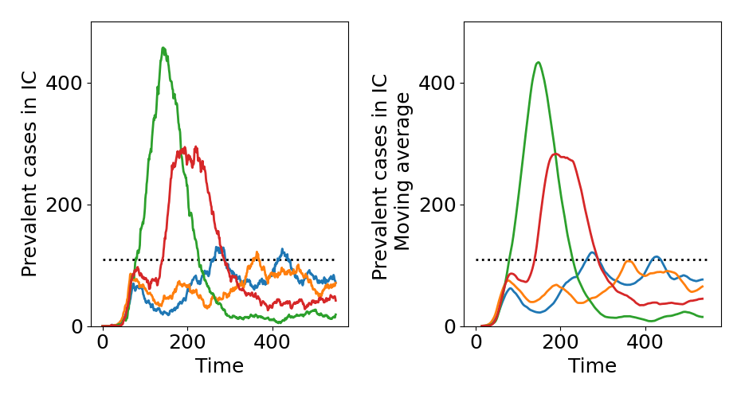
Predicting the future: COVID
Evaluation of different exit-strategies
Based on: Edeling et al., The Impact of Uncertainty on Predictions of the CovidSim Epidemiological Code, Nature Computational Science, 2021.
Source: Gugole et al., Uncertainty quantification of COVID-19 exit strategies in an individual-based and geographically stratified transmission model, Draft, 2021.
Notes:
Recently we also started to look at predicting the future of the corona virus spread and the uncertainty associated with the model predictions, together with colleagues from Erasmus University. For example, on the right you can see an evaluation of four different strategies, such as lockdowns or contact tracing, and what their expected effect is on the number of people on the intensive care.

Slide 5
Predicting the future: physical models
Universal laws of nature
But:
Sensitive to conditions (nonlinear, chaos)
Uncertainty in formulation or parameters
Expensive to solve
2% uncertainty
in gravity
baseline
completely different solutions
Notes:
These examples from climate, energy, and COVID have one feature in common: at the basis they have fundamental physical models or laws such as conservation of mass or conservation of energy, which are often expressed in terms of differential equations.
I call this the classic approach to predict the future, which is dominantly physics-based. The core strength is the universality and generality of the approach. However, at the same time making future projections with these models can still be very difficult.
On the right you see an example of such a physics-based simulation of a simple double pendulum.
As you will see, a very small change in conditions (in this case the gravitational constant) can lead to completely different results in the long run.
The nonlinear, chaotic nature of these models and the uncertainty present in their formulation makes future predictions with only physical models difficult. Another complication is that for realistic applications such as climate predictions, these models are computationally very expensive to solve.

Slide 6
Predicting the future: data-driven techniques
Computer learns model (machine-learning)
But:
Big (?) data
Generalization difficult
Physical constraints not satisfied
Often not robust to perturbations
data-driven prediction
not satisfying physics
Notes:
As a result, data-driven techniques have become very popular. The premise is that, if sufficient data of a system is available, artificial intelligence or machine learning can be used to learn the system behavior and make predictions about the future. While this has indeed been shown for classification tasks in image recognition and in playing games like Go or Chess, this seems to be very difficult for physical systems such as the climate. A main issue is that machine learning methods typically require Big data, while in many physical systems we typically only have very little data. Furthermore, it is difficult to guarantee that machine learning methods satisfy physical constraints; to have them generalize outside the conditions for which they were trained; and to make them robust to changes in the inputs.
In this movie we have trained a neural network to predict the solution of a very simple physical system (a mass-spring system). The neural network is trained on a number of noisy observations of the correct physical solution, which is a perfect circular orbit, as shown in black. The neural network solution, in red, is however not aware of the physics behind this problem, and leads to a diverging prediction of future states.

Slide 7
Idea: integrate physics and data with structure
Physical model
Data
Structure!
“Learning physics from data”
“Enhance physics with data”
Predictions
Notes:
The way to tackle these issues and the way forward to make robust predictions of the future is to tightly integrate physical models and data-driven techniques.
I believe that such an integration is to be accomplished by embedding what I call “structure” into both components.
This will not only help to make predictions by learning physics based on data (blue arrow),
but also to improve predictions by enhancing physics models by embedding data (red arrow).
But what does this mean, “structure”?

Slide 8
Structure in physical models
Many physical systems possess structure:
Conservation laws
Symmetries
Invariants
The challenge:
Find suitable structure
Preserve structure from continuous to discrete (needed for computer simulation)
Emmy Noether
Notes:
Well, many physical models possess a certain kind of structure.
For example, when formulating the equations of motion for the double pendulum, it turns out that there is a ‘hidden’ conserved quantity, known as the Hamiltonian, which expresses that energy is conserved by the system.
More in general, there is a deep connection between conservation laws and symmetries in physical systems, that was formalized by Emmy Noether (maybe you know her when making reservations for room L121)
When simulating physical systems on a computer, it is of critical importance to detect which conservation laws, symmetries, invariants are important for the system under consideration, and to preserve them when discretizing them from a continuous to a discrete setting.

Slide 9
Example: double pendulum
looks nice, but completely wrong
(physically impossible)
Structure: Hamiltonian (=energy)
Conserve Hamiltonian when discretizing
Stable and accurate results
conserving structure
not conserving structure
Notes:
Let us look at the double pendulum problem again. An important structure is conservation of the Hamiltonian.
When simulating this system on a computer, it is not self-evident that the Hamiltonian will be conserved. On the right you see two simulations, one with a method that conserves the Hamiltonian, and one with a method that does not conserve it. Although both simulations at first look reasonable, the method that does not conserve structure leads in the long term to completely wrong results, as the pendulum ends up at a higher position than where it started.
So, structure-preserving methods are of crucial importance to obtain physically realistic results.

Slide 10
Example: incompressible fluid flow
Structure: kinetic energy
Conserve energy when discretizing
Stable and accurate results

Slide 11
Structure in data-driven methods
Embed structure to:
Need less data
Generalize better
Satisfy physical constraints
Make robust to perturbations
Idea: design neural networks analogous to physical models
Popular data-driven method: neural network
Notes:
A main ongoing question is now whether we can use structure-preserving techniques to design new data-driven methods.
The idea is, that if we can do this, we expect them to have some of the universality that physical models have, meaning that: they need less data; they generalize better to unseen cases; they satisfy physical constraints; and they could be more robust to perturbations.
The main idea is therefore to design neural networks analogous to physical models. Of course, the question is how to do that.

Slide 12
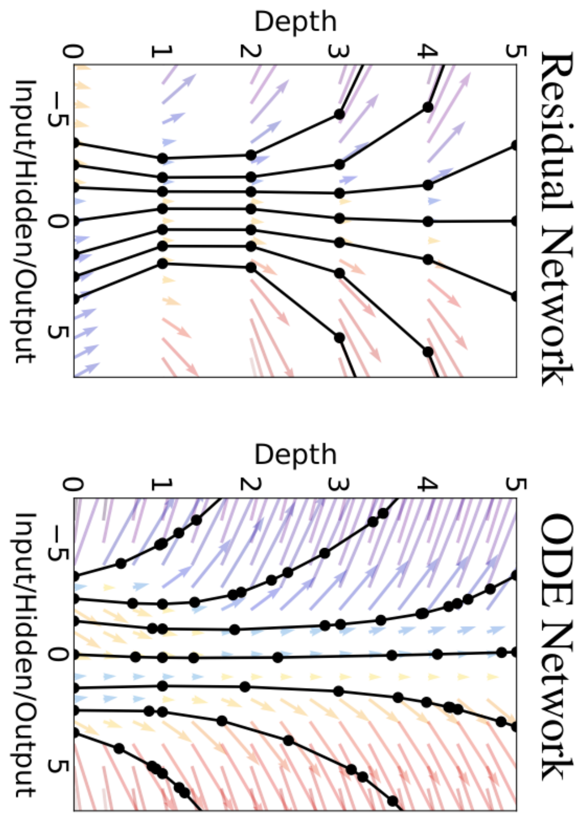
Structure-preserving neural networks
Physical model
Neural networks (data-driven)
Structure!
deep link
Differential equations
Chen et al., 2018
E, 2017
Haber et al., 2018
Predictions
Notes:
The core idea is as follows.
Recently it has been shown that there is a deep link between neural networks and differential equations. This allows us to interpret neural networks as a special case of a discretized differential equation.
At the same time, we know already for a long that there is link between physical models and differential equations. So the interpretation of neural networks as differential equation allows us to make a link to physical models.
Since we know how to embed structure in physical models, this gives us an idea how to include structure also in data-driven techniques,
and finally to make robust predictions about the future.

Slide 13
Structure-preserving neural networks
data-driven prediction
Embedded Hamiltonian structure into the neural network: “learn the Hamiltonian, not the dynamics”
Accurate and stable learning of physical models based on data
conserving structure
Greydanus et al., 2019
Notes:
Let’s go back to the data-driven example that I showed before, where we had noisy observations of a mass-spring system and a neural network prediction that diverged from the circular orbit.
We now change the neural network architecture so that we learn the Hamiltonian of the system. This enforces that the Hamiltonian is conserved, and leads to accurate and stable predictions. The first results indicate that these networks are less sensitive to perturbations, need less training data, and lead to physically realistic solutions.

Slide 14
Summary
Grand challenges in climate change and energy transition require advanced computational models
Structure preservation guides us in:
constructing state-of-the-art discretized physical models
designing new data-driven techniques
merging these two
Physical model
Data
Structure!
Predictions
Notes:
To summarize, in our scientific computing group we are developing advanced computational models that help to address grand challenges in topics like climate change and energy transition.
Preserving structure when setting up computer simulations and designing data-driven techniques is a cutting edge research topic which will be a guide when making predictions about the future.

Slide 15
Notes:
I’d like to finish now with congratulating CWI with its 75 anniversary.
Please let me know if you have any questions!

