Slide 1
Integer and Linear Programming Beyond the Worst-Case
Daniel Dadush

Slide 2
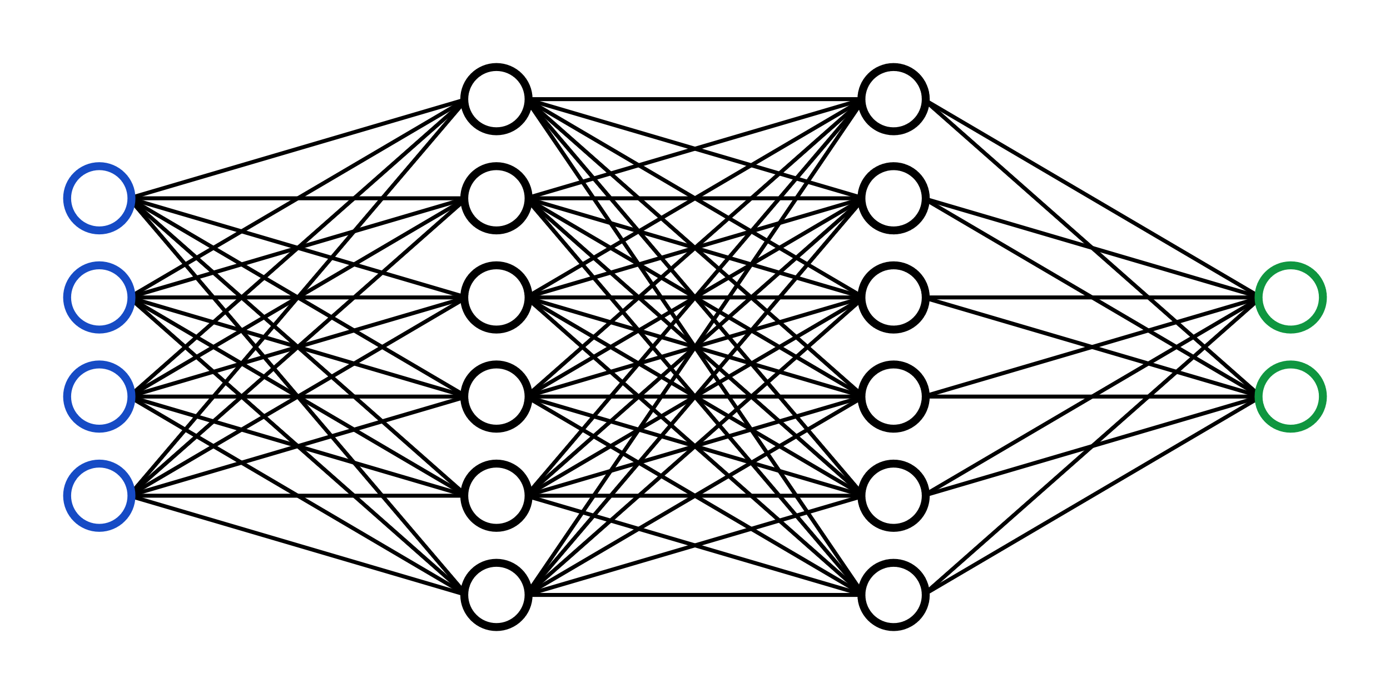
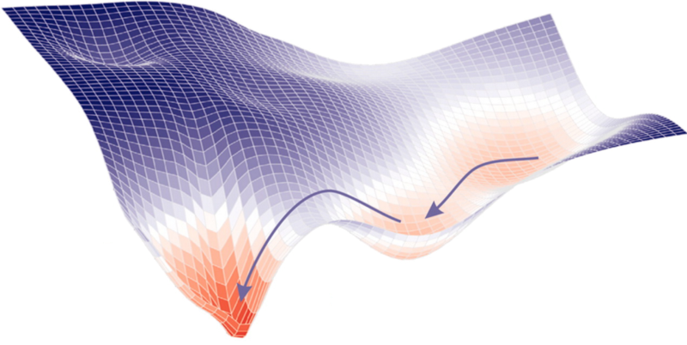
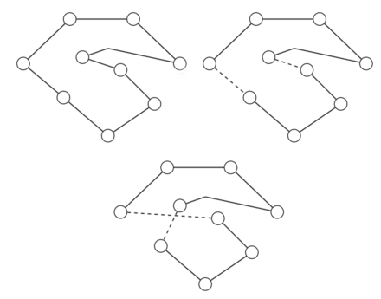
Why Are Simple Algorithms so Effective in Practice?
Gradient Descent for Neural Network Training:
2-OPT Heuristic for the Traveling Salesman Problem:

Slide 3
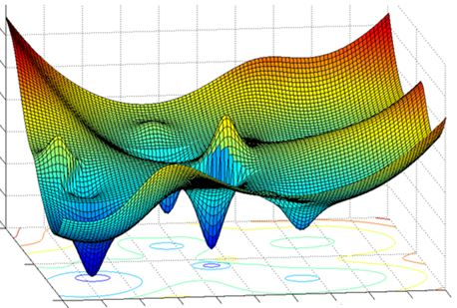
Analytical Challenge: Easy to Find Bad Examples
Gradient descent can find a bad local minimum
For many algorithms, however, worst-case behavior is rare in practice.

Slide 4
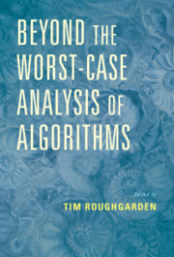
Beyond Worst-Case Analysis
Goals:
Provide rigorous theoretical models to explain the observed behavior of algorithms.
Develop new algorithmic paradigms.
Motivation:
Theory must keep up with practice to stay relevant.
Insights may lead to improved algorithms.
Exciting mathematics!
December ‘20

Slide 5
Beyond Worst-Case Analysis
Common Approach: Assume the input is “well-structured” or comes from a “nice distribution”.
Successfully Applied To:
Robust Statistical Estimation
Topic Modeling
Clustering
SAT Solving
…
Smoothed Analysis of the Simplex Method
D. & Huiberts ‘20

Slide 6
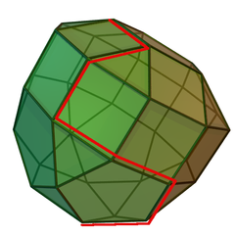
Two Vignettes in Optimization
$$c$$
1. The Simplex Method for Linear Programming:
$$x^{∗}$$
$$\max{c⋅x}$$ s.t. $Ax≤b$
$x∈ℝ^{n}$
2. Branch & Bound for Integer Programming:
$$x^{∗}$$
$$c$$
$$\max{c⋅x}$$ s.t. $Ax≤b$
$x∈ℤ^{n}$

Slide 7
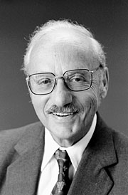
The Simplex Method
$$c$$
$$x^{∗}$$
Iteratively choose an adjacent vertex with better objective value.
$$x_{start}$$
Dantzig ‘47
Most popular method in practice.
SCIP

Slide 8
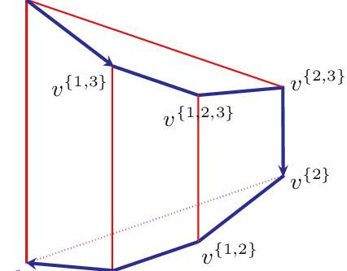
The Simplex Method
$$c$$
$$x^{∗}$$
Iteratively choose an adjacent vertex with better objective value.
$$x_{start}$$
Dantzig ‘47
Klee-Minty cube: Can visit every single vertex!
Klee & Minty ‘70

Slide 9
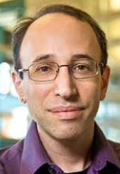
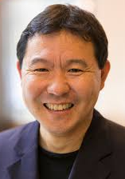
Smoothed Analysis
Insight: Bad instances are fragile!
$$\max{c⋅x} \\ \left(A+noise\right)x≤b+noise \\ x∈ℝ^{n}$$
Spielman & Teng ‘01
noise
Original Instance
Perturbed Instance

Slide 10
Smoothed Complexity of the Simplex Method
$$\max{c⋅x} \\ \left(A+σ⋅Gaussian\right)x≤b+σ⋅Gaussian \\ x∈ℝ^{n}$$
N(0,1) entries
$A∈ℝ^{m×n}$, rows of $(A,b)$ have norm $1$, $σ≤1$
Works | Expected Number of Steps
Spielman & Teng ‘01+‘04 | $$\tilde{O}(n^{55}m^{86}σ^{−30})$$
Vershynin ‘06+‘09 | $$O(n^{3}\log^{3}{m}σ^{−4}+n^{9}\log^{7}{n})$$
D. & Huiberts ‘18+‘20 | $$O(n^{2}\sqrt{\log{m}}{σ^{−2}}+n^{3}\log^{3/2}{m})$$

Slide 11
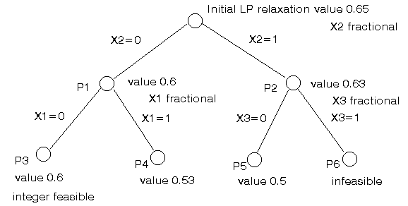
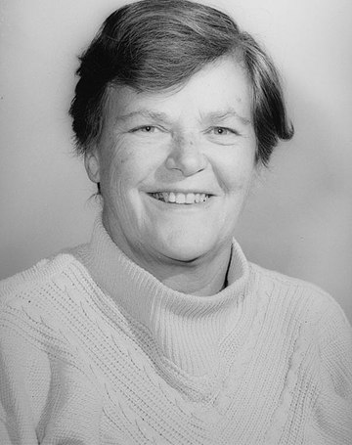
Integer Programming
Binary Integer Program:
$$(0,1)$$
$$(1,1)$$
$$\max{c⋅x}$$ s.t. $Ax≤b$
$x∈\{0,1\}^{n}$
$$c$$
$$x^{∗}$$
$$(0,0)$$
$$(1,0)$$
Branch & Bound:
SCIP
Land & Doig ‘60

Slide 12
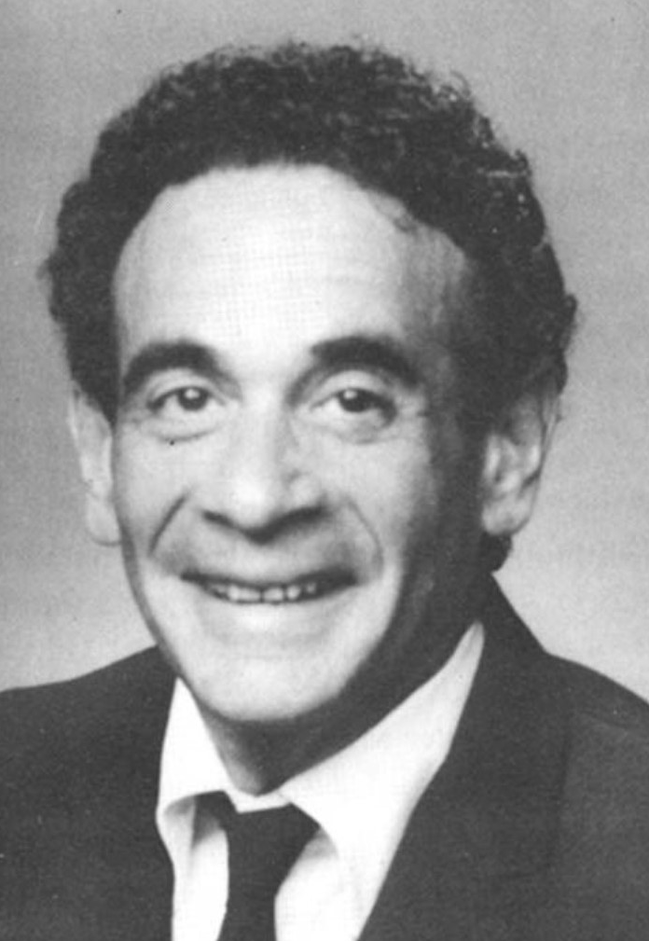
“Trivial Integer Programs Unsolvable By Branch & Bound”
$\max{ x_{1}+⋯+x_{n}}$ s.t. $x_{1}+⋯+x_{n}≤ n/2$
$x∈\{0,1\}^{n}$
For $n$ odd, Branch & Bound takes $2^{\left\lfloor n/2\right\rfloor }$ time.
Jeroslow ‘74

Slide 13
When Is Branch & Bound “Good”?
Random Packing Integer Programs:
$$\max{c⋅x}$$ s.t. $Ax≤ \left[\begin{aligned}\begin{aligned}n/3 \\ ⋮\end{aligned} \\ n/3\end{aligned}\right], x∈\{0,1\}^{n}$
$c∈{\left[0,1\right]}^{n}, A∈{\left[0,1\right]}^{m×n}$
sampled uniformly.
Dey, Dubey, Molinaro ‘21
Branch & Bound takes $n^{2^{O(m)}}$ time.
$n$ variables, $m$ constraints

Slide 14
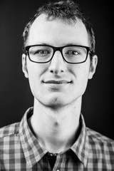
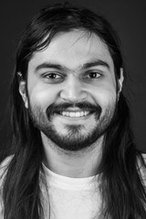
When Is Branch & Bound “Good”?
Random Gaussian Integer Programs:
$$\max{c⋅x}$$ s.t. $Ax≤b, x∈\{0,1\}^{n}$
$c∈ℝ^{n}, A∈ℝ^{m×n}$ sampled with Gaussian entries.
$b≥0$ (deterministic)
Borst, D., Huiberts, Tiwari ‘21
Branch & Bound takes $n^{poly(m)}$ time.
$n$ variables, $m$ constraints

Slide 15
Conclusions
The behavior of many fundamental algorithms is still poorly understood.
Novel analytical approaches are needed to better model algorithmic performance in practice.
THANK YOU!

