Slide 1
Working with companies, the Inria way :
From research partnership to technology transfer
Michel Cosnard

Slide 2
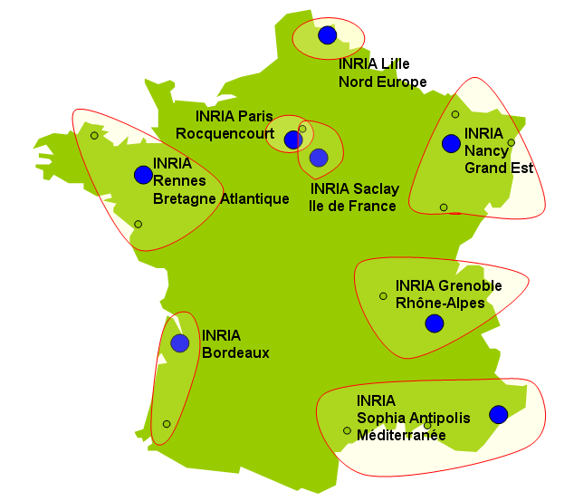
Inria at a glance
A national institute with 8 regional centers
A 5 years strategic plan
An organization based on project teams
  10-20 scientists with a strong scientific leadership and a clear focus
  Assessment: every 4 years
  About 200 teams, 80% in partnership
Features
  4200 pp, incl. 3400 scientists (1200 PhD)
  Annual budget of 235 millions euros
  31 ERC Grants
  1000 softwares (100/yr)
  300 patents (20/yr)
  120 spin-off companies (6/yr)

Slide 3
Transfer @ Inria
Missions
          Excellence in research
          Technology transfer
Organization
          Transfer and Innovation Department (DTI), about 20 persons
          Two to four officers in charge of partnerships and technology transfer in each center
          Since 2011, a Joint Venture with CDC-Entreprises : IT-Translation
(funding of spin-off companies, seed-money/early stage)

Slide 4
Transfer pathways @ Inria
R&D partnerships with « big » companies (Joint Labs)
Technology transfer with SME (Innovation Labs)
Creation of startups

Slide 5
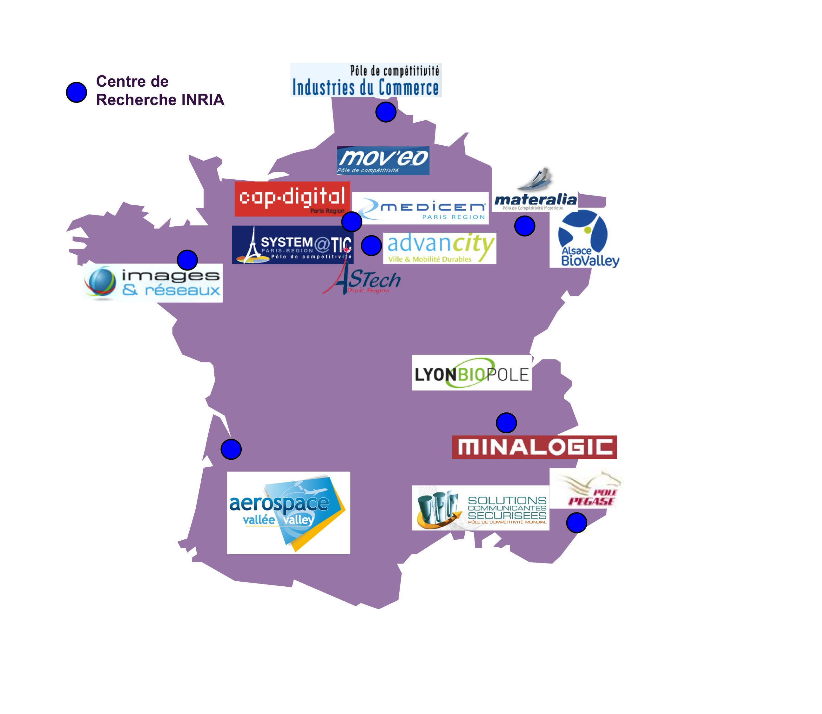

French and european contexts, for transfer @ Inria
    Competitiveness clusters
EIT ICT Labs,
the European IT innovative cluster

Slide 6
Joint Labs

Slide 7





Joint Labs with « big » companies
Ambitious strategic partnerships
    Based on a joint R&D roadmap
    Long term ( 5 to 10 years ) cooperation project

Slide 8
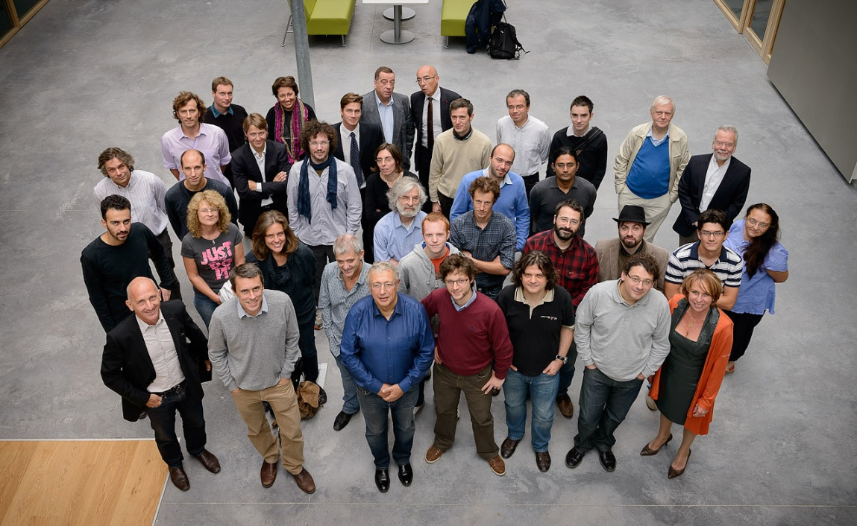
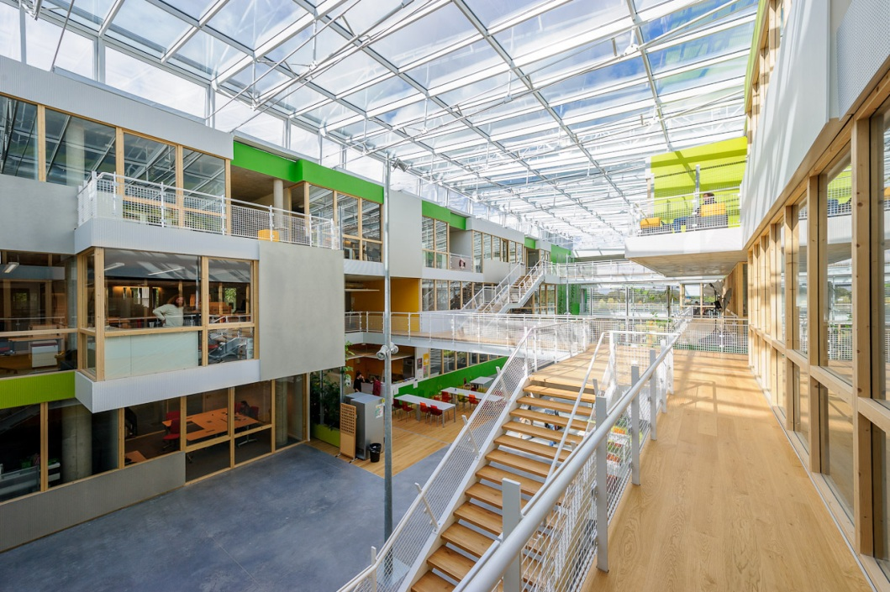
MSR-Inria Joint Centre Overview
Paris
Director: Laurent Massoulié

Slide 9
Genesis and mission
Public-Private partnership between Microsoft Research (Europe and US) and Inria
  Initiated in 2005
Aiming at basic research
  Emphasis on scientific excellence
  Dedicated to produce open-source software
  Initially focused on formal methods

Slide 10
Expanding portfolio of projects
Cloud workflows
Math Components
Social Networks
Infoviz
Security & Privacy
Structured ML
ML-Based SE
Cardiac& Brain
TLA Proof System
Video Mining
Formal Methods
Machine Learning

Slide 11
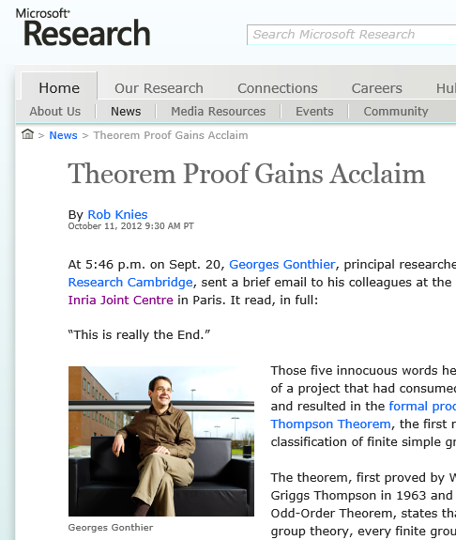
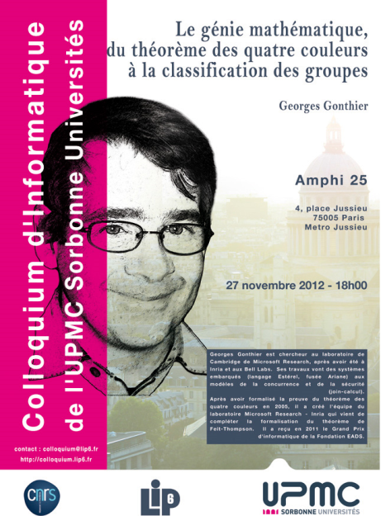
Highlights
Fundamental advances in formal methods
  Computer Proof Assistants for Mathematicians
  Cyber-security
    Verification & synthesis of crypto and privacy protocols
    Certified compilers of javascript

Slide 12
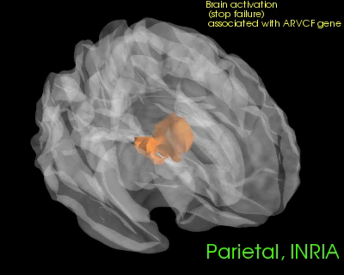
Highlights
Breakthroughs in computer vision & medical imaging
  Recognition of human actions in videos
  Determination of brain activity pattern conditioned by genetics
  Personalized modeling of heart behavior

Slide 13


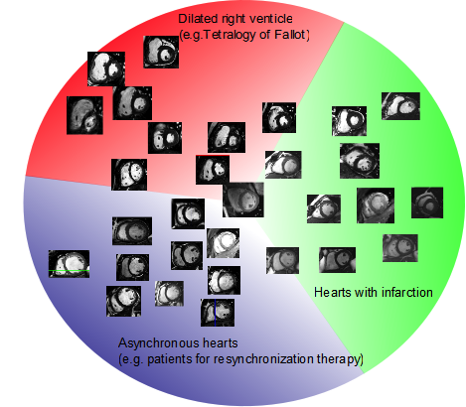
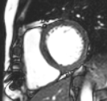
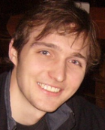
Smart Atlas for 4-D Cardiac Images
Large databases of 4-D Cardiac Images (real & simulated)
  Find most similar 4-D image from an atlas
Assist diagnosis and therapy planning
?
Jan Margeta, E Geremia, A Criminisi, N Ayache. Layered Spatio-temporal Forests for Left Ventricle Segmentation from 4D Cardiac MRI Data. STACOM Workshop at MICCAI 2011.

Slide 14
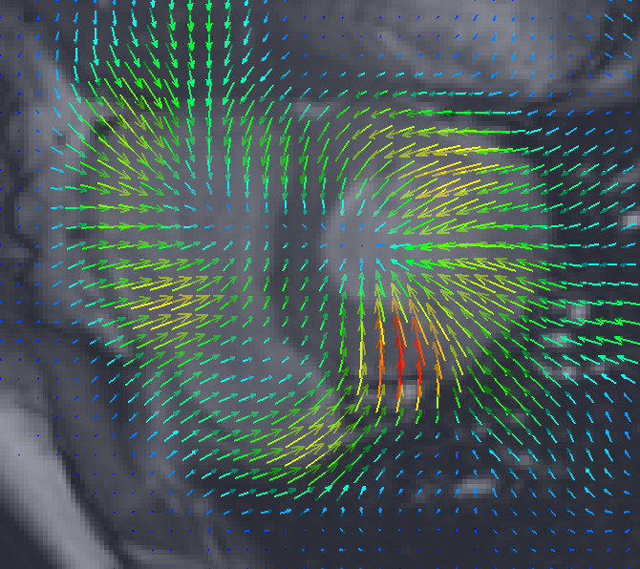
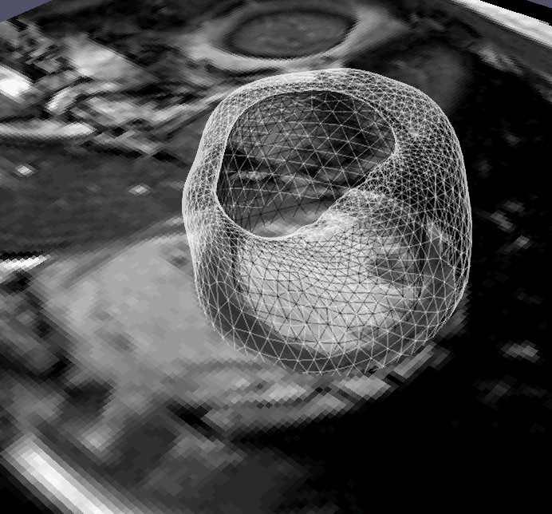
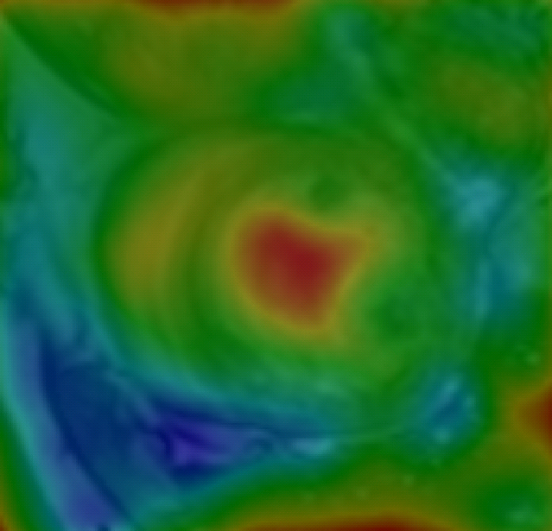
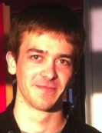
Cardiac Motion Tracking with uncertainty estimation
Recovered Motion
L Le Folgoc, H Delingette, A Criminisi, and N Ayache.
Current-based 4D shape analysis for the mechanical personalization of heart models. MCV Workshop at MICCAI 2012.
Uncertainty Map

Slide 15
Highlights
10 projects
70 permanent researchers (40 Inria, 30 MSR)
16 PhD students graduated and 26 (Postdoc/visiting faculty) years hosted
Publications at top venues (ACM POPL, ACM Siggraph, NIPS, MICCAI, IEEE FOCS…)
One project led to startup Iconem: 3D models of buildings from pictures taken by drones and archeologist drawings

Slide 16
Numbers
10 projects
70 permanent researchers (40 Inria, 30 MSR)
16 PhD students graduated and 26 (Postdoc/visiting faculty) years hosted
http://www.msr-inria.com/

Slide 17
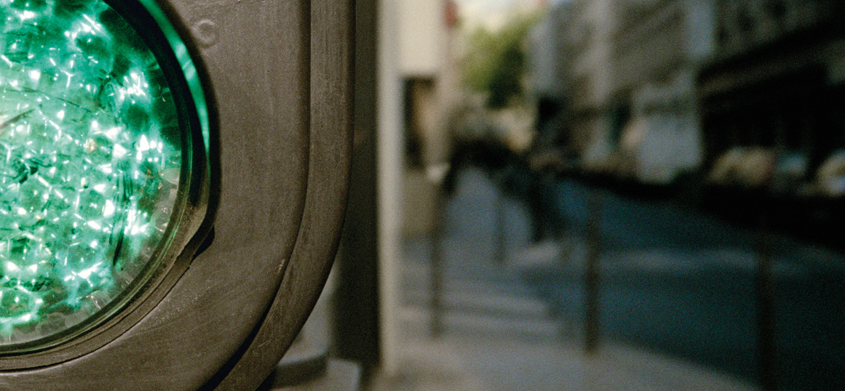
CBT - CUSTOMER PROOF POINTS
September 16, 2011
Common lab INRIA – Alcatel Lucent Bell Labs
Co-directors: Albert Benveniste (Inria), Olivier Audouin (ALU)
2013

Slide 18
History of a cooperation
1997: first framework agreement between Alcatel & Inria
  Steering committee (“copil”) ; sharing the industrial vision of Alcatel
  Call for targeted research programs, from Alcatel to Inria via “copil”
2003: Alcatel launches an External Research Program with 10 academic partners worldwide (Inria=1st partner, serves as a benchmark)
  Same operating mode as above
  Alcatel wants to focus its cooperations on selected academic partners
2008: The Alcatel-Lucent BellLabs / Inria Common Lab is launched
  Steering Committee; sharing the industrial vision of ALU
  3-4 year research agenda structured into a few ADR (Actions de Recherche)
  Each ADR gathers researchers from both sides

Slide 19
Objectives of our common lab
As defined at its startup…
  Coordinated, long term, bold joint actions
  Associate ALU and Inria teams at early stage of research
    Mixing cultures
    Building a common strategic vision
  To promote innovation coupled with excellence of results
    Publications
    Patents
  Create a pool of young researchers
    phD and post docs hired by INRIA and fully dedicated to the common lab

Slide 20
Some Good practices
Careful selection of research themes to be covered by ADRs
Take enough time to align with ALU and INRIA strategies
Thematic workshops for mutual discoveries and analyze collaboration opportunities
ADR leaders
  Connect internally to the ADR but also externally (towards research community, BD, Bell Labs worldwide)
  Light but efficient reporting : Prepare synthesis of the work 2 times a year

Slide 21
Some Good practices
Hiring postdoc/PhD’s
  Priority are defined, giving room for agility for adaptations in the course of the ADR
  Candidatures and research content jointly selected by INRIA and ALU ADR leaders
Moving people
  Foster cross-stays of phDs and postdoc in INRIA and Bell Labs
  Leverage LINCS for interactions
Intellectual property
Fostering researchers to think patents
Simple and Flexible co-ownership regime

Slide 22
Three research tracks
High manageability
  Automating the management of complex network according to high level policies fixed by the operator
Semantic networking
  Traffic-aware, flow-based and self-managed networking
Self-optimized mobile cellular networks
  Developing methods and distributed algorithms enabling the self-optimization of cellular networks, exploiting information available in the network and targeting a global optimization
  Self-optimization of the network topology and radio configuration according to real time conditions
  Energy usage optimization, cell to cell cooperation

Slide 23
Outcomes of phase 1
11 INRIA teams involved
28 permanent researchers from INRIA and Bell Labs involved
15 phD’s and 11 post doc specifically hired
4 INRIA researchers hired by Alcatel Lucent
Successful achievements of the phase 1
  130 publications
  15 patents
  12 public demonstrations in Alcatel Lucent « open days »
  3 multilateral collaborative projects launched (National and European levels)
  1 winter school on optimization techniques
  Numerous productive interactions with Business Units

Slide 24
A retrospective of 2008-2012
Common Lab Phase 1
3 Examples of results

Slide 25
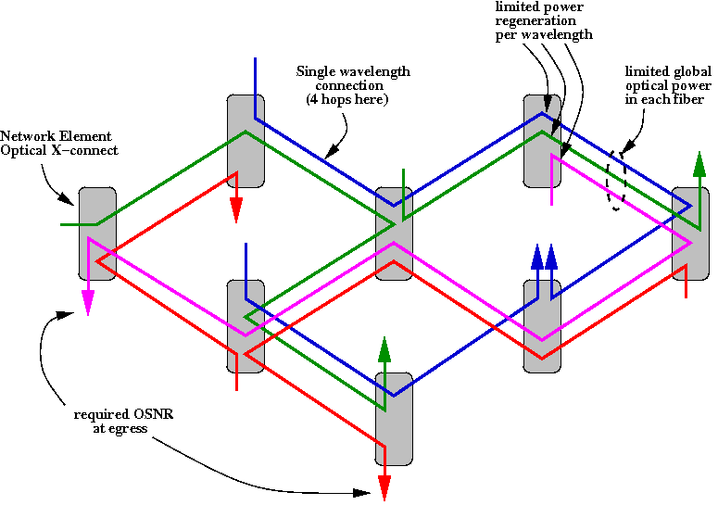
Channel Powers “Equalization” in Wavelength Switched Optical Network
INRIA team : DISTRIBCOM / E. Fabre
Objectives were:
  Zero-touch commissioning ⇨ Autonomous system
  Scalable solution ⇨ Local agents (distributed)
  Coherent Network wide configuration ⇨ Collaboration between agents
  Dynamic adaptation ⇨ Monitoring triggers re-optimization
  Minimization of regeneration usage ⇨ Favoring long-reach connections

Slide 26
Channel Powers “Equalization” in Wavelength Switched Optical Network
Proposed solution: a distributed iterative approach
    inspired by Gauss-Seidel methods
    input powers adjusted by each link
    communication between routers to ensure consistency
    convergence is guaranteed
    power optimally (re)allocated when connections join or leave
Saving more than 1/3 of regenerators

Slide 27
Self adaptation of radio parameters in cellular networks
INRIA teams : TREC, MESCAL, MAESTRO, SOCRATE

Slide 28
Case of small cell networks
Densification of networks is required for:
- better capacity (Mega bits per seconds)
- better spectrum efficiency (Mega bits per second per Hertz)
- better power merit (Mega bits per second per Hertz per Watt)
But difficulty to manage highly dense networks needing Self-organization to:
- avoid human intervention
- scale with the number of base stations
- follow traffic adaptation in quasi real time
Requirements for such a solution:
- fully distributed to be able to scale
- able to discover optimal parameters for optimization
- good convergence time to follow real time variations

Slide 29
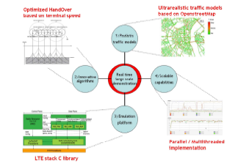
Results
Collaboration with INRIA has enabled to develop a new range of optimization tools that can be very powerful for addressing next generation cellular issues
Current collaboration with Business Unit is on-going to apply these techniques to LTE
Some fundamental questions remains but most of what has been achieved can be operationally deployed

Slide 30

Application of Super resolution: advanced features to IMS based communication applications of Alcatel Lucent INRIA TEAM: TEMICS
Super-resolution algorithms (predicting a high resolution image from one or many lower resolution images)
  Similar performance or Better performance as state of the art methods (equivalent distortion W.R.T. the true high resolution image) with lower complexity and without a need to tune parameters for each image
On-going test bed for evaluation of SR inside Alcatel Lucent solution
signaling
signaling
Low Resolution (QCIF 176x144)
Data channel
vidéo CIF (352x288) H264 15fps
High resolution
Super resolution
SIP Phone
on laptop
Media Box
MRF
(IMS Multimedia Server)
  Purpose: Bandwidth saving (divide by 4) for video-conferences web-browser users, while maintaining quality of video with high spatial resolution
Notes:
Afin de pourvoir tester la Super Resolution, nous avons créé un nœud qui n’existe pas habituellement appelé « Media Box ».
L’algo de Super Resolution a besoin en input d’images HR et LR, cependant un softphone n’est capable que d’envoyer ou de recevoir un « flux vidéo» en même temps.
C’est pourquoi nous avons ajouté un nœud qui permet d’envoyer ou recevoir des images HR (pour les images de références) et des images LR dans le flux vidéo.
Les images HR sont envoyées et reçues à travers un canal spécifique qui n’est pas standard que l’on appelle « Data Channel ». Ce canal de communication propriétaire repose sur le protocole TCP.
Notre but est de consommer le moins de bande passante possible entre le MRF et la Media Box en divisant la bande passante par 4.
Le use case que nous avons imaginé pour les premiers tests est un play vidéo CIF (352x288) H264 15fps:
1 - Le softphone (boghe) établi un appel vidéo en H264 au MRF à travers la Media Box.
2 - Le MRF joue un fichier vidéo :
il récupère la vidéo au format 352x288 H264 (format d’origine de la vidéo)
décode les images H264 au format YUV420
extrait des images HR et les envoie à la Media Box (via le Data Channel ) périodiquement (pour l’instant toutes les 60s)
retaille l’image au format QCIF 176x144
s’il a envoyé une image de référence HR, il envoie l’image LR associée (via le Data Channel ).
encode l’image en H264
envoie l’image à la Média Box
3 - La Média Box transfert la vidéo :
reçoit la vidéo H264 au format QCIF 176x144
décode les images H264 au format YUV420
reconstruit l’image HR à partir de l’image LR avec l’algo de Super Resolution
lorsqu’elle reçoit une image HR et LR via le Data Channel, elle ajoute un sous dictionnaire.
encode l’image en H264
envoie l’image au softphone
4 - Le softphone reçoit et affiche la vidéo.
4 – Performance
Sachant que l’algo de Super Resolution reçoit 15 images par secondes et que sur cette seconde on pense allouer 200ms de CPU pour traitement MRF et 800ms pour la Super Resolution, il faut donc que l’algo puisse traiter 15 images en 800 ms.
Cela fait un traitement d’images en 53ms maximum si on traite ces images séquentiellement.
Avec une machine d’au moins 15 CPUs, on pourrait traiter ces images en parallèle et allouer 800ms de CPU par images J

Slide 31
2013-2017
Common Lab Phase 2
5 Actions de Recherche (ADR)

Slide 32
Objectives of our common lab
As defined at its startup…
  Coordinated, long term, bold joint actions
  Associate ALU and Inria teams at early stage of research
    Mixing cultures
    Building a common strategic vision
  To promote innovation coupled with excellence of results
    Publications
    Patents
  Create a pool of young researchers
    phD and post docs hired by INRIA and fully dedicated to the common lab
… and further developed for phase 2:
  Wider scope
  Seeking more breakthroughs
  Seeking more Impact on Business Units

Slide 33
5 ADR
Content Centric Networking
Green Networking
Self-Optimized Wireless Networks
Privacy and Security
Network Science

Slide 34
Conclusion
Successful achievements 15 patents
  130 publications
  Permanent presence for common events like open days
  Numerous productive interactions with BDs, some transfers towards products lines well engaged
  A community of the common lab has been successfully set up
  The common lab is the core of ALU-Inria partnership which counts numerous joint initiatives (Greentouch, EIT ICT labs, French clusters …)

Slide 35
Innovation Labs

Slide 36
Innovation Labs with SMEs
With a real transfer objective, and creation of economic value for the SME
One to three years project
Concept created in 2012, around 15 active Innovation Labs today, with the objective of 10 to 20 new ones per year.

Slide 37
An example
3D Vision, reconstruction of Dimoede Villa in Pompei (Italy)
Iconem
Inria – ENS – CNRS project-team Willow, leaded by Professor Jean Ponce, ERC laureate

Slide 38
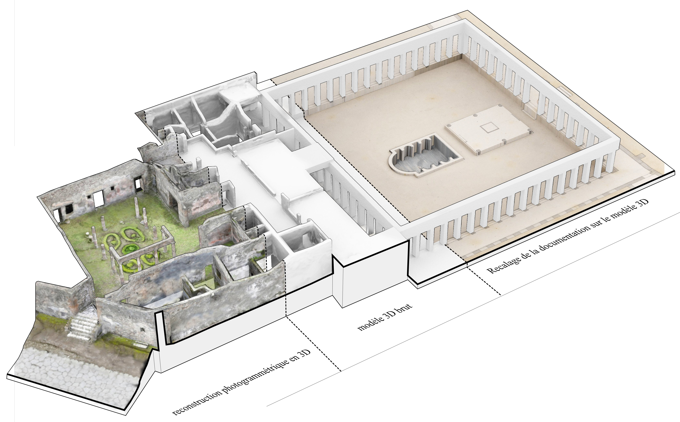

3D Vision : Diomede Villa in Pompei
A model constructed
from 30,000 photos

Slide 39
Creation of start-ups

Slide 40
Company start-ups
  Inria technology
  companies
  Inria promotes company start-ups
120 companies created, with 60 in operation
Ilog, Realviz, Trusted Logic…
6 companies created in 2010:
  Verbatim Analysis vera
  Sysfera,
  Karrus,
  Lyatiss
  Robocortex
  Powedia
7 compagnies created in 2011 :
  Alien
  Alphability
  Ambientic
  HiKoB
  Lixoft
  OCamlPro
  Tocea
  .
By providing effective start-up support
structures
Inria Participation and IT Translation
By promoting seed -financing
IT Translation Investissement, I-Source,
C-Source, T-Source
By working in partnership and networking
Regional incubators

Slide 41
A way for transfer
From 2009 to 2012:
    Purchase of Lorin by Nexeya (2009), Ilog by IBM (2009), Gene-IT par GenomeQuest (2009), Trusted Logic by Gemalto (2009), UdCast by Digital Barriers (2011) andEsterel Technologies by Ansys (2012).

Slide 42
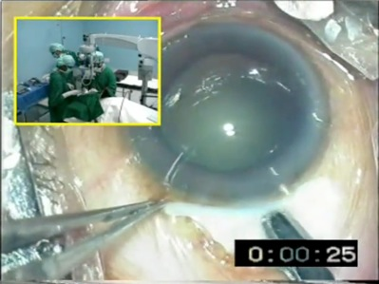
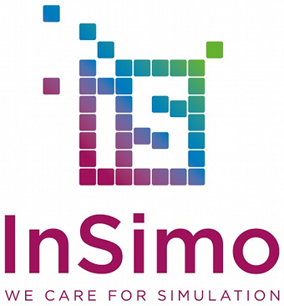

A nice story
Research
Software development : Sofa
    2005 start of a Inria – Boston project
    Virtual simulation platform (Surgery, video games,…)
    90 contributors, 140 k loadings
  A NGO : HelpMeSee
    Fights againt blindness, specially in Afrrica
    Has conceived a quick (15’) and cheap (50$) cataract surgery
    Call for proposals for a cataract surgery simulator : a consortium leaded by MOOG with partnership with InSimo and SenseGraphics has been selected
Start-up InSimo
    Created in 2013, to develop simulators

Slide 43
EIT ICT Labs

Slide 44






































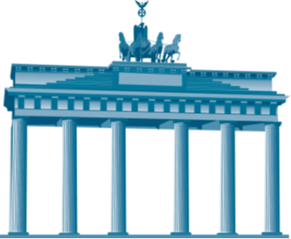





6 European colocations bringing together top ICT players
Berlin
Eindhoven
Helsinki
Paris
Stockholm
Trento

Slide 45
















Paris Node Partners
Academics (6)
Research Centers (2)
Clusters (4)
Industrials (10)

Slide 46
French Node Organization
1 Site in Paris / 2 Satellites (Rennes, Sophia-Antipolis)

Slide 47
Conclusion

Slide 48
Conclusion - discussion
    R&D partnerships is distinct from transfer technology
    Both are necessary and useful for Inria
    Transfer technology is more difficult than R&D partnerships since it is less natural for researchers and more constraining
    Transfer technology needs a voluntarist policy
            Clear, known, shared processes
            Dedicated staff
            Stimulation of the environment
        All this require investments before being a source of profit
        Critical to share between academic and industrial worlds
            Regular meetings / workshops between our researchers and industry, on a given subject (« Rencontre Inria – Industrie »)
            www.iCommunity.fr

