Slide 1
CWI Lectures 2014:
Socially-Aware Multimedia
Richer Documents,
Richer Human-Computer Interaction:
A Progress Report
Andries (Andy) van Dam
Brown University
May 22, 2014

Slide 2
Sketchpad
1963
“Sketchpad: A man-machine graphical communication system”
Ivan Edward Sutherland’s Ph.D. Thesis

Slide 3
Sketchpad Video (requires QuickTime)
1963

Slide 4
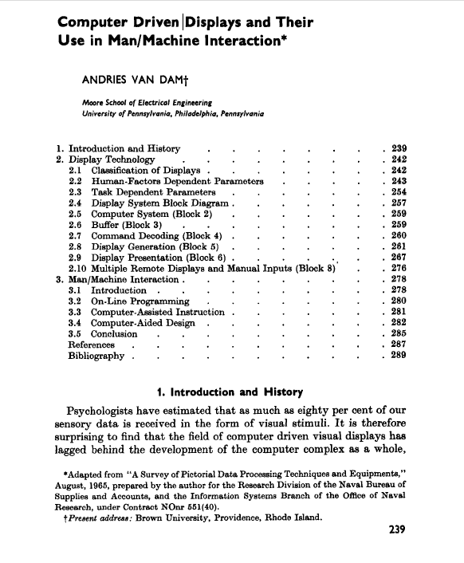
1966

Slide 5
Hypertext/Hypermedia

Slide 6
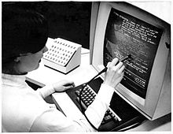
HES (Hypertext Editing System)
1967

Slide 7
HES (Hypertext Editing System)
1967
Partnered with Ted Nelson
IBM 2250 vector display connected to IBM System 360/50 mainframe, thus single user
Vehicle for experimenting with hypertext using fine-grained links
Hyper-linked database of electro-plating patents
Used by NASA for Apollo documentation
Notes:
example of bimanual

Slide 8
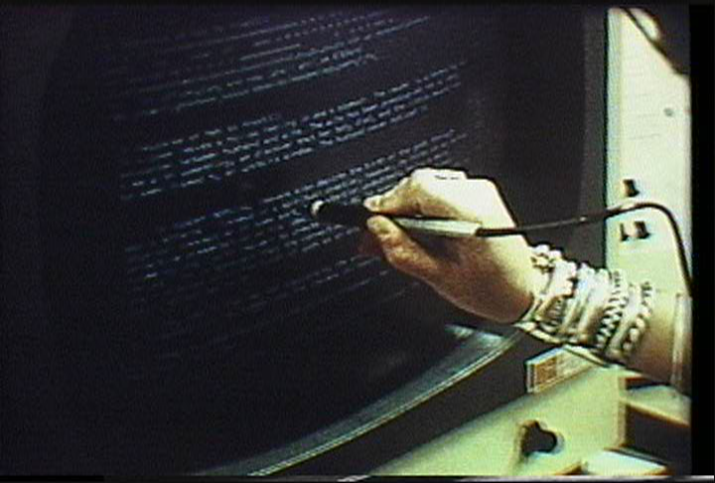
FRESS (File Retrieval and Editing System)
1968
Multi-user, used at Brown, KU Nijmegen ...
PhilText, 1972, driving Photon typesetter

Slide 9
Intermedia – IRIS (Institute for Research in Information and Scholarship)
1985

Slide 10
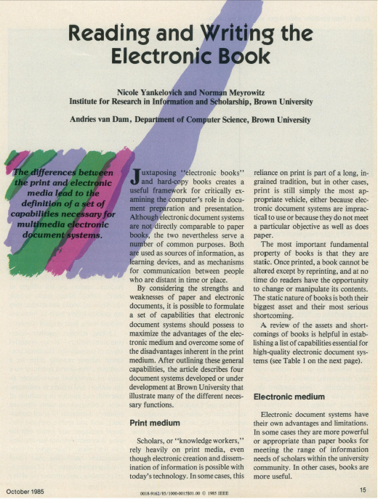
1985

Slide 11
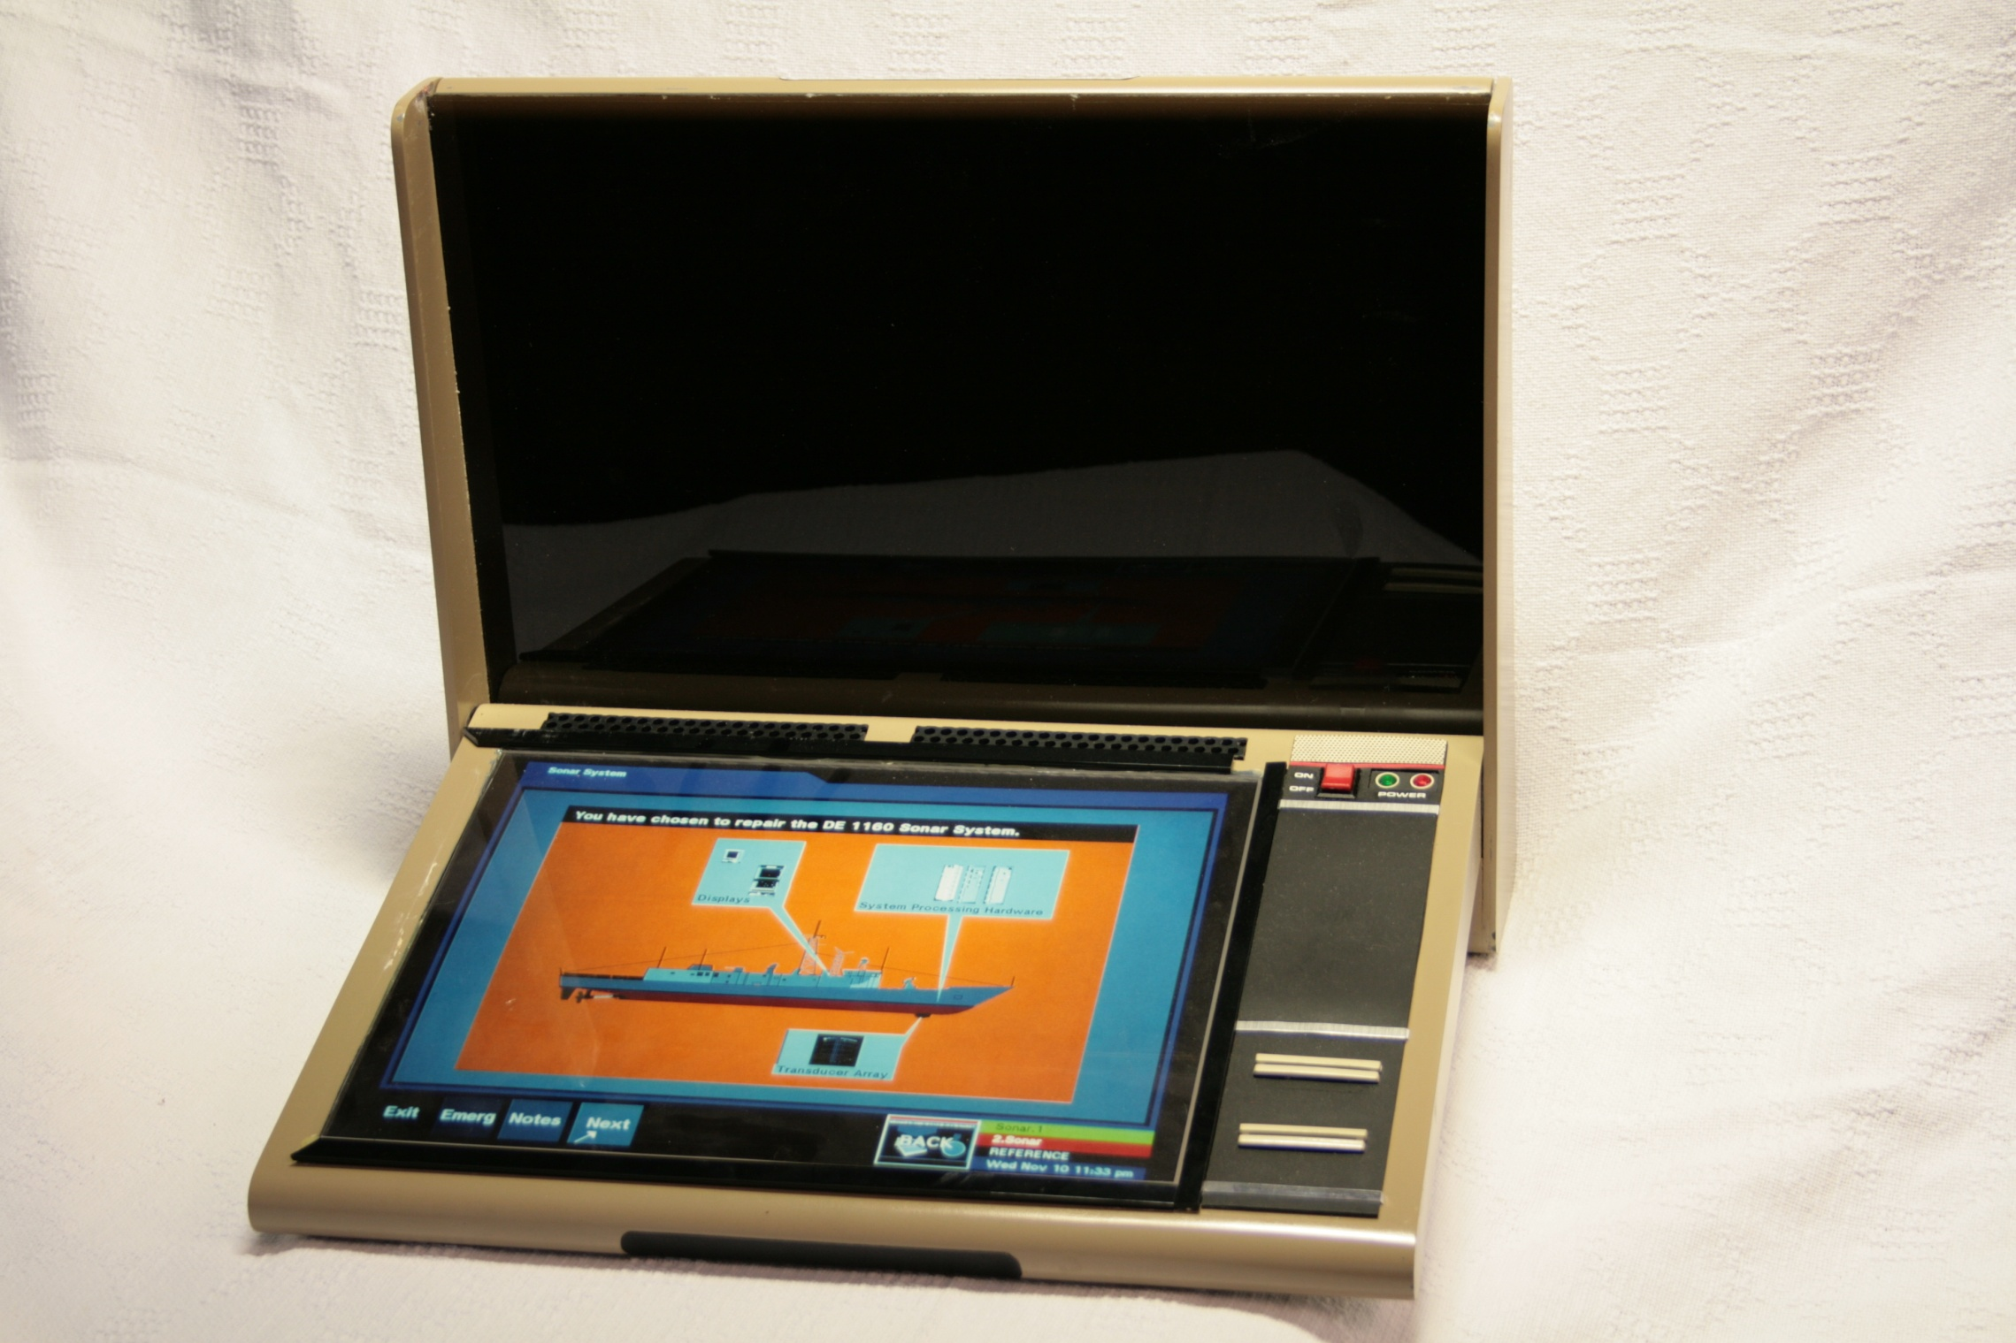
EDS (Electronic Document System)

Slide 12
User Interaction HCI UX

Slide 13
Sketchpad
1963

Slide 14
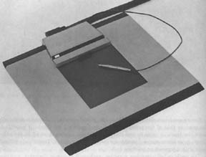
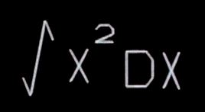
Rand Tablet
1967
Robert Anderson’s 2D Math Recognizer

Slide 15
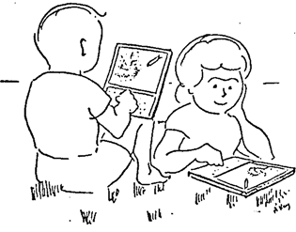
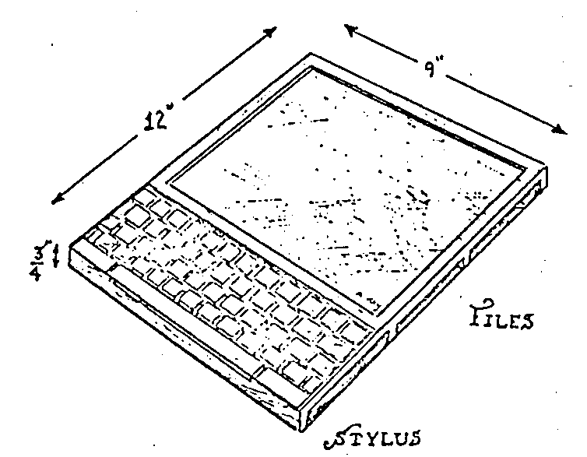
Tablets and Electronic Books
1972
Alan Kay Dynabook proposal in
“A personal computer for children of all ages”

Slide 16
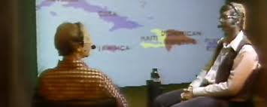
Put That There
1979
"Put-That-There":
Voice and Gesture at the Graphics Interface
Richard A. Bolt
Architecture Machine Group
Massachusetts Institute of Technology
Cambridge, Massachusetts 02139

Slide 17
Put That There Video (requires QuickTime)
1979

Slide 18
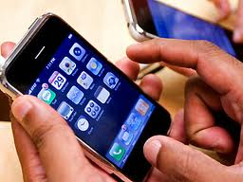
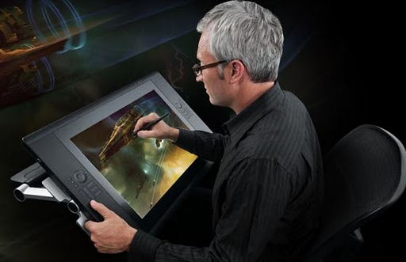
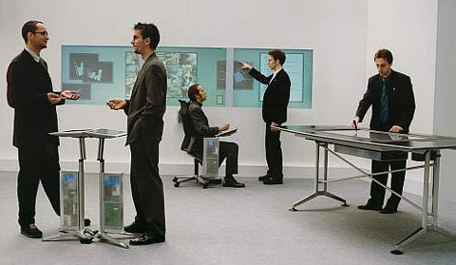
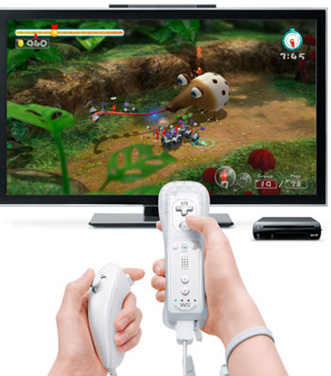
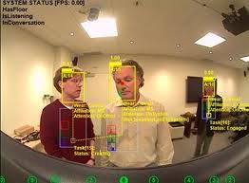
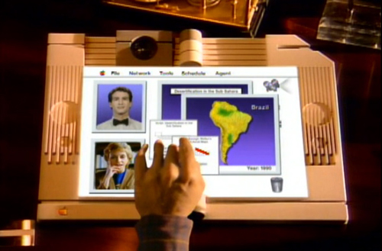
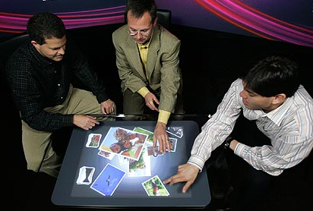
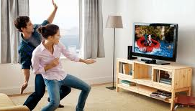
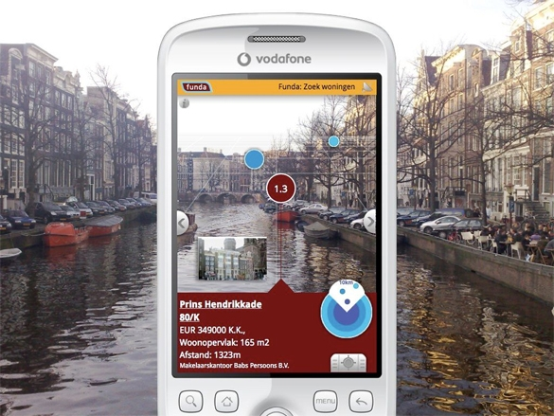
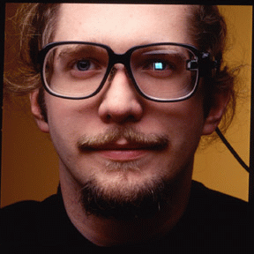
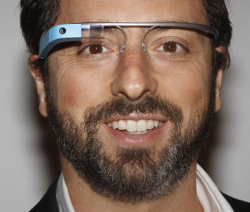
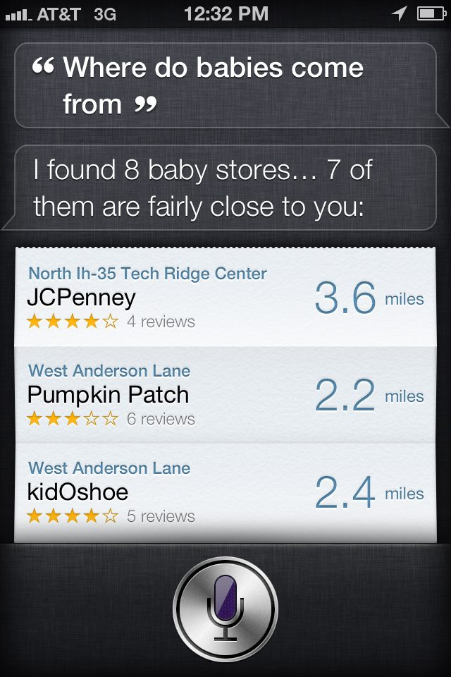
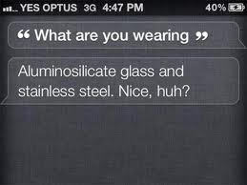
WIMP
WIMP
Pen/Touch
Pen/Touch
Motion/
Game
Controller
Ubicomp
Ubicomp
Ambiente –
Smart Future Initiative
Motion/
Game Controller
NUIverse
Agents
Agents
Agents
Gestures
Gestures
Augmented
Reality
Gestures
Speech
Augmented Reality
Augmented Reality
Augmented Reality
Speech
Speech
Notes:
Gestures – group first
Make NUIverse look different
get pictures for each.
wimp – new image showing mouse
WII controller – gadgets that you manipulate
gestures – kinect and a pinch zoom
speech – siri
layar picture
agents – horovitz people interacting with concerage
abimente

Slide 19
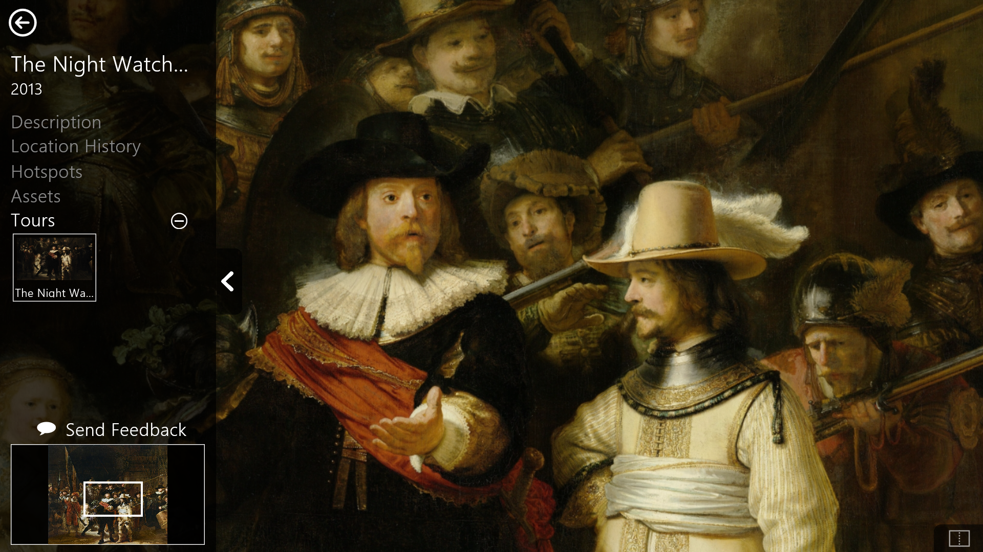
TAG (Touch Art Gallery)
Notes:
***Pick one with just the right window.*****

Slide 20
TAG (Touch Art Gallery)
TAG lets curators, educators, ... create, contextualize, and share digital collections
Kiosk mode for walkup users
explore even the largest artworks with familiar touch gestures
interact with multiple artworks simultaneously using split screen
view interactive tours
Authoring mode for non-digerati – Klara’s “lightweight authoring sys”
KISS design principle
direct manipulation only, no scripting
Content is stored in the cloud
Kiosk mode runs on browsers; authoring mode on Windows 8/8.1
Sponsored by Microsoft Research; free download Windows Store

